Slide 1
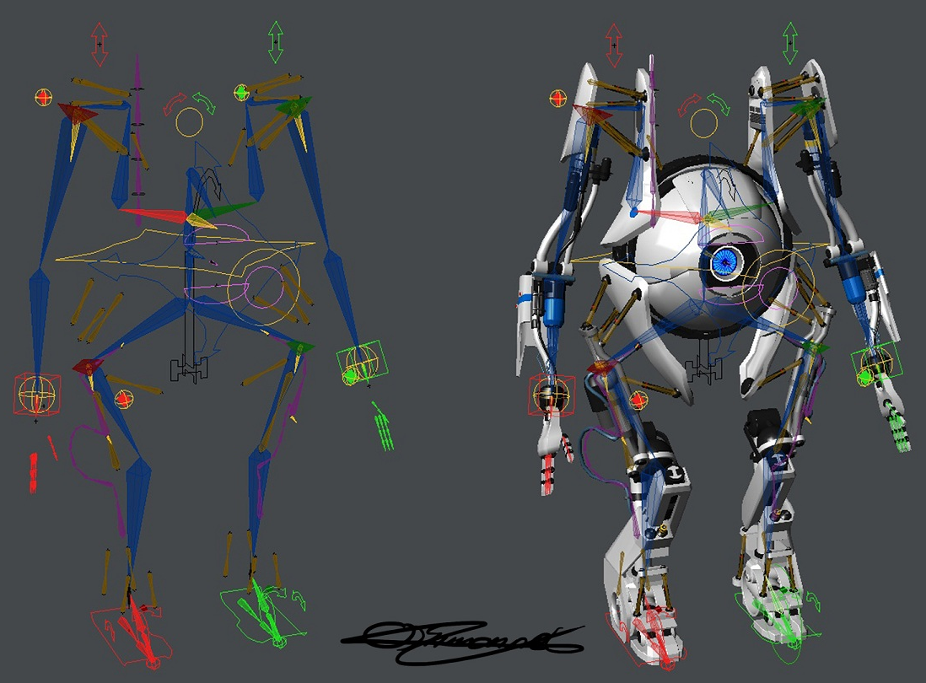
Rigging
#project_vr_something
Notes:
https://www.raywenderlich.com/6055-creating-reusable-characters-with-blender-and-unity

Slide 2
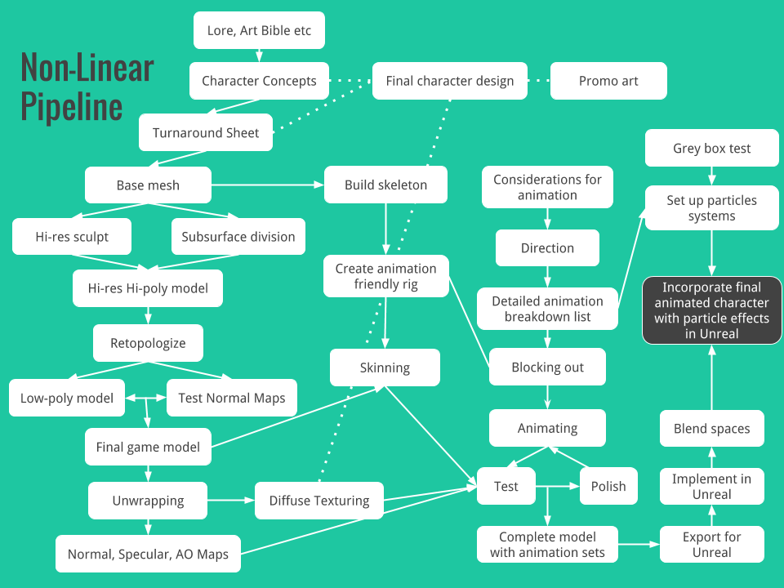
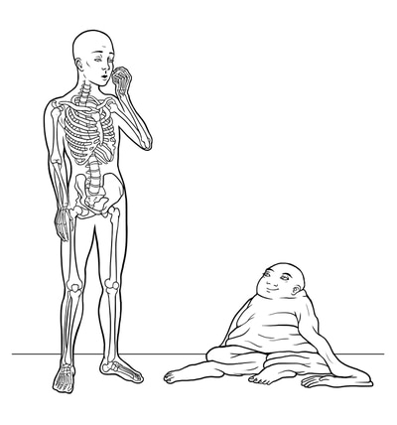
Review: 3D game art pipeline
Rigging
Animation
Modeling
Texturing

Slide 3
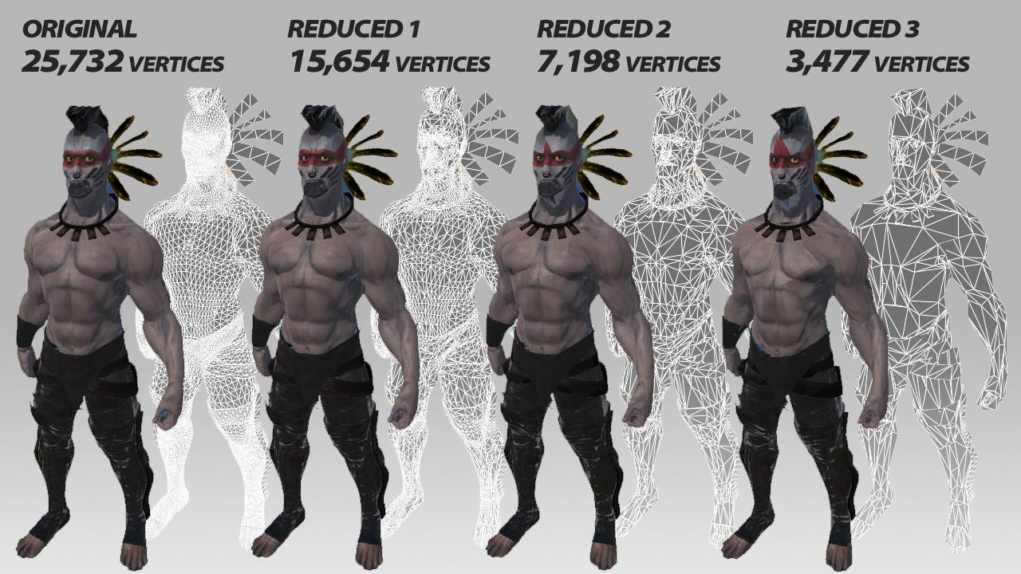
Deforming a 3D model
Brute-force deformation
Degree-of-freedom = #vertices x 3
Uncontrollable
Reducing DoF of deformation system
Deformation cage
Shape blending
Skeletal animation
…

Slide 4
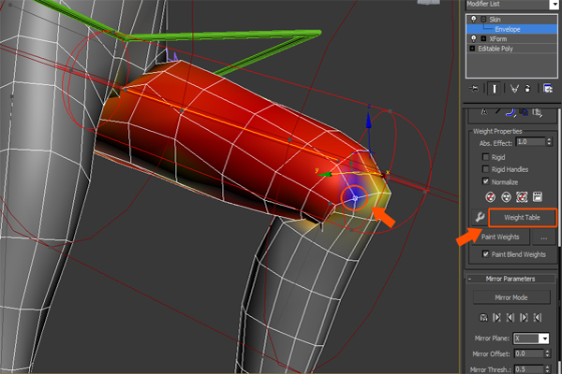
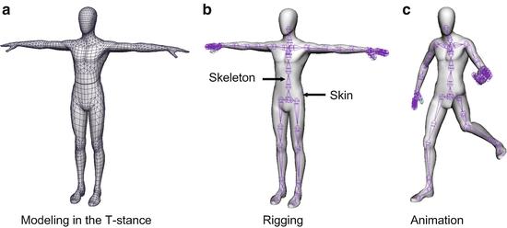
Rig, skeleton, joint, bone
Rig = Skeleton + skin (weight)
Skeleton = $Σ$ Bone + $Σ$ Joint
Each bone has its transformation (position, rotation, scale)
Bones are connected by joints

Slide 5
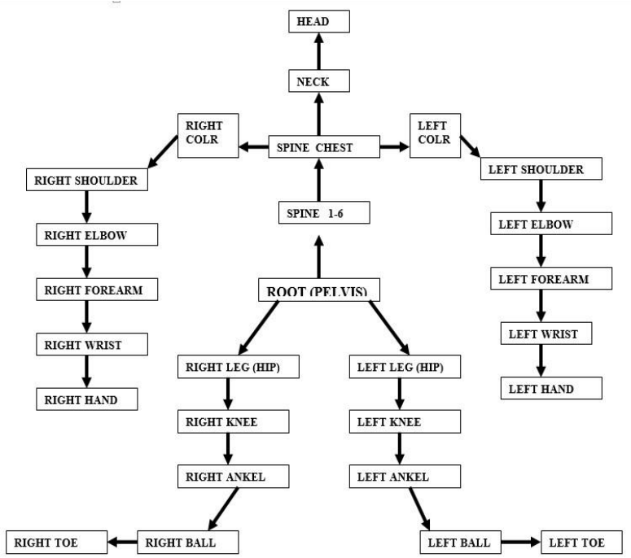
Skeletal hierarchy
Hierarchical relationship of bones
Tree structure
Root bone
Highest of the hierarchy

Slide 6
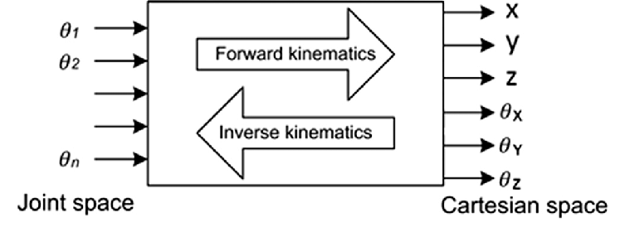
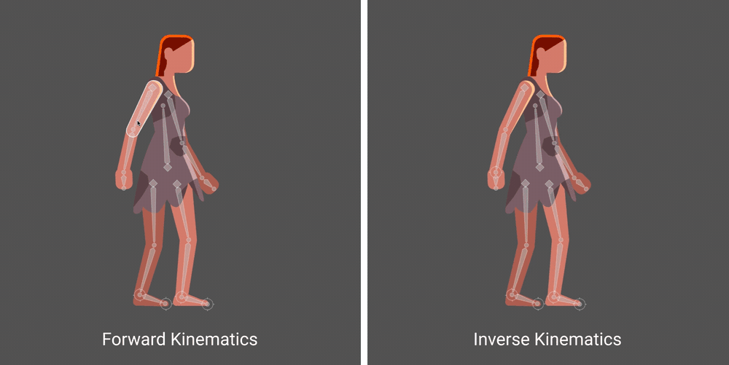
Forward kinematics / inverse kinematics
Leaf node of the hierarchy
Hand, foot, head, tail, …
Moves to a target, express an action, …
Position / rotation is determined by parents’ transformation
Forward kinematics (FK)
Computing resulting position from bone transformations
Inverse kinematics (IK)
Computing required bone transformations for desired position
Ambiguity → Adding more control points

Slide 7
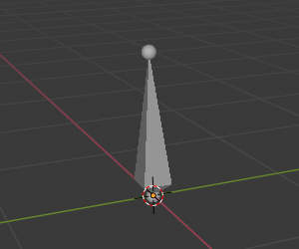
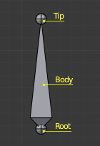
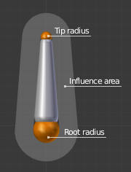
Rigging in Blender
Armature
Notes:
https://docs.blender.org/manual/en/2.80/animation/armatures/index.html

Slide 8
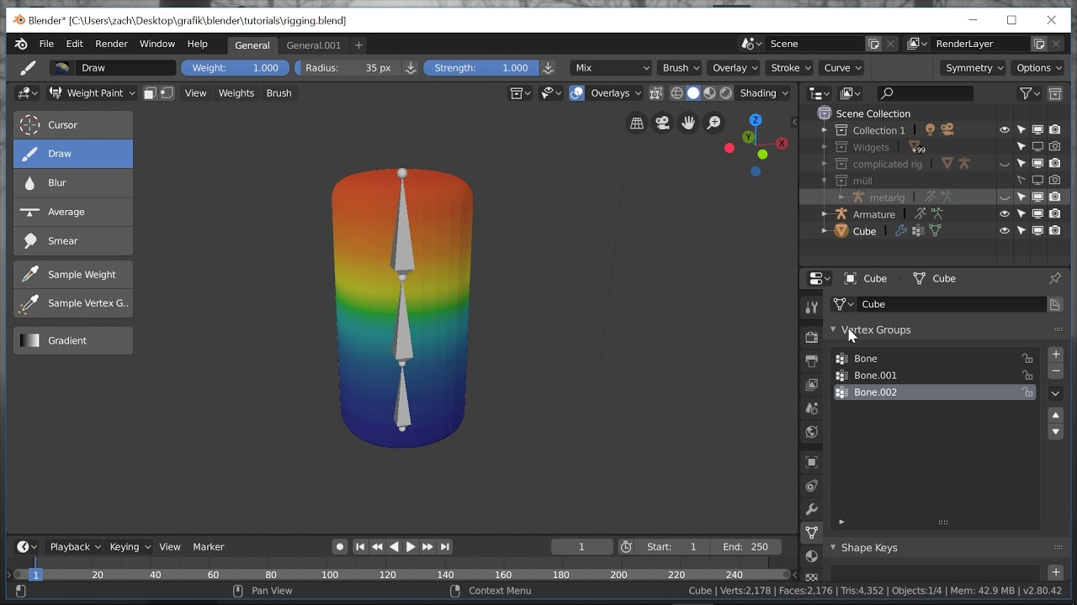
Rigging in Blender
Weight paint mode

Slide 9
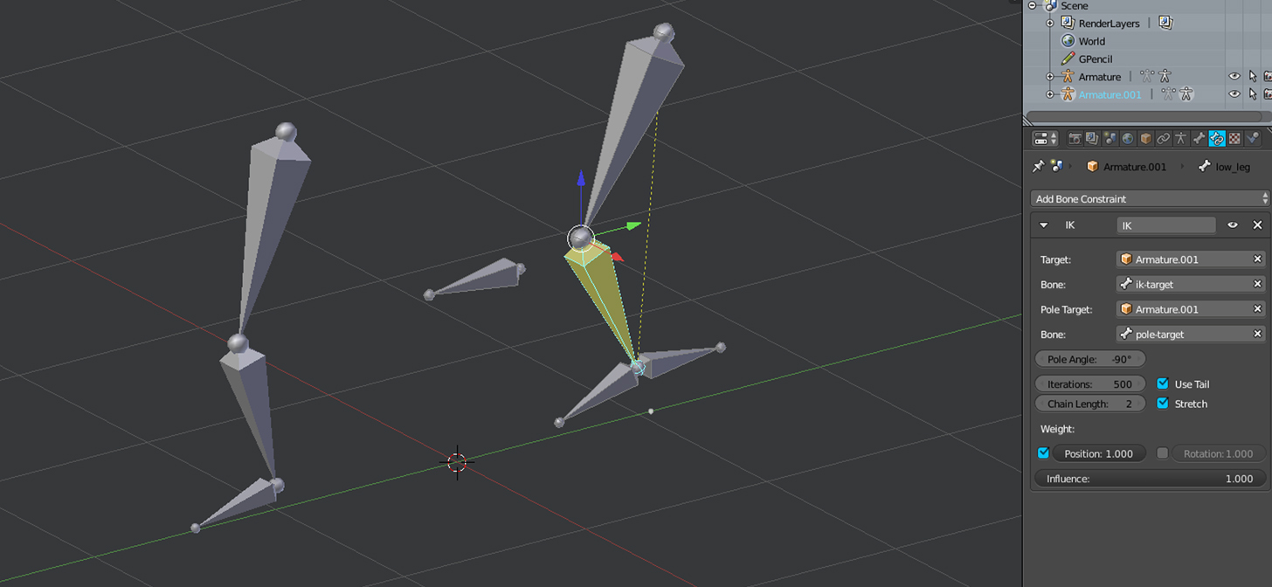
Rigging in Blender
Inverse kinematics constraint

Slide 10
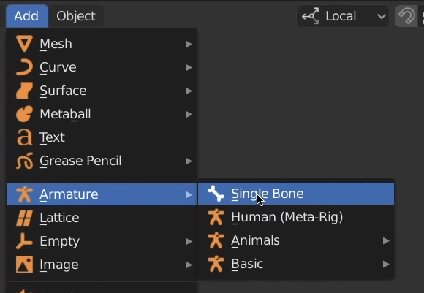
Blender addons for rigging
Rigify

