Slide 1
The Wonders Of Excel
Competitive Spread Sheeting and Spreadsheet games

Slide 2
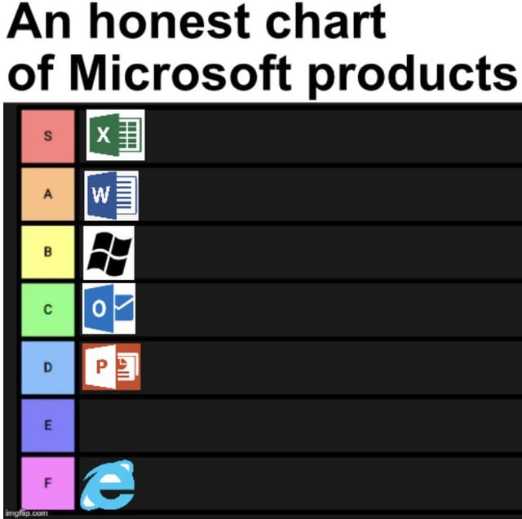
The General Consensus and the sleeping dragon on all our computers

Slide 3
Excel Games?????
Excel games are games designed entirely within the Microsoft Excel platform using its features,
such as formulas, conditional formatting, and VBA (Visual Basic for Applications).
From simple puzzles to complex strategy games, Excel offers endless possibilities for gaming.
Competitive Spreadsheeting
These events test creativity, Excel mastery, and problem-solving skills under time constraints.
Competitive spreadsheeting refers to contests or events where individuals or teams are tasked with
solving problems, completing challenges, or creating games using Excel as their primary tool.

Slide 4
Types Of Excel Games
Puzzle Games
Examples: Sudoku, Crosswords, Minesweeper.
Use Excel’s grid and formulas for logical puzzles or games of skill.
Strategy Games
Examples: Tic-Tac-Toe, Battleship, Connect Four.
Players interact with grids or cells, while Excel’s formulas or VBA scripts handle game logic and win conditions.
Simulation and RPG Games
Examples: Text-based RPGs or adventure simulations.
Use Excel’s sheets as "maps" or "worlds" with choices and player stats, while VBA or formulas drive events.
All Make use of excel macros

Slide 5
How Excel Games Work
Formulas and Functions
Formulas like IF, COUNTIF, and VLOOKUP help manage game logic, player actions, and
event tracking.
Conditional Formatting
Used to highlight cells, change colors, or display special effects based on player actions or game status.
VBA (Visual Basic for Applications)
Automates game flow, such as making moves, generating random numbers, or responding to player input.

Slide 6
Too Difficult For The Normies Chad Up And Excel

Slide 7
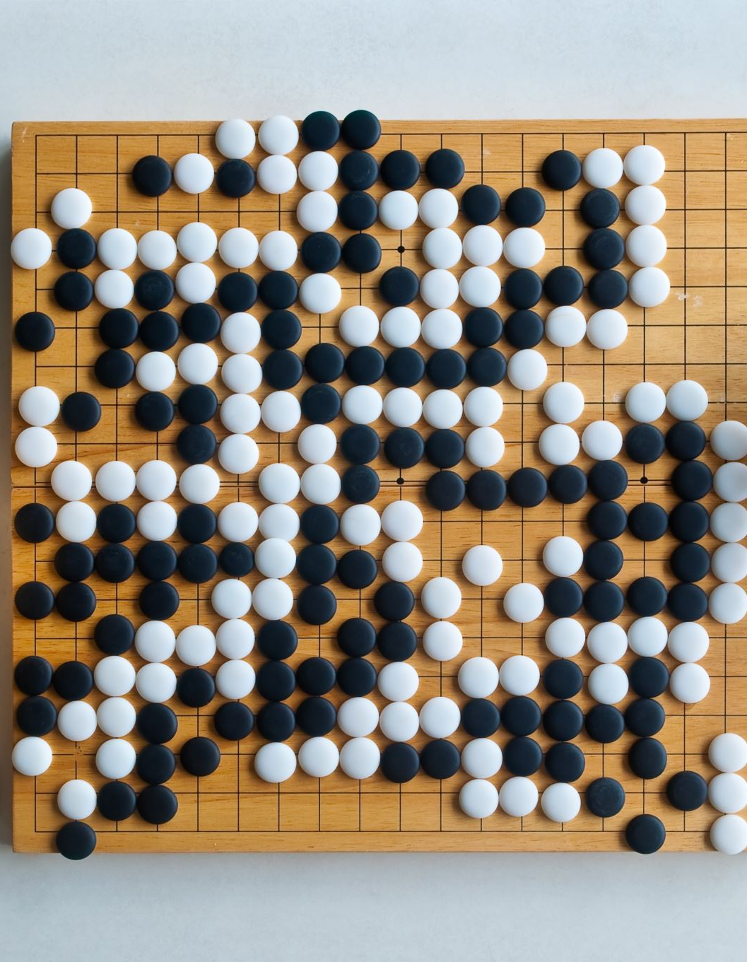
Examples of Excel Games
Excel Sudoku
A grid-based puzzle where Excel formulas validate rows, columns, and grids to ensure the puzzle’s
correctness.
Excel Tic-Tac-Toe
Classic 3x3 grid game where players alternate marking cells with Xs and Os. VBA checks for winning
conditions.
Excel Battleship
Players hide ships on a grid and try to guess coordinates, with VBA handling hits and misses.
Excel Snake
An interactive Snake game using Excel’s grid layout and VBA to control the snake’s movement and collisions.

Slide 8
Competitive Spreadsheeting
What is Competitive Spreadsheeting?
A form of competition where participants are tasked with solving challenges using Excel
in innovative and efficient ways.
Challenges may involve creating complex formulas, automating data tasks, or even building
interactive games using Excel.
Famous Events
Excel World Championship: An annual event where participants compete in Excel-based challenges,
showcasing their speed, accuracy, and creativity.
Spreadsheet Competitions: Many companies and universities hold Excel-based contests to promote
learning and problem-solving.

Slide 9
Examples of Competitive Excel Challenges
Excel Data Modeling
Participants are given raw data and asked to build a model to predict outcomes or create dashboards using Excel’s advanced features.
Automating Processes
Challenges may require creating macros or VBA scripts to automate repetitive tasks or improve workflow efficiency.
Game Development
In some competitions, participants must create a fully functional game (such as a version of Tic-Tac-Toe, Minesweeper, or Battleship) within a given time limit.

Slide 10
Excel Obstacle Course

Slide 11
World Championship

Slide 12
Art With Excel

Slide 13
Spread sheet stop motion

Slide 14
https://www.youtube.com/watch?v=QirS2oGo4Qk&pp=ygUKZXhjZWwgZ2FtZQ%3D%3D

Slide 15
Roller Coaster Simulation

Slide 16
More info From A quick Query Its So Complex
Automation and Customization:
Excel’s VBA (Visual Basic for Applications) allows users to write custom code to automate tasks and create more complex game mechanics. With VBA,
users can:Create buttons or other interactive elements (e.g., to start the game, roll dice, or make moves).Write game logic that’s too complex for Excel’s standard functions, such as implementing random number generators (for games involving chance).Control game flow, such as determining the order of turns or automating game events (like the passing of time or random events).
Example: VBA can be used to create a fully interactive game like Excel Snake, where the player controls the movement of a snake on the grid using arrow keys, and the game automatically tracks the snake's growth and collisions.

Slide 17
Visual Feedback and CustomizationGraphics Using Cells:
While Excel isn’t a graphic design tool, users can creatively utilize cells to display game-related graphics. For example:Color Cells: Cells can be color-coded to create basic graphics (like representing characters, objects, or obstacles in games).
Shapes and Images: Excel allows the insertion of basic shapes or images, which can be used to create visual elements like character icons, obstacles, or backgrounds in games.Creative Game Design: Using a combination of cell formatting, images, and shapes, users can design visually appealing game environments, like a maze, a dungeon map, or a game board, to make the game more immersive.

Slide 19
Game Logic Through Arrays and ListsArrays and Data Storage:
Excel's ability to handle arrays (a series of values in a row or column) can be leveraged to store game data, such as player stats, inventory items, or game progress. This makes it easy to manage complex game states, like tracking scores or saving game progress.
Lists for Choices: Excel allows for easy creation of drop-down lists (via Data Validation) that can give players options within the game, like selecting a character, making decisions in a text-based RPG, or choosing different strategies in a simulation game.

Slide 21
Random number generation is also useful

