Slide 1
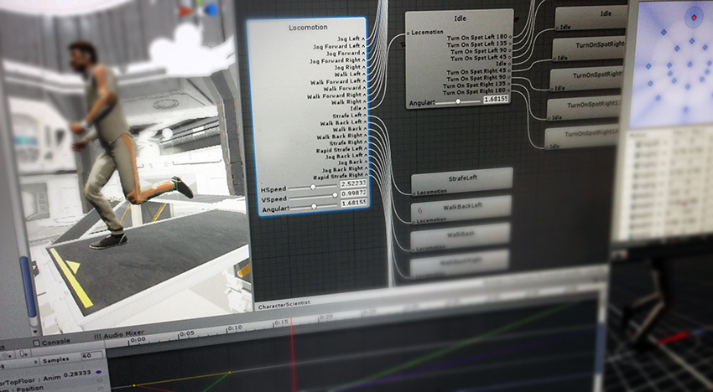
Animation in Unity 3D
#project_vr_something

Slide 2
Animation system in Unity
Animation clips
Short animation for a particular action
(e.g. walking, jumping, shooting, …)
Animator controllers
Set of clips describing the behavior of a character
(e.g. shooter, dog, …)
Animator
Mapping from an animator controller to a particular model
→ Shared controller for humanoids

Slide 3
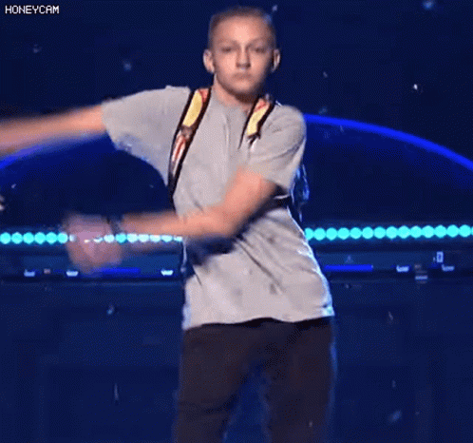
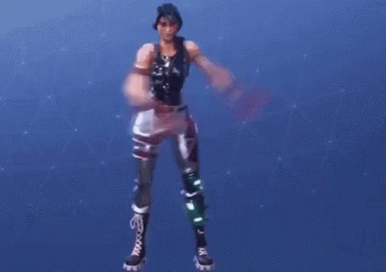
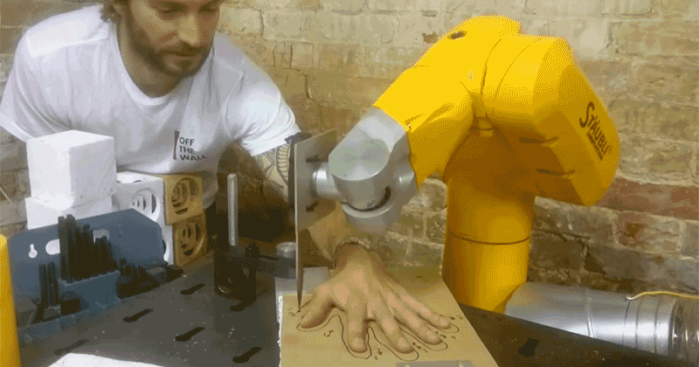
Animation clips
Created within Unity
Controls transformation + other properties (no rigs required)
Imported from external sources
Controls the skeleton in the model

Slide 4
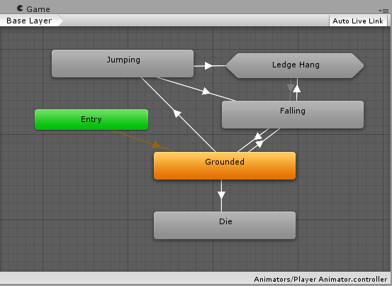
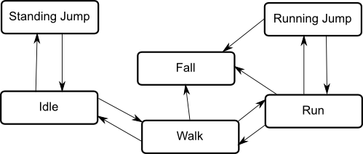
Animation controllers
Animation state machines
Models the behavior of a character in a directed graph
Notes:
https://docs.unity3d.com/Manual/AnimationStateMachines.html

Slide 5
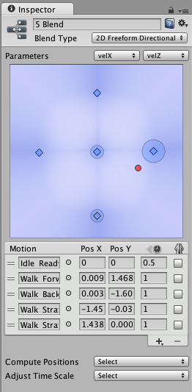
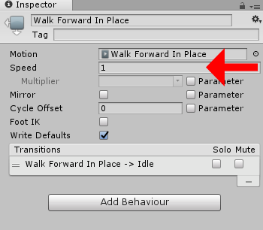
Animation controllers
Animation parameters
Parameterizes movements
E.g. walking/running speed, walking direction, …
Animation blending
Blend multiple animation clips → Smooth transition
Examples
Walking → running
Walking forward → sideway

Slide 6
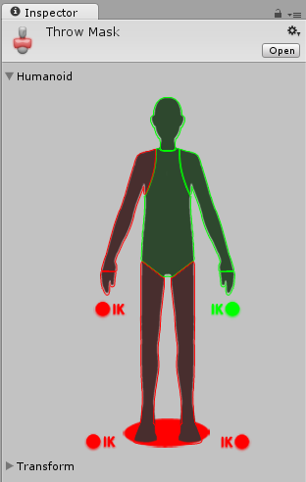
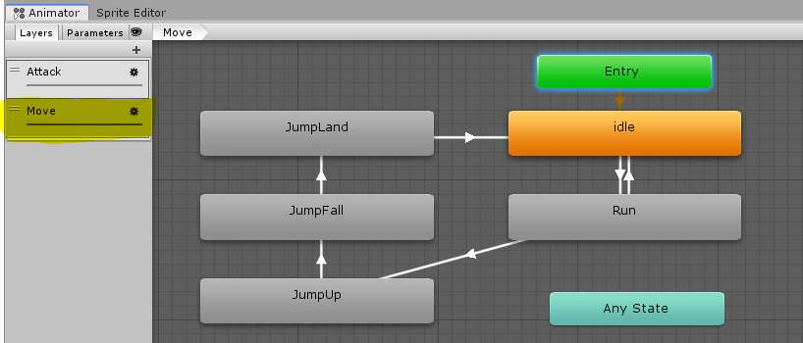
Animation controllers
Animation layers
Allows (semi-)independent movements for different body parts
E.g. Lower body (idle, walking, jumping, …) + Upper (idle, throwing, grabbing, punching, …)
Avatar masks
Body parts where the layer affects

Slide 7
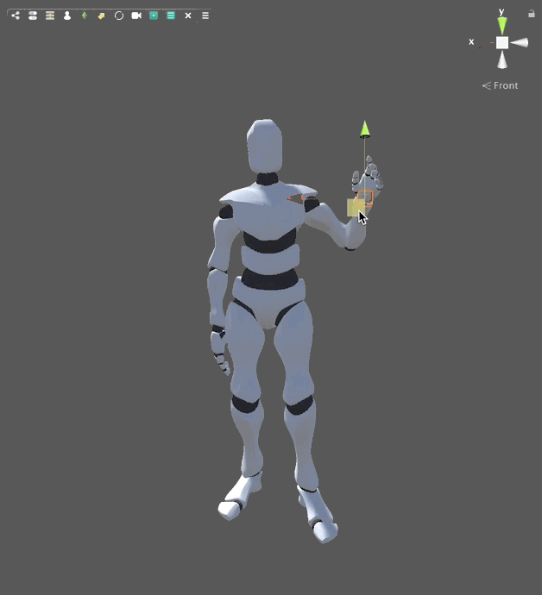
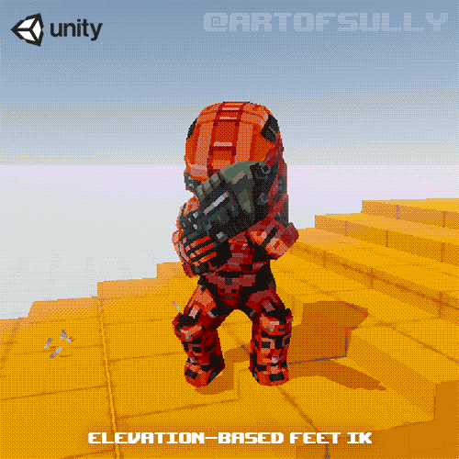
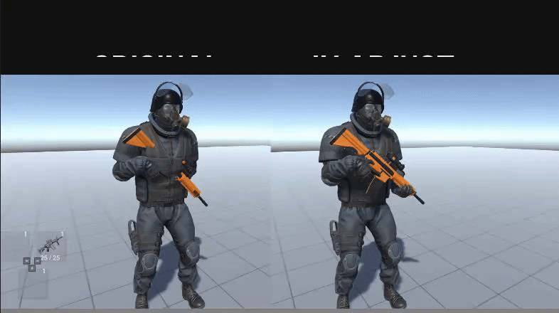
Animation controllers
Inverse Kinematics (IK)
Automatically compute rig positions for given target
Simple management → work efficiency
Adaptive to the environment → procedural animation
E.g. VR controller tracking, walking up the stairs, grabbing weapon variants

Slide 8
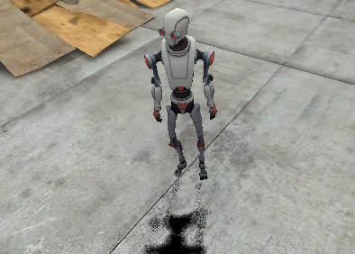
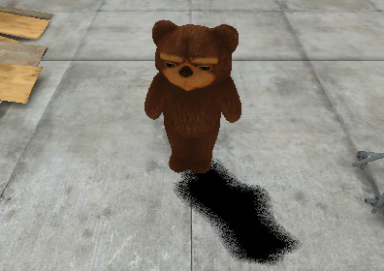
Animator
Retargeting
Humanoids only
Shared controller for different models (with similar rig structure)

Slide 9
Animation workflow in Unity: Humanoid

Slide 10
Third-party animation tools

