Slide 1
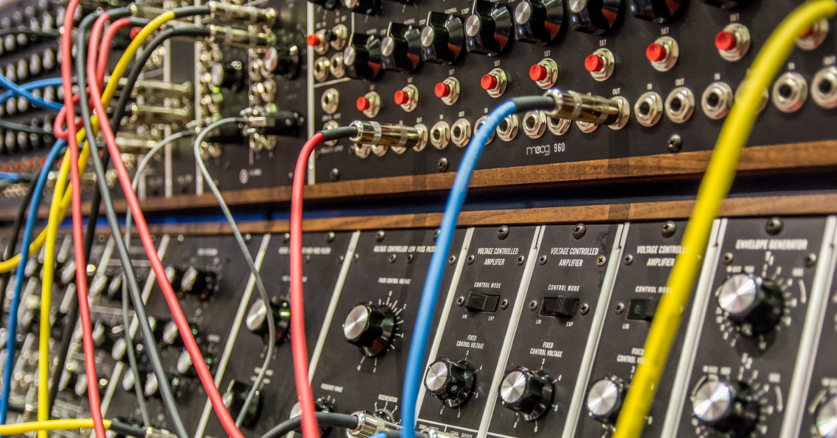
Basic Sound Synthesis
#study_sound

Slide 2
What is sound?

Slide 3
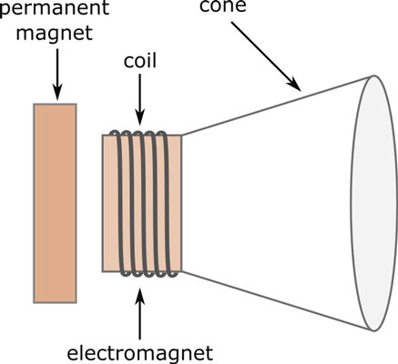
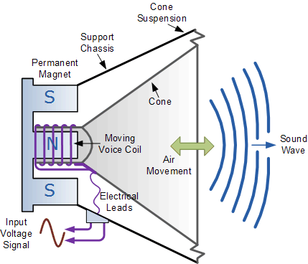
How sound waves are generated electronically?

Slide 4
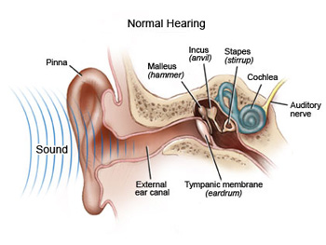
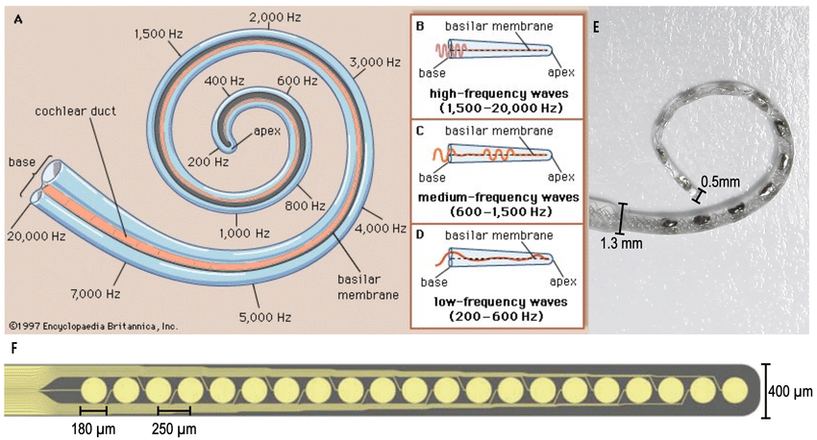
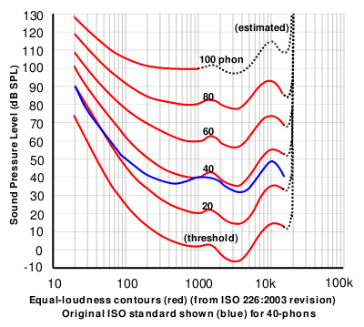
How humans hear sound waves?
“Cochlear tonotopy”

Slide 5
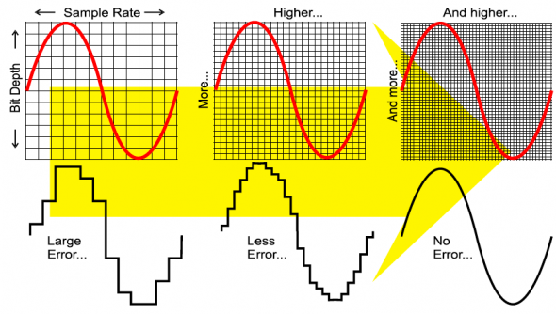
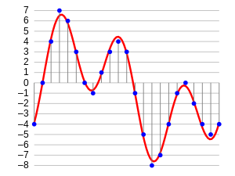
How does digital audio work?
Quantization
– amplitudinal discretization
Example: 4-bit
CDs: 16-bit
HiFi streaming: 24-bit
Bit rate
– total bits per second
CDs:
16 bits/sample
* 44100 samples/s
* 2 channels (L/R)
= 1.4112 Mbps
Sampling
– temporal discretization
Nyquist limit: 40 kHz
CDs: 44.1 kHz
HiFi streaming: 192 kHz
Why 44.1 kHz?

Slide 6
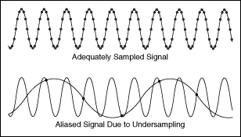
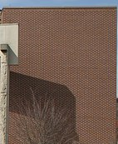
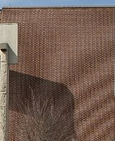
Nyquist-Shannon sampling theorem
“Sampling rate must be 2x of the original signal for a lossless recovery without aliasing”

Slide 7
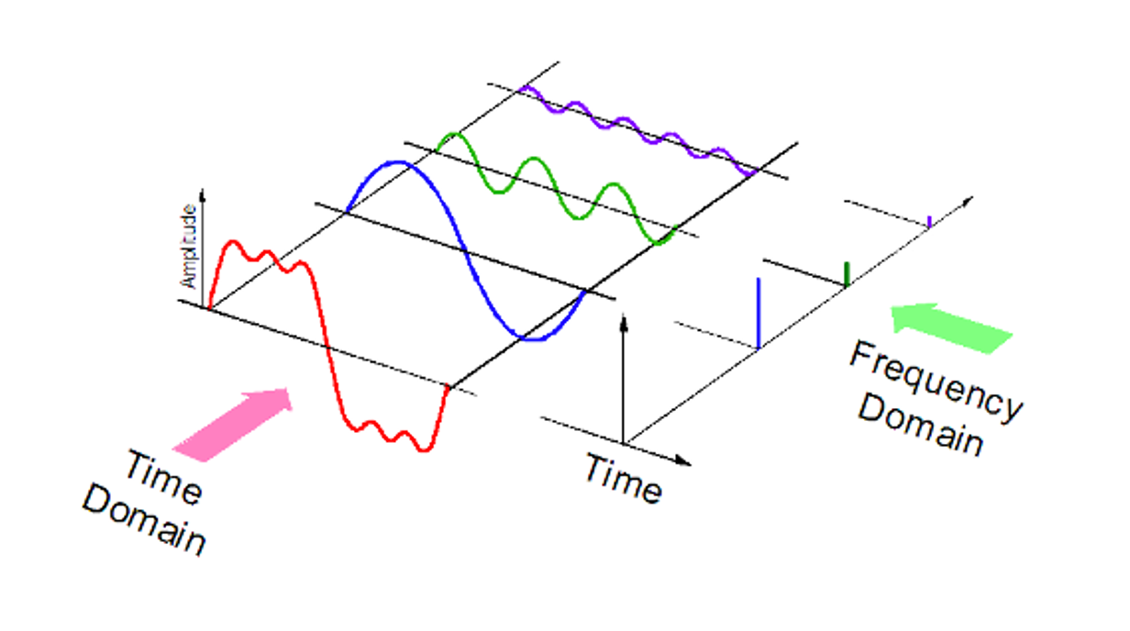
Fourier transform

Slide 8
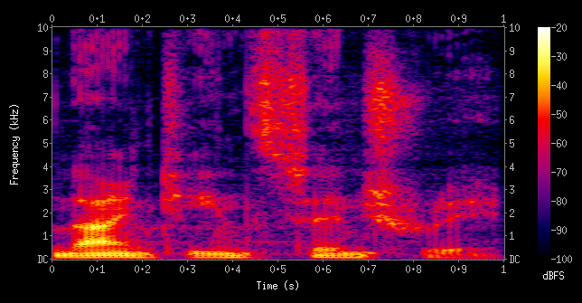
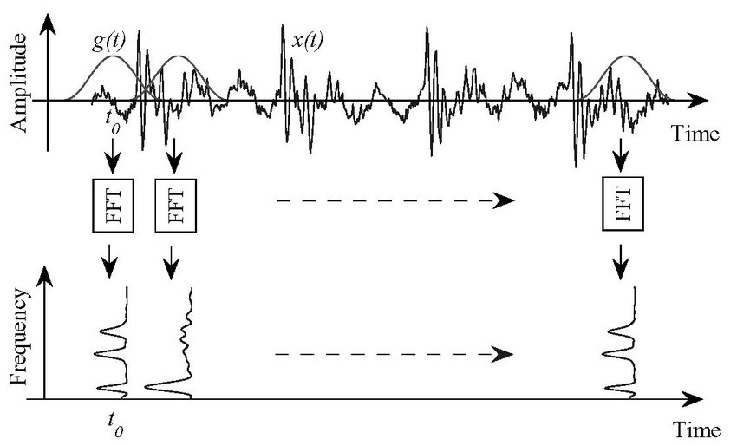
Short-time Fourier transform
Gabor limit
“Can’t have both high time/frequency resolution”

Slide 9
Do it yourself!
https://colab.research.google.com/drive/1p3moQHn9C7O4jxWFybgsprsrNskvfB16?usp=sharing

