Slide 1
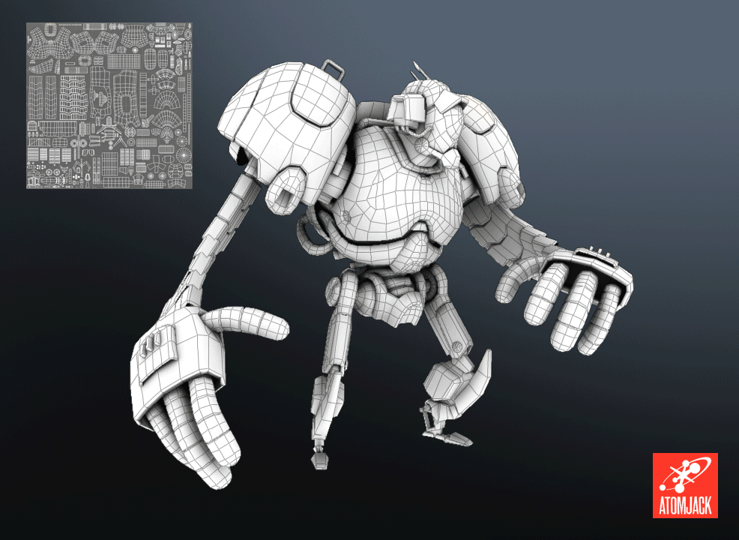
Texturing
#project_vr_something

Slide 2
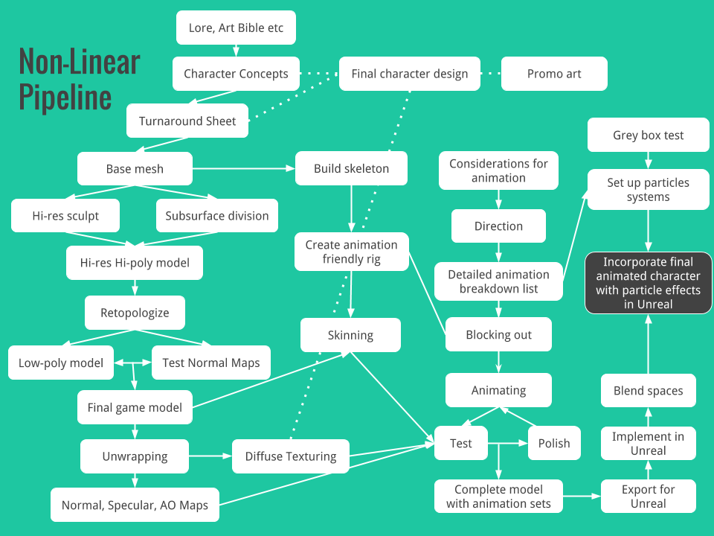
Review: Modeling Pipeline
Rigging
Animation
Modeling
Texturing

Slide 3
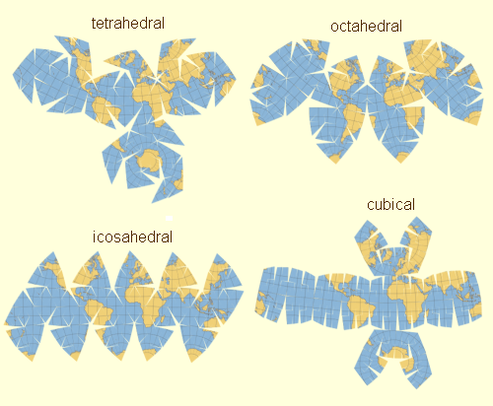
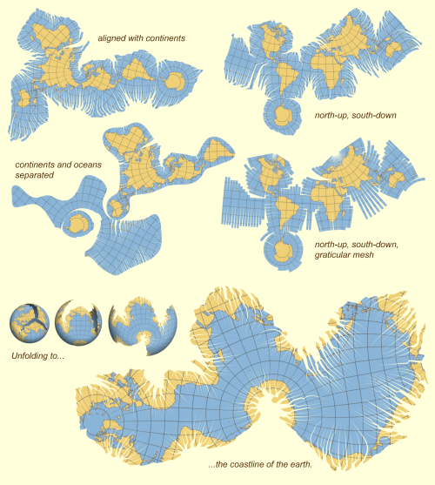
UV Unwrapping

Slide 4
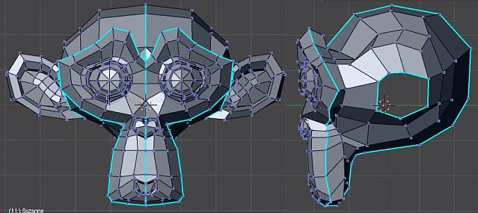
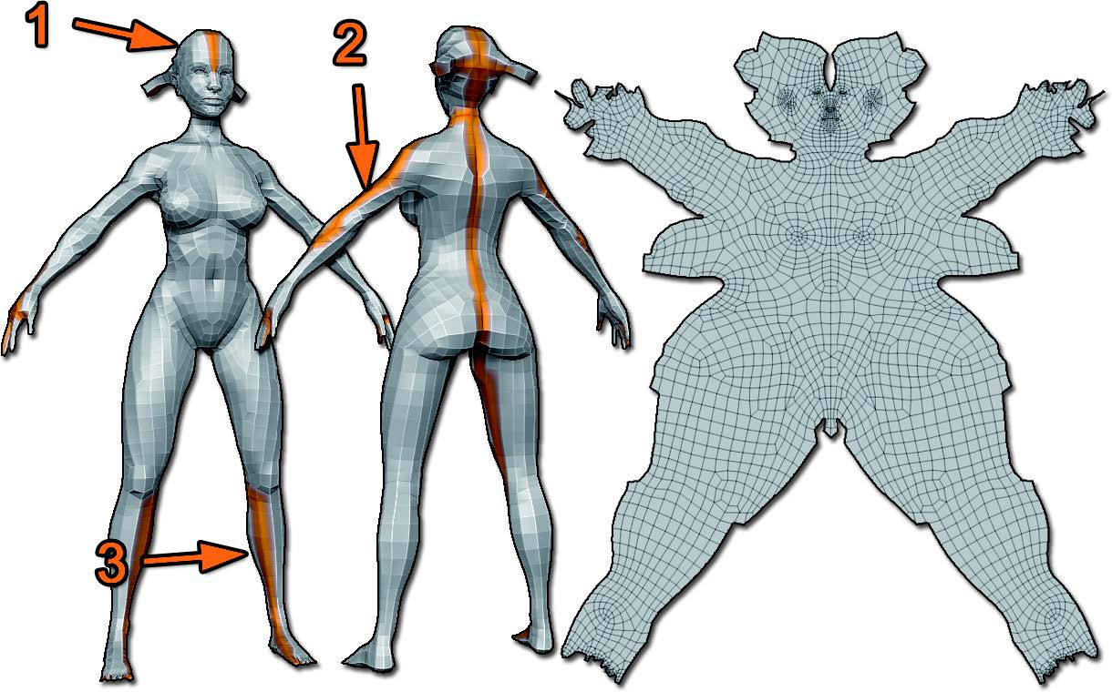
UV Seams

Slide 5
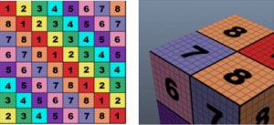
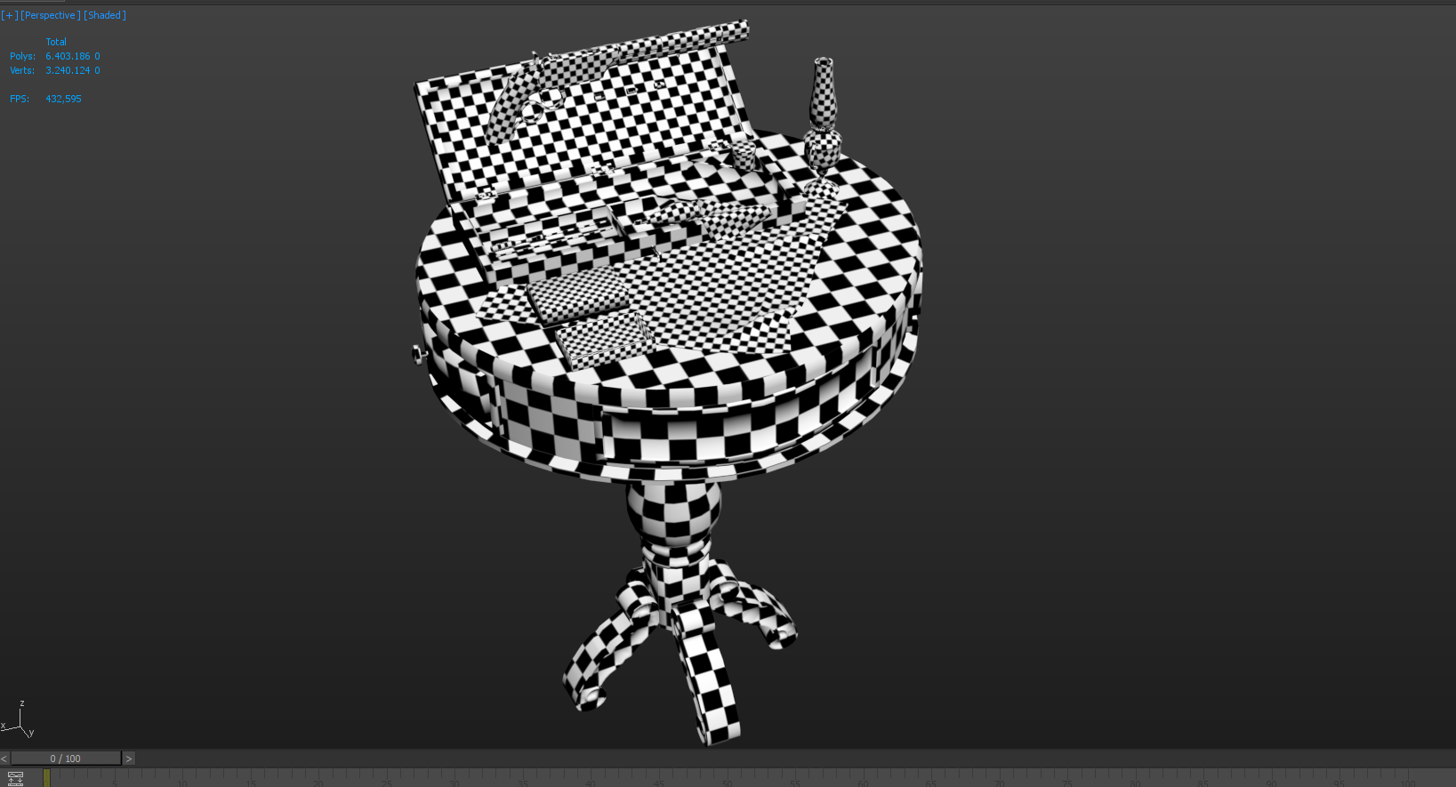
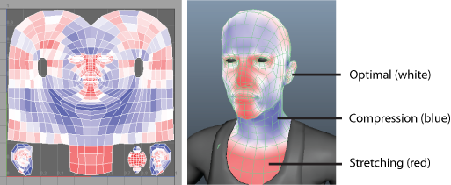
UV Unwrapping Strategy
Using a good UV grid texture
Consistent scale
Minimal seams & distortions
Consistent orientation
Tight packing
Notes:
https://www.somagames.com/getting-technical-best-practices-for-uv-unwrapping/

Slide 6
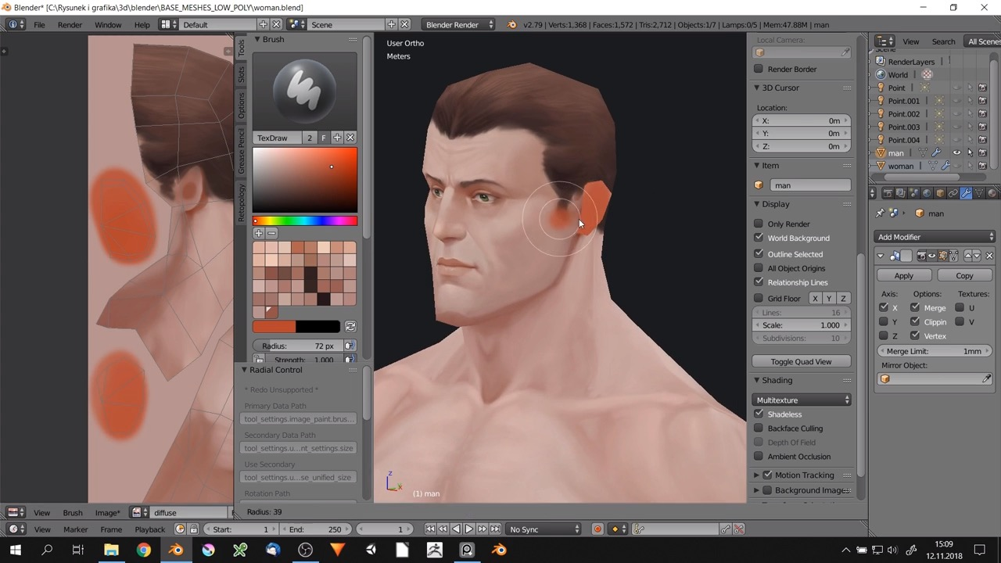
Texturing

Slide 7
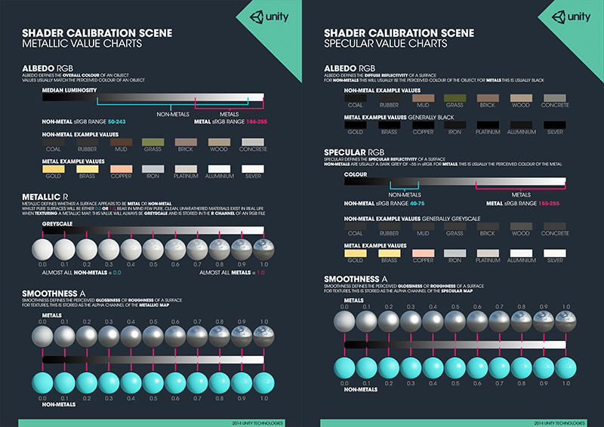
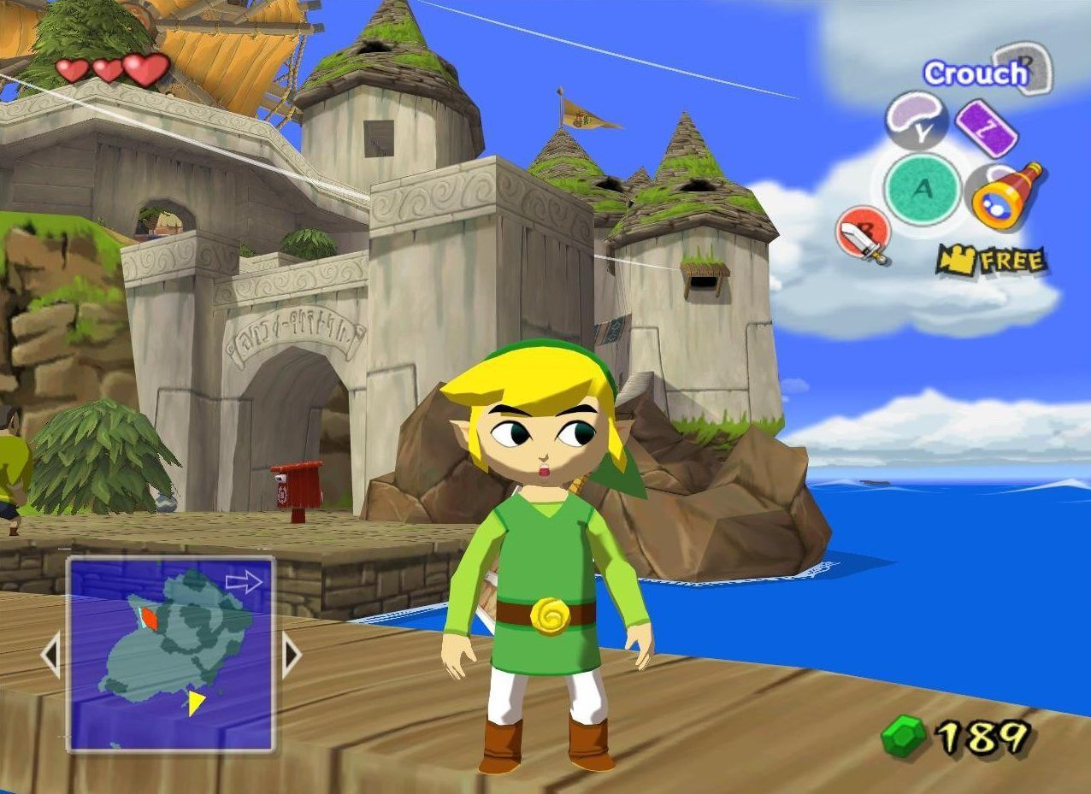
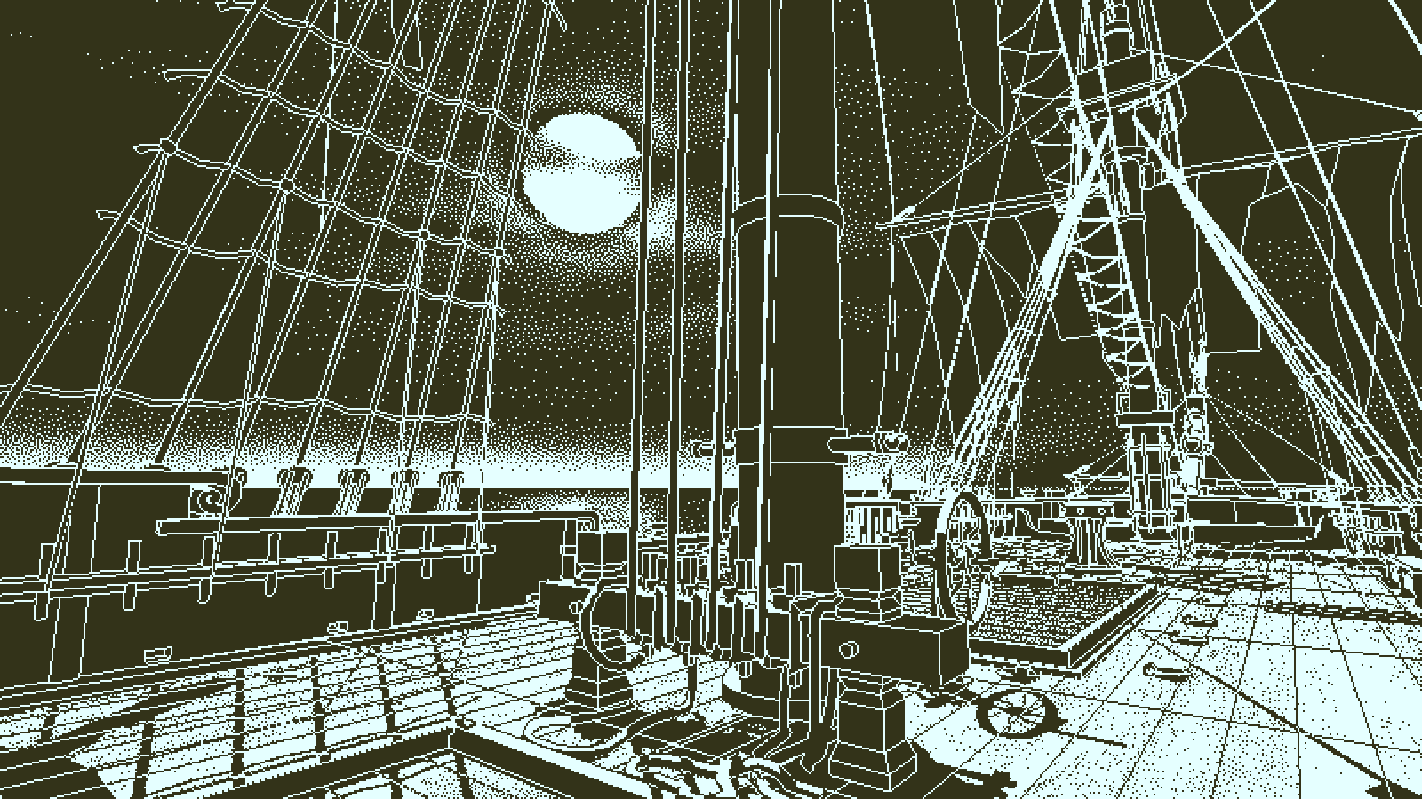
Material
Photorealistic
Physically-based rendering (PBR) materials
Non-PBR materials
Non-photorealistic
Cel shading material
Etc…

Slide 8
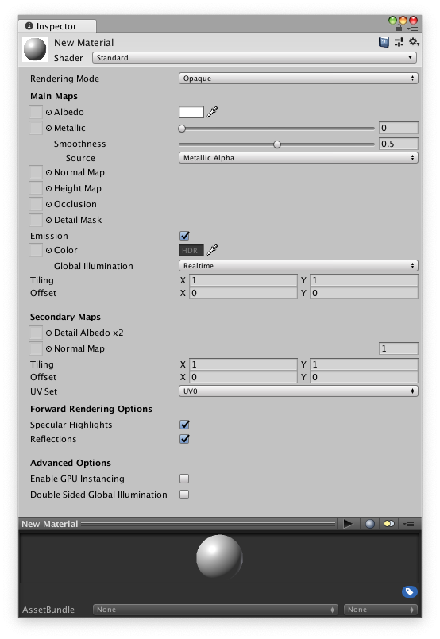
Unity Material
Albedo
Metallic / Smoothness
Normal map
Height map
Occlusion
Emission
Secondary Maps (detail maps)
Mask
Albedo
Normal

Slide 9
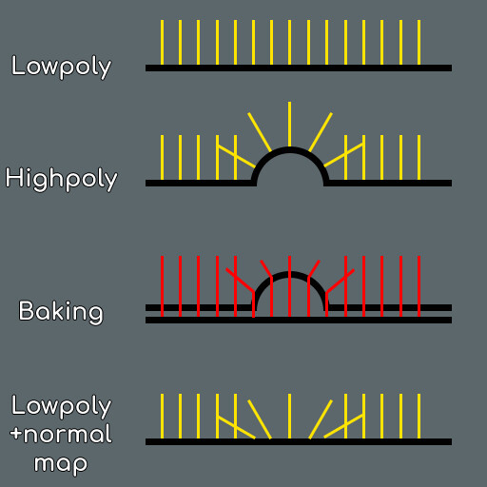
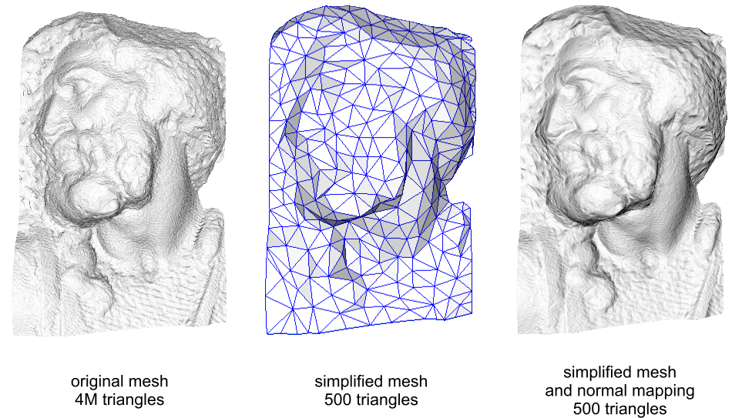
Normal Map Baking
Bake high-poly details into textures of low-poly models

Slide 10
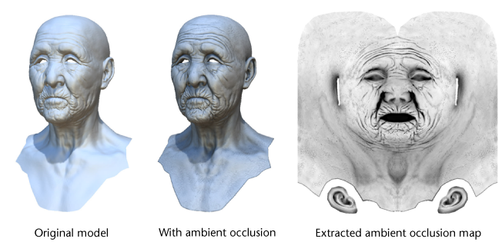
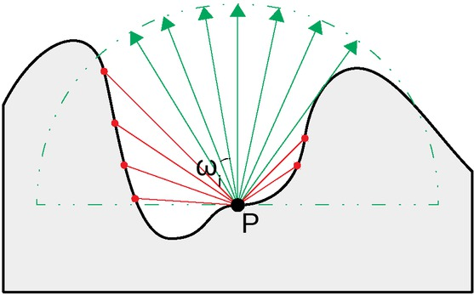
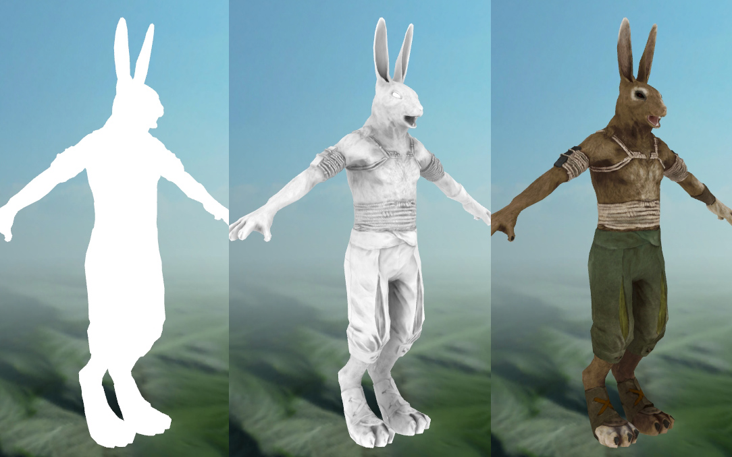
Ambient Occlusion Map Baking
Bake self-shadowing properties onto the texture

Slide 11
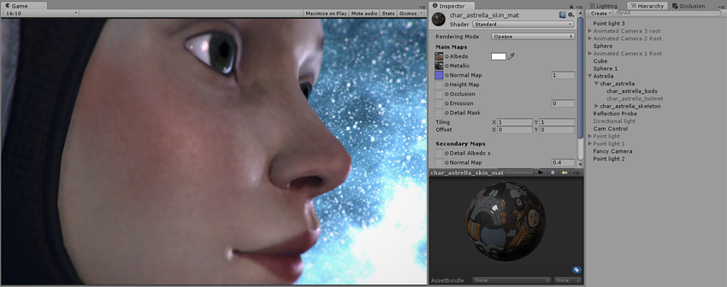
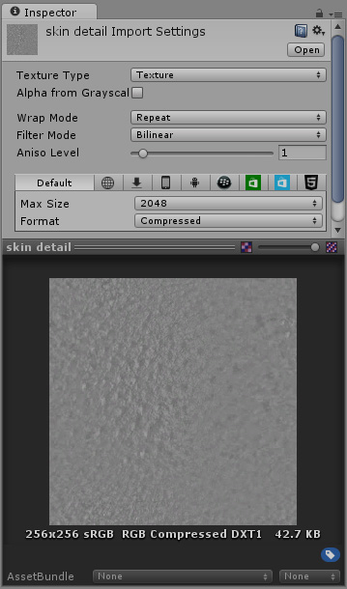
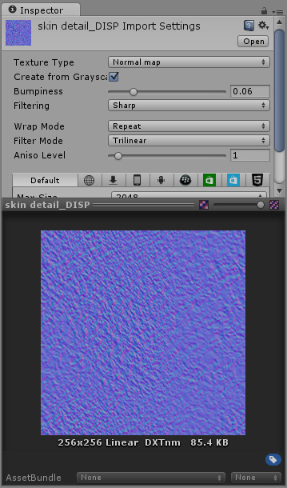
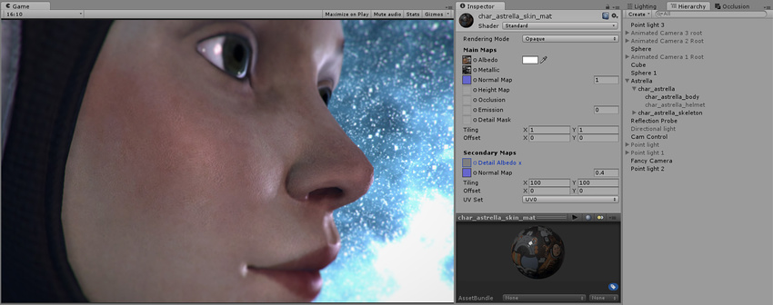
Secondary Maps & Mask
Microscopic + repeating (high-frequency) details as a secondary textures
E.g. skin, brushed metal

Slide 12
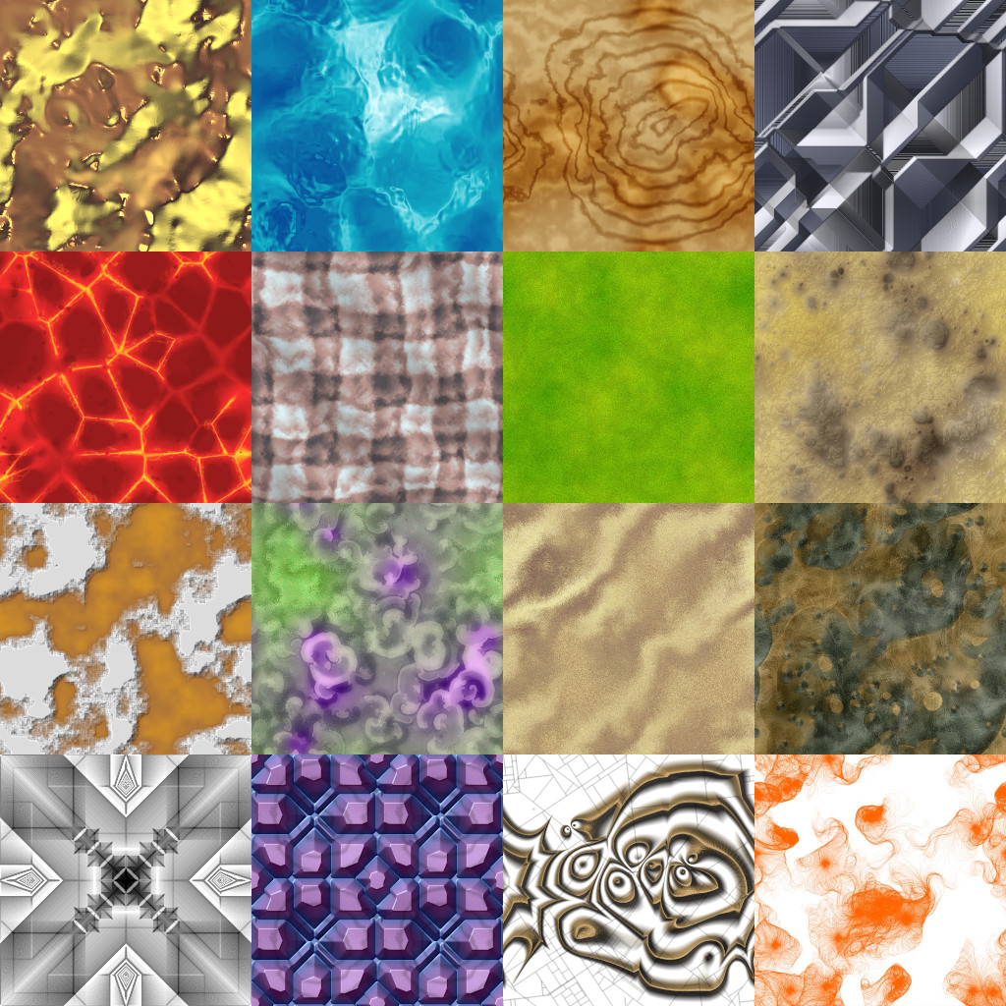
Procedural Texture
Textures generated in a purely algorithmic way
Unlimited resolution
Run-time generation
Reactive
Gradient noise
Natural-looking randomness
E.g. Perlin noise / Simplex noise

Slide 13
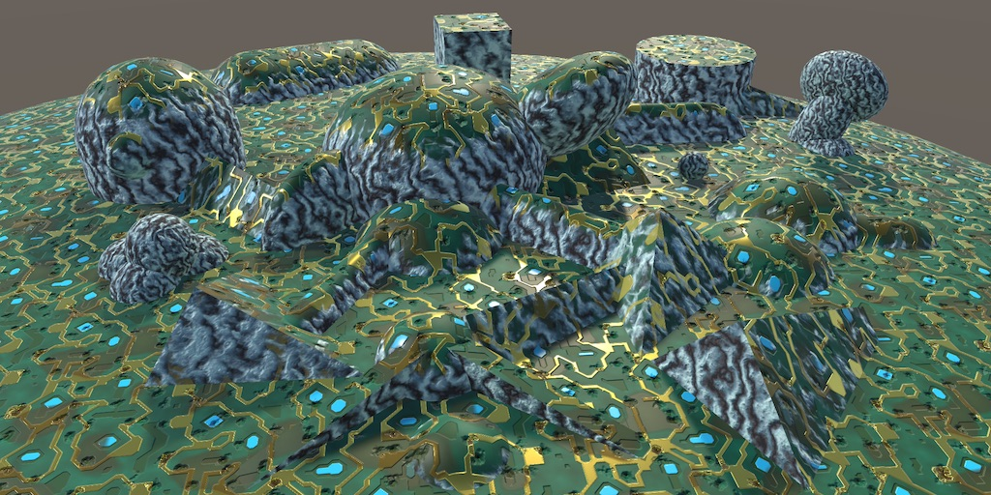
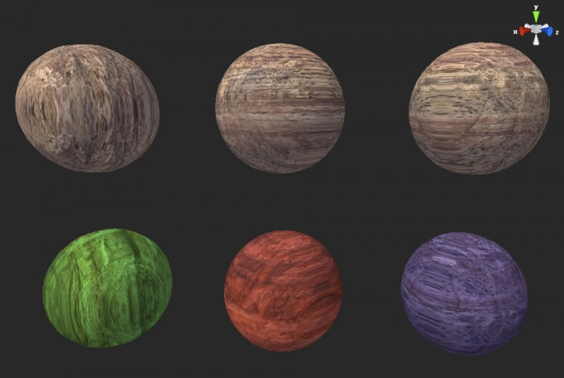
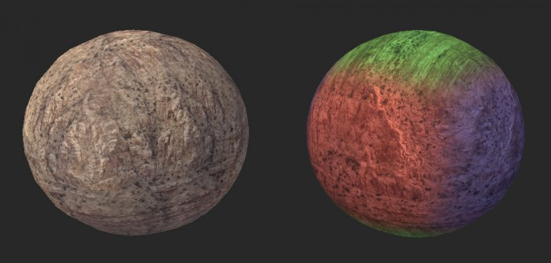
Triplanar Mapping
Apply textures without UV mapping
Mapping is approximated from geometry
Commonly used for terrain
Notes:
https://catlikecoding.com/unity/tutorials/advanced-rendering/triplanar-mapping/
https://www.martinpalko.com/triplanar-mapping/

Slide 14
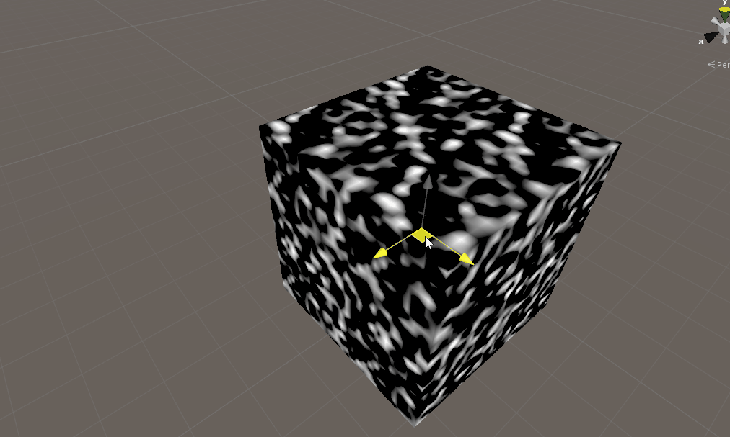
3D Texture
Can also applied without UV mapping
Texel is mapped to the geometry by its 3D position
Often generated procedurally

