Slide 1
달출 Escape to the Moon
20220825 Enrique (@ChEcKeN)

Slide 2
Main Idea
융합하는 몬스터 Roguelike-RPG
Unity 연습

Slide 3
Glee 기쁨 Role: Buffer Buffs the entire party and acts fast.

Slide 4
Peace 평화 Role: Healer Heals the party in its turn.

Slide 5
Distracted 산만함 Role: Buffer-Healer Buffs the party and heals depending on the number of buffs.

Slide 6
Fury 화 Role: Attacker Attacks the enemy reliably.

Slide 7
Sadness 슬픔 Role: Debuffer Debuffs enemy.

Slide 8
Disappointment 실망 Role: DoT attacker Attacks enemy by inflicting them with poison damage.

Slide 9
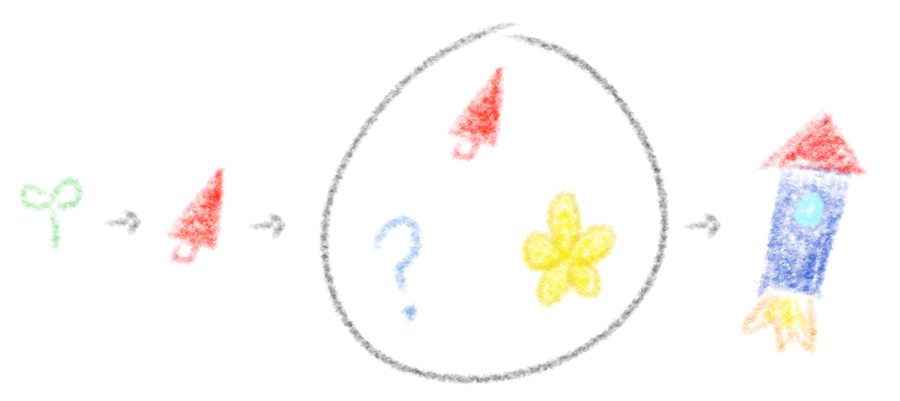
Roguelike
Roguelike?????
Preparation Stage
Start
Battle
Escape

Slide 10
Progress
Battles are almost complete
Missing enemy variety
Balancing
“Roguelike” features missing
???

Slide 11
Help Wanted
Need betatesters that can find exploits, bugs and possibly overpowered strategies!!!!
Hopefully before midterms
Involve team to implement the roguelike mechanics (???)
Any advice is appreciated!
-> #project_escape in Slack

Slide 12
Thank you!!!!!!!!!!!!!!!!!

