Slide 1
Virtual Reality Hardware
Capabilities and Limitations based on Human Perception

Slide 2
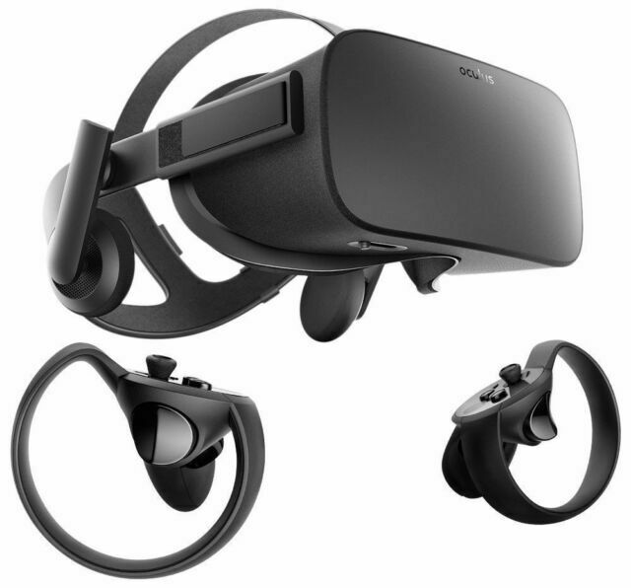
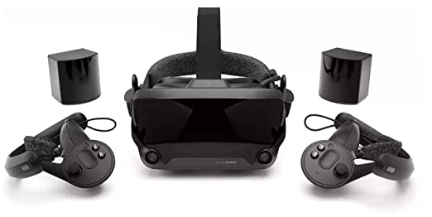
Virtual Reality Headsets
Valve Index
Latest High-end HMD in the market
Released in 2019
$999
Oculus Rift CV1
HMD which HAJE owns
Released in 2016
Discontinued in 2019
Succeeded by Oculus Rift S
$599

Slide 3
Human Perception: “Five Senses”

Slide 4
Senses Ranked by Devoted Neurons in Brain
30%
8%
2%
<1%
~0%

Slide 5
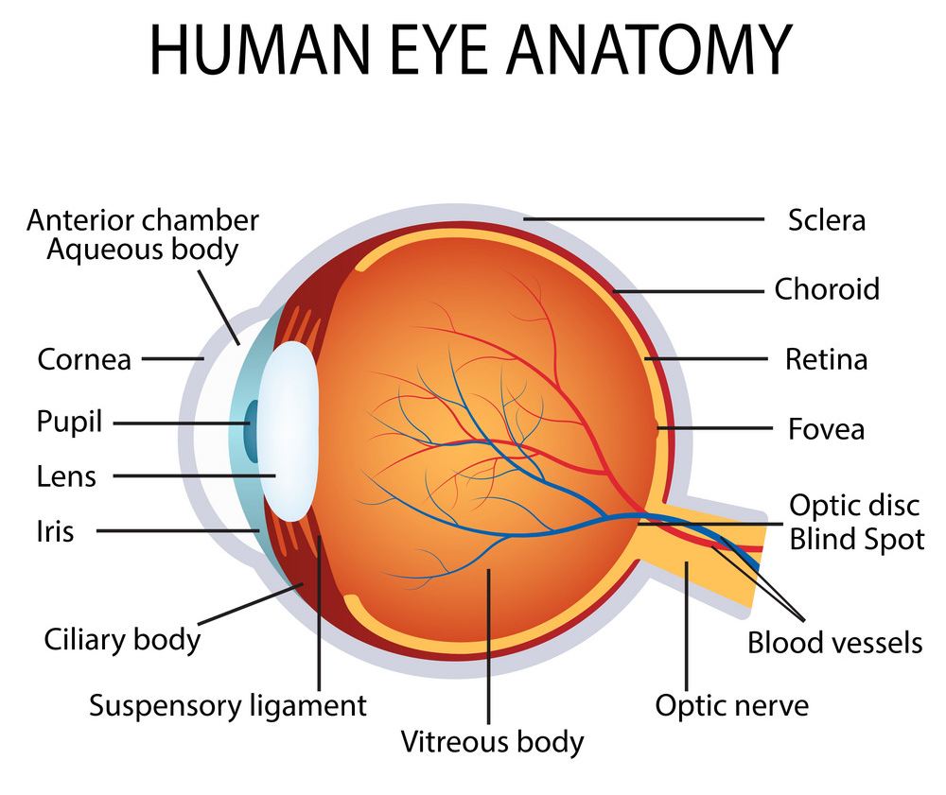
How Eyes Work
Relevant structures
Pupil
Lens
Retina
Fovea
Capabilities
FOV: 200° X 130°
Framerates: 60-120Hz
Resolution: 30K X 20K dots
Not uniform; denser near fovea

Slide 6
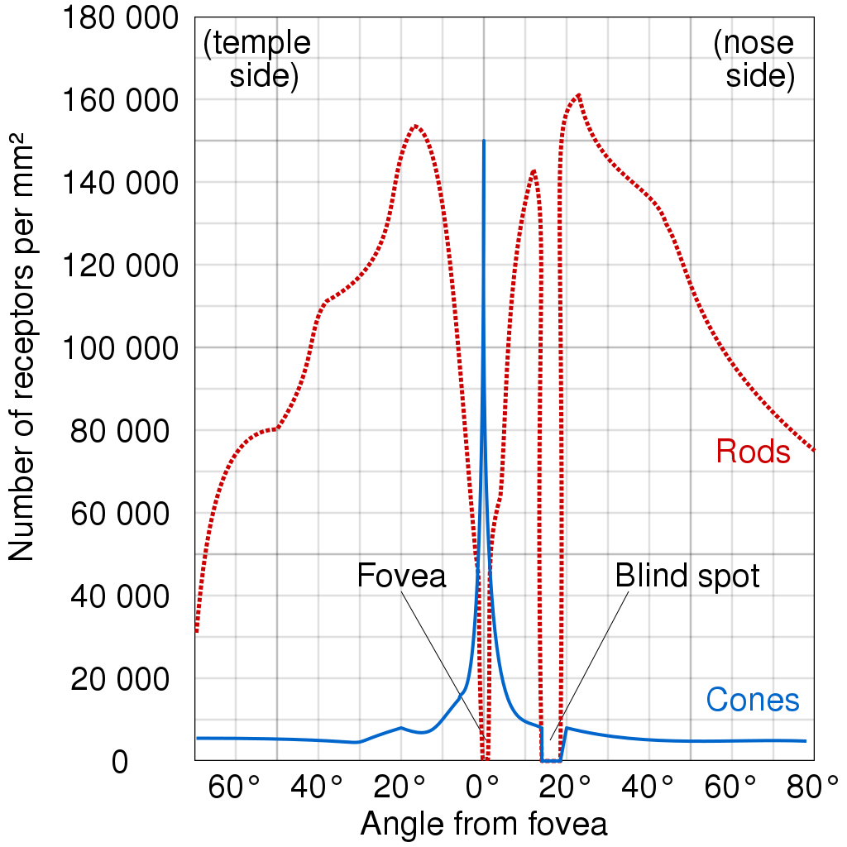
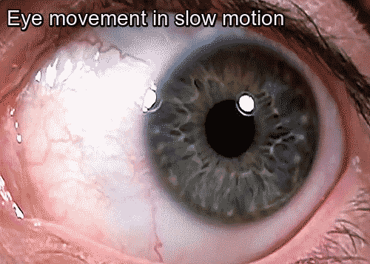
Foveated Vision
Most cone cells are located within 2° from central axis (=fovea)
High-res image within fovea, low-res image outside of fovea
Human eyes overcome this by unconsciously jittering while gazing

Slide 7
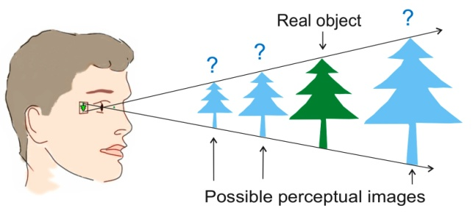
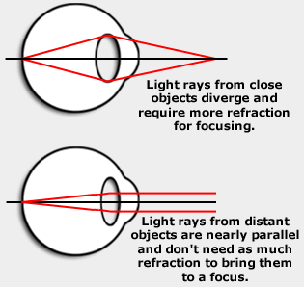
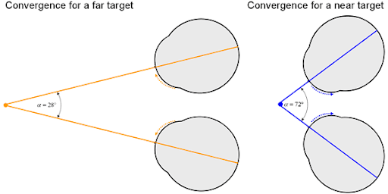
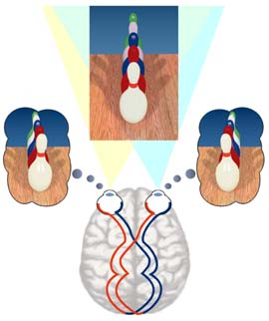
Depth Cues for Depth Perception
Accommodation
(Con-)vergence
Stereoscopic Vision

Slide 8
Virtual Reality Headsets: Resolutions + Framerates
Valve Index
1440 X 1600 per eye
80, 90, 120, 144Hz available
Oculus Rift CV1
1080 X 1200 per eye
90Hz

Slide 9
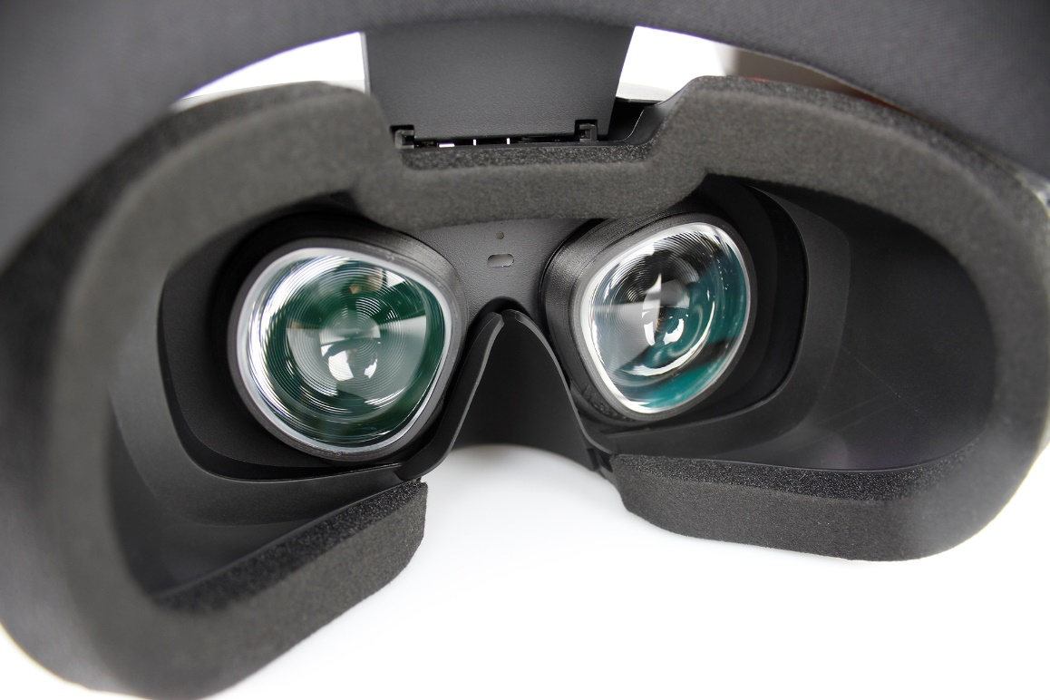
Virtual Reality Headsets: FOV
Field of view =How wide a human eye can see?
Human: 200° horizontal, 130° vertical
How to effectively cover human FOV? → Lenses

Slide 10
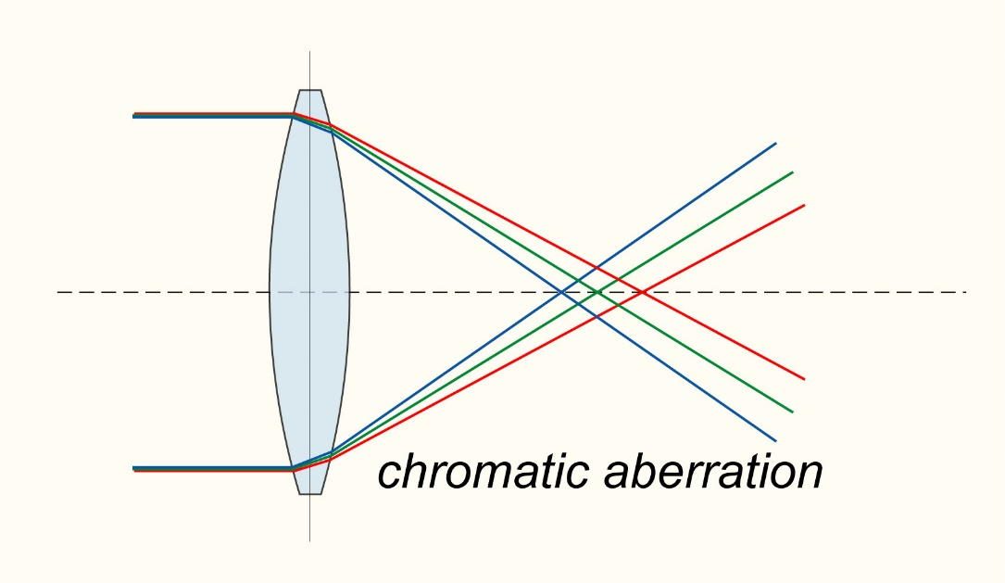
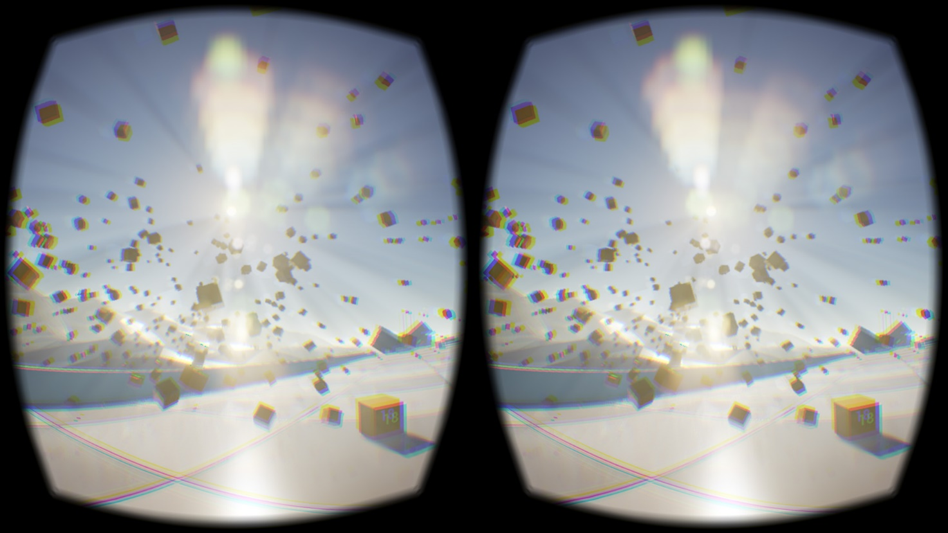
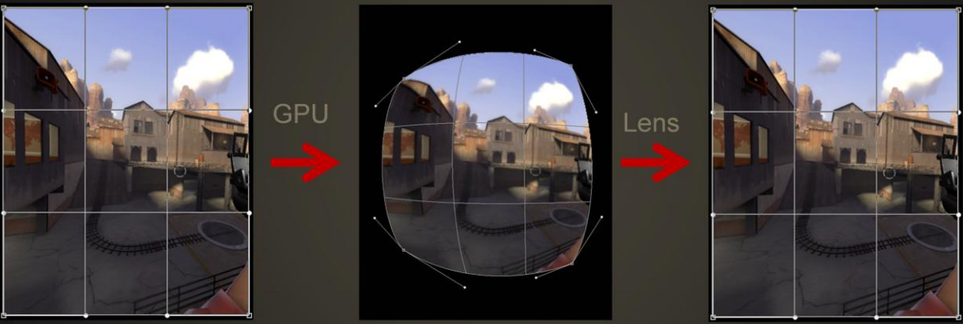
Virtual Reality Headsets: FOV
Challenge: Lens distortion
Lens distorts image behind it
Pin-cushion distortion: lens stretches the image more at the edges
Lens also distorts color (chromatic aberration)
Solution: Distortion correction
HMD displays rendered images after applying inverse distortion
Limitation: uneven pixel density

Slide 11
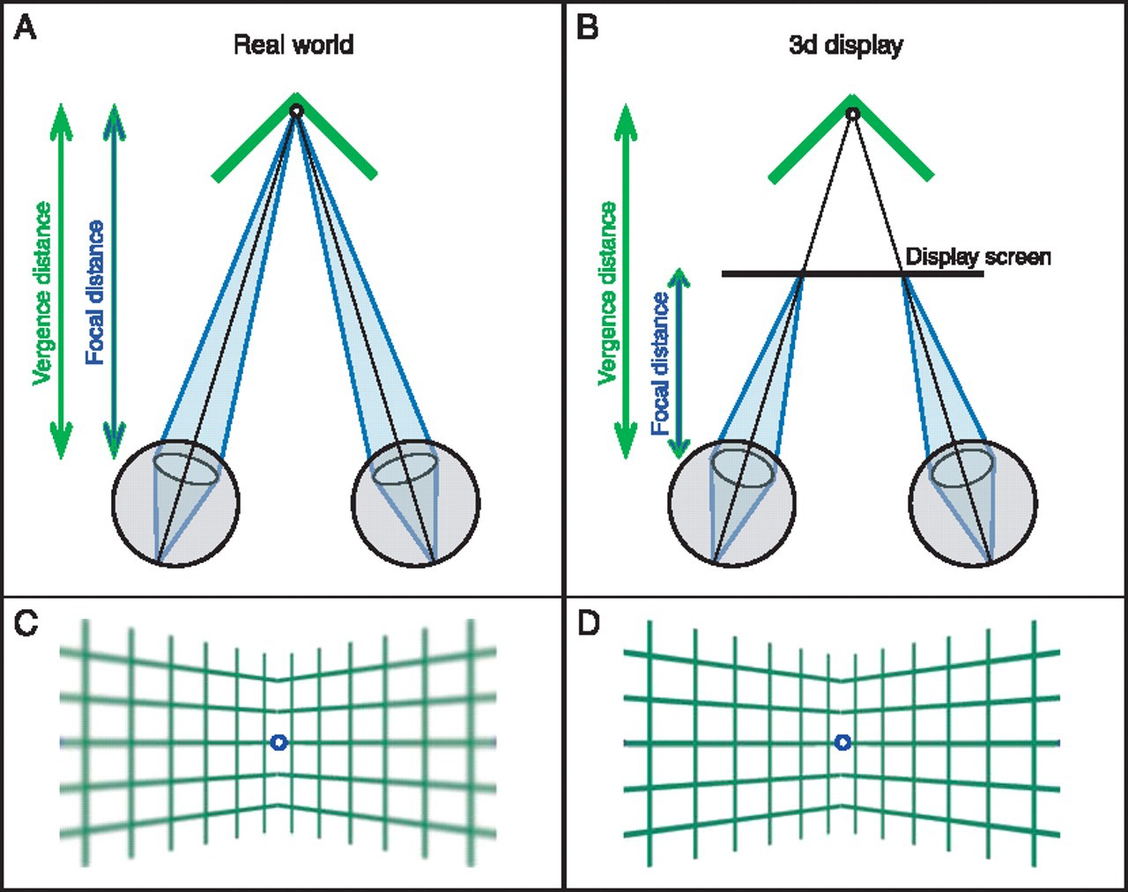
Virtual Reality Headsets: Depth perception
Depth cues checklist
✔ Stereoscopic vision
✔ Vergence
✖ Accommodation
Vergence-Accommodation Conflict
Causing discomfort, fatigue to eyes
Limiting the length of sessions
Possibly inducing headache
No depth-of-field effect (minor complaint)
Every visual is located at the same focal distance
Image may look unusual

Slide 12
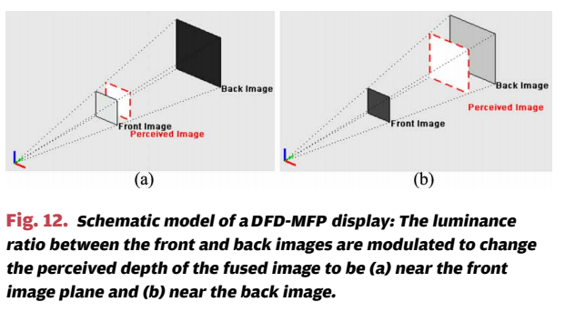
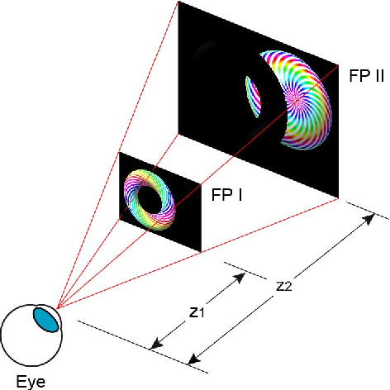
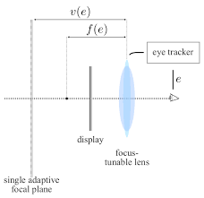
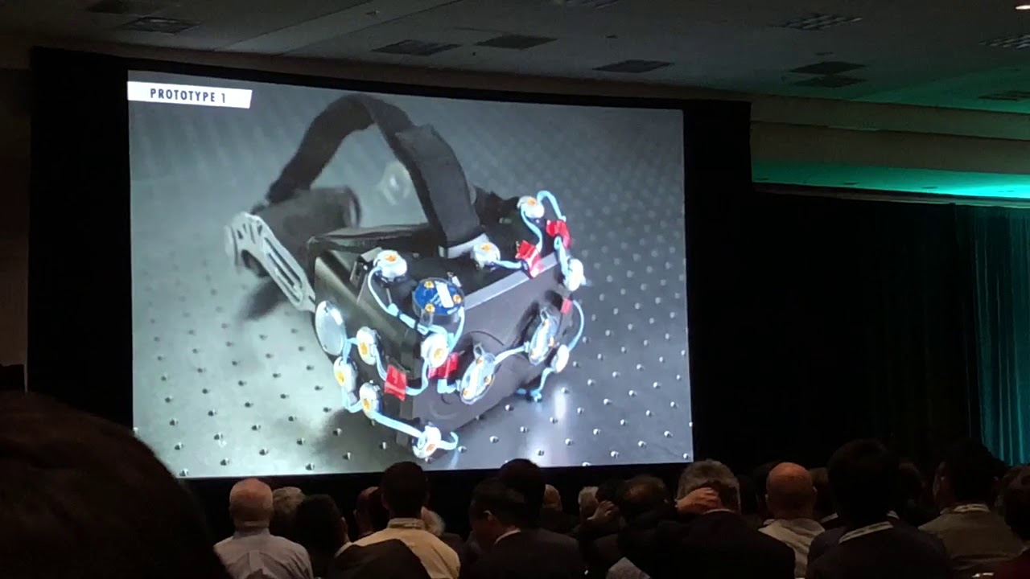
Solution to Vergence-Accommodation Conflict
Hardware solution: Multifocal display
Hardware solution: Varifocal display with focus-tunable lens

Slide 13
Solution to Vergence-Accommodation Conflict
UI/UX solution
Know your focal distance
Due to lenses, optical distance between eye-display is farther than physical distance
Oculus Rift CV1: ~2m
Valve Index: ~2m
Minimize vergence-accommodation mismatch as much as possible
Frequent UI elements should be located around the focal distance
Slow down the quick vergence changes
Maximize the reliability of other depth cues
…

Slide 14
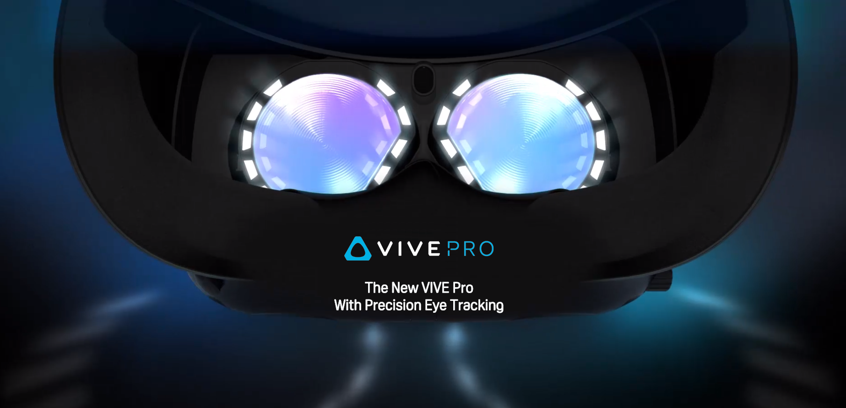
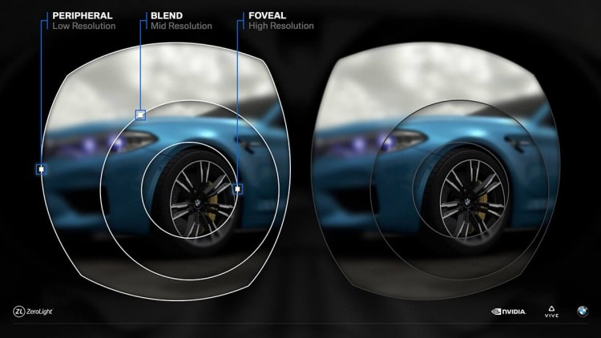
Coming Near Future: Foveated Rendering
Recall: Foveated vision
Human eye can only see in Hi-res within very small area
Foveated Rendering
More detailed image with less computing
Eye tracking required to find the user’s viewing direction

Slide 15
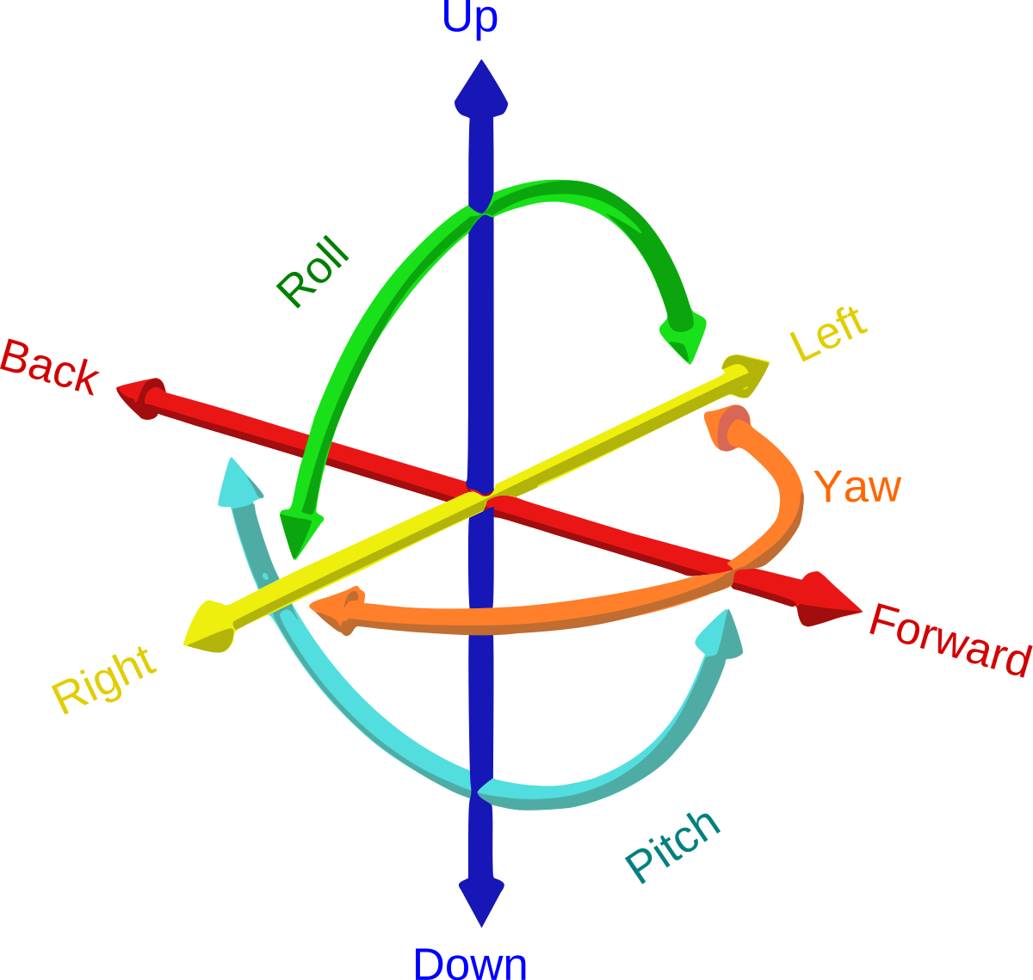
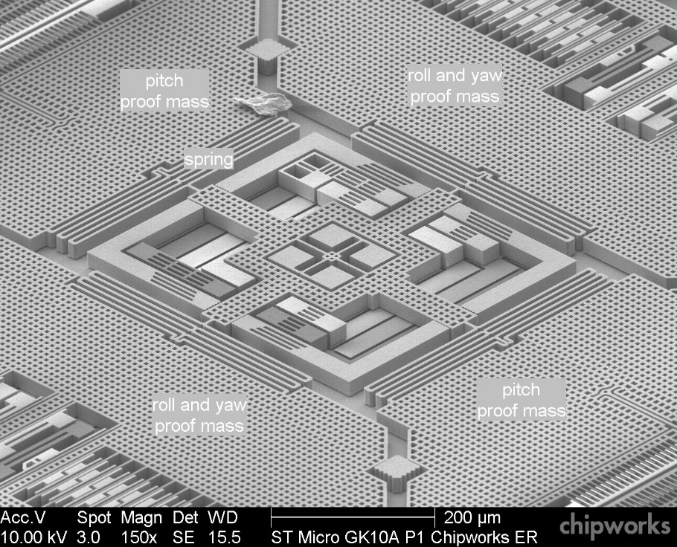
Head/Hand Tracking in Virtual Reality
Rigid bodies: 6 Degrees of Freedom
3 Translational + 3 Rotational
Rotation tracking
Gyroscope sensor
Position tracking
Somewhat challenging

Slide 16
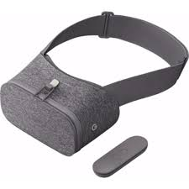
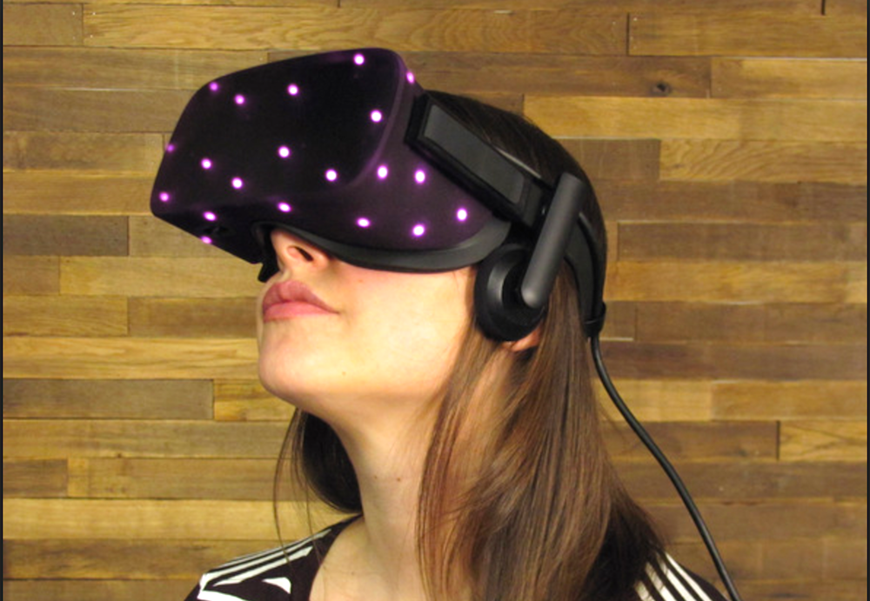
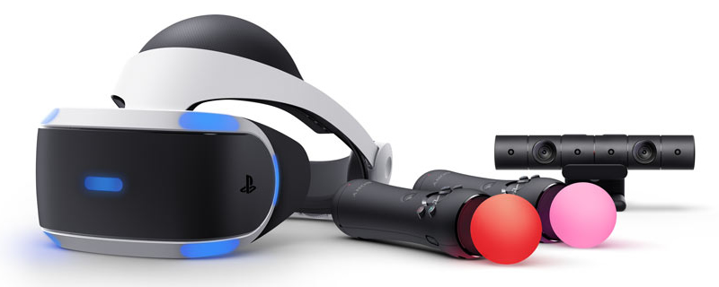
Position Tracking Methods
Giving up
Most mobile VR headsets (Oculus Go, Gear VR, Google Daydream View, …)
Tracking system
Sensors detect patterns on the device, compute the position
Low cost, high quality
Predefined patterns → Limited trackable peripherals
Limited field of view of sensors → Smaller tracking area
Oculus Rift, PlayStation VR

Slide 17
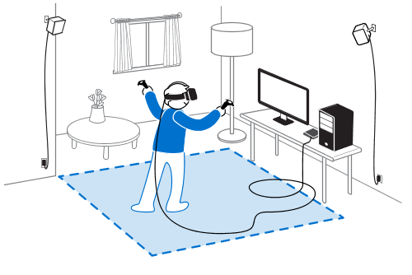
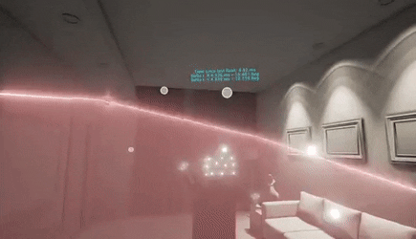
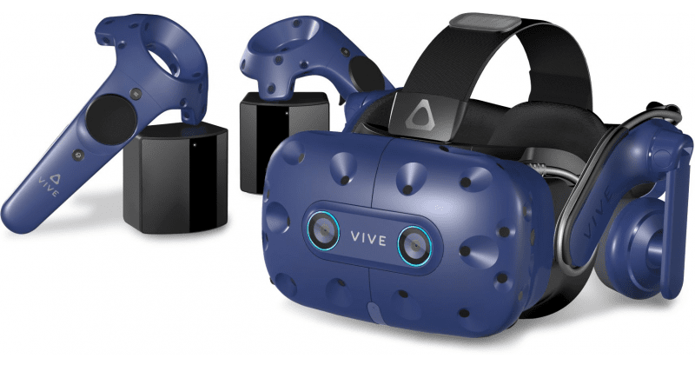
Position Tracking Methods
Lighthouse system
Each station emits timed signal in space
Peripherals detect the signal and compute positions
Lighthouse does not need to connected to PC
High quality, wide range of tracking → Room-scale
Expensive, hard to install
Reflective surface → Glitch
HTC Vive, Valve Index

Slide 18
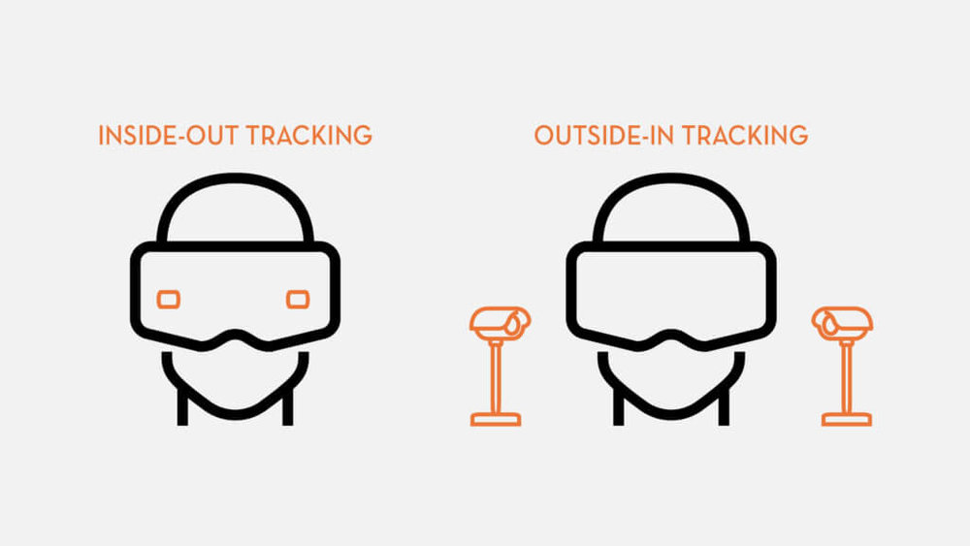
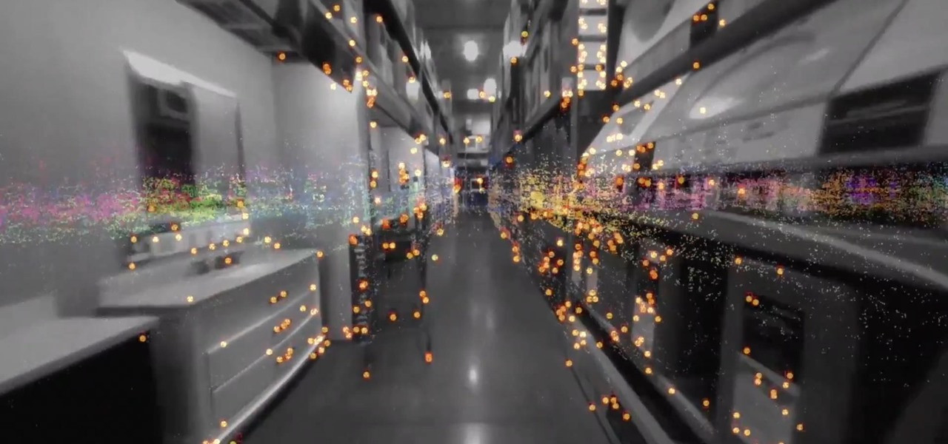
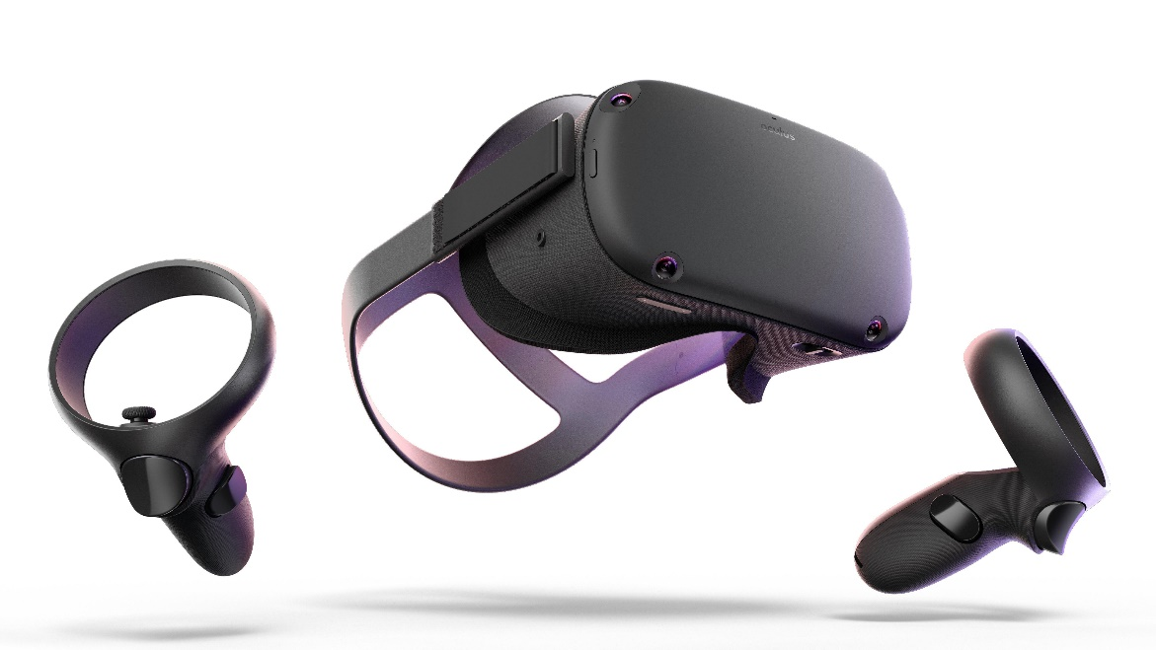
Position Tracking Methods
Inside-out tracking
Also called Simultaneous Localization and Mapping (SLAM)
Headset captures the environment, infers its position (difference) in 3D space
Low cost, no setup required
Relatively low quality tracking
Not working in dark
Oculus Quest, Windows Mixed Reality

Slide 19
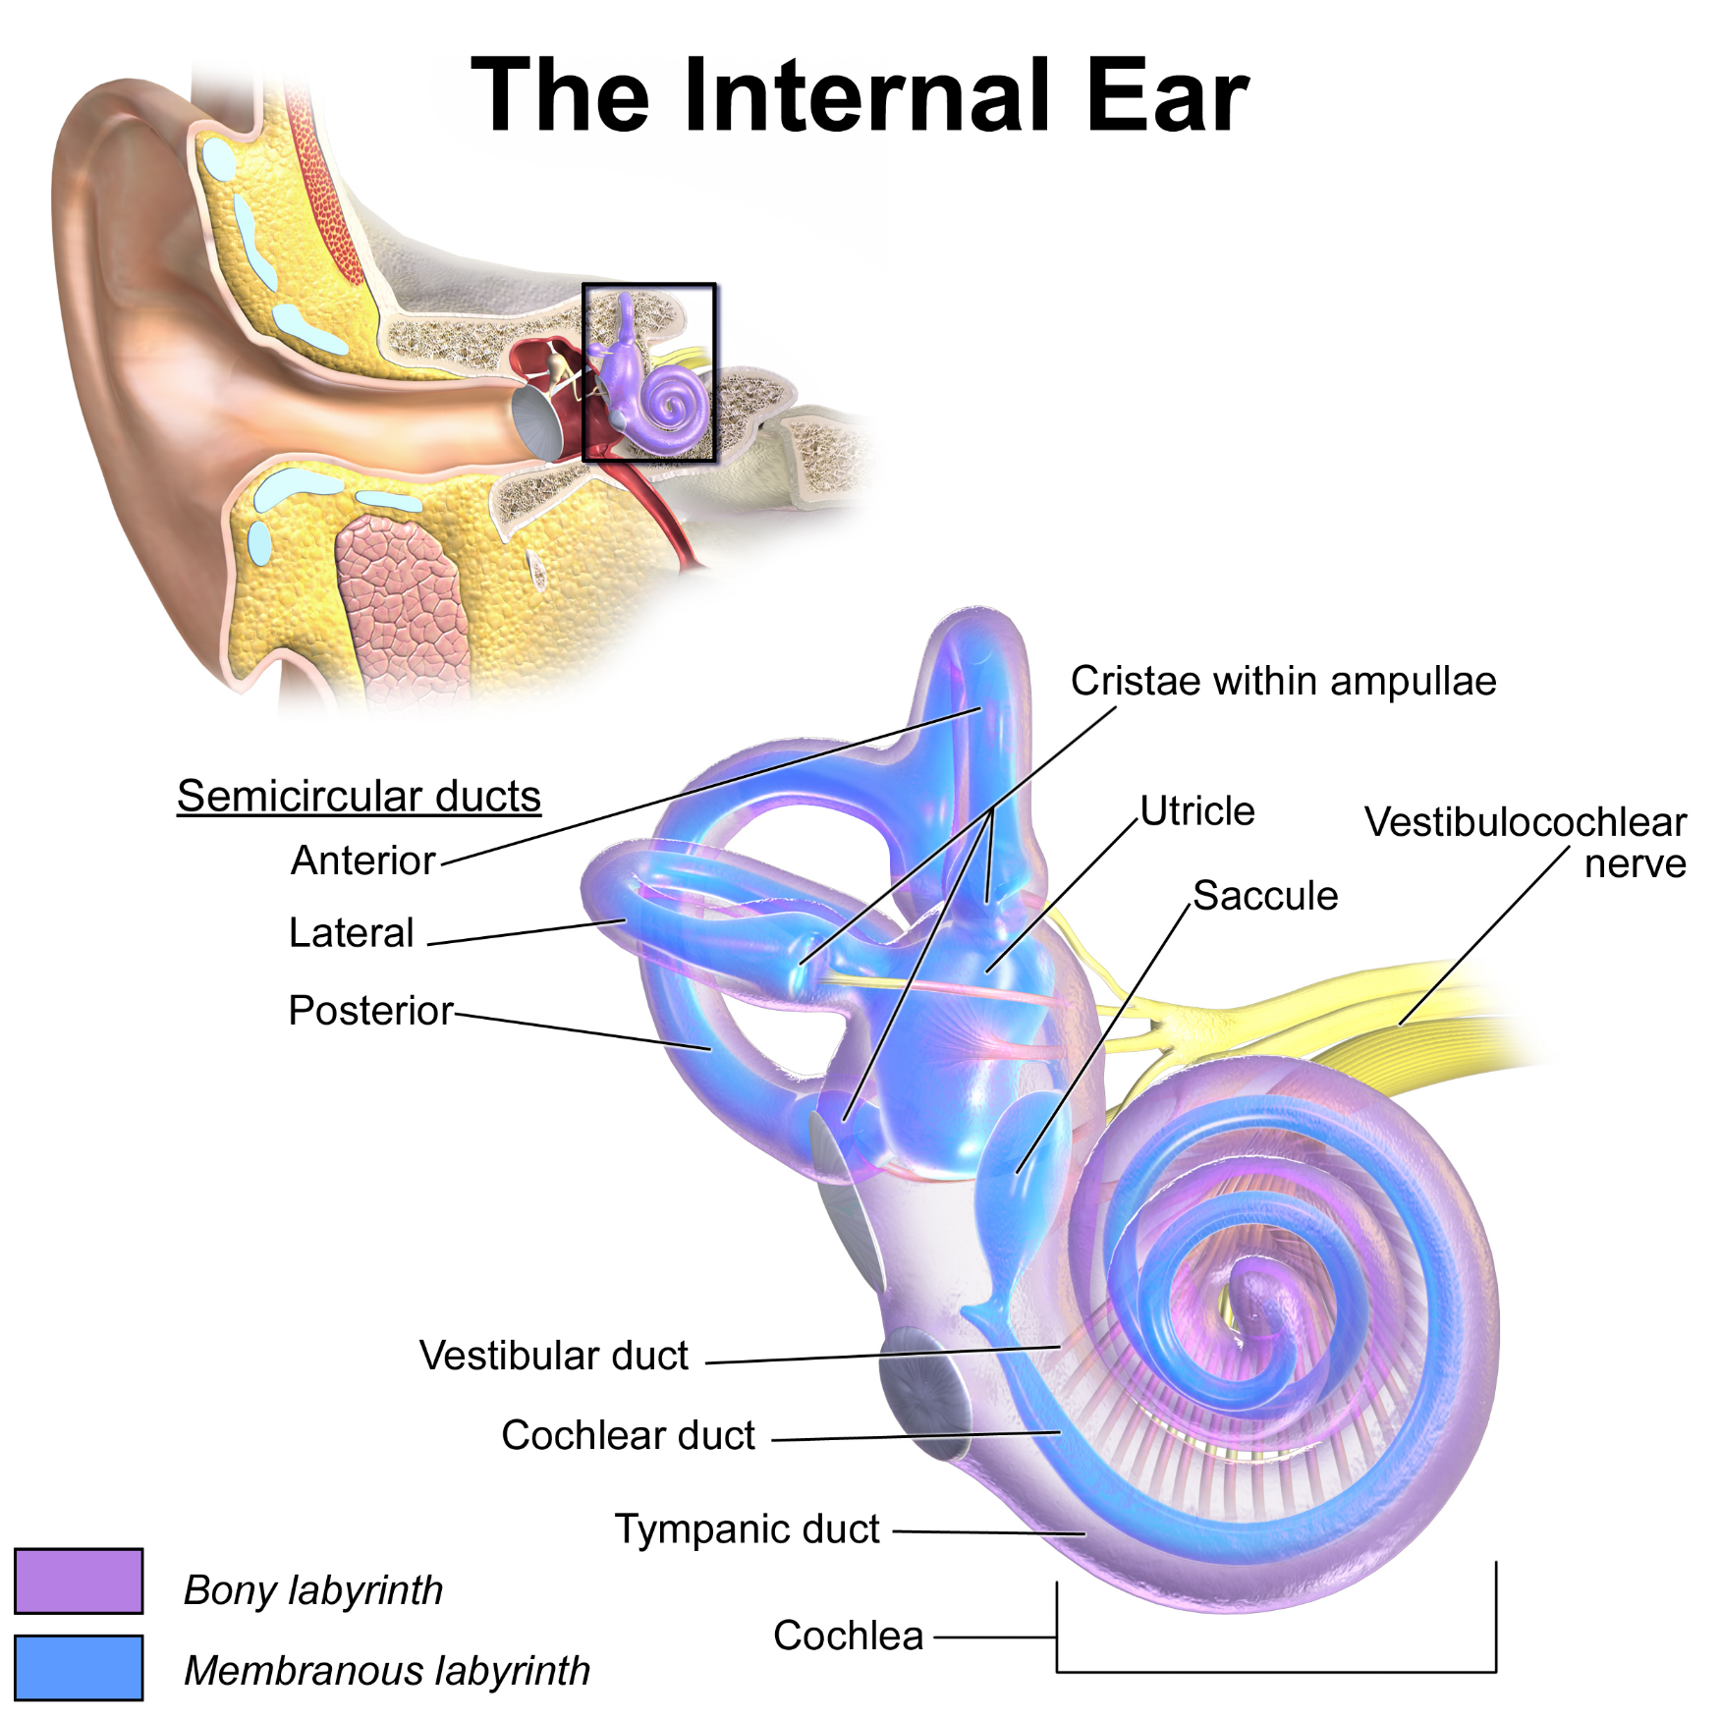
Balance Sensing of Human
Recall: “Five Senses”
Gravity/acceleration sensing

Slide 20
VR Sickness
Usually caused by sensory conflict
Visual inputs of virtual motion vs Non-visual perception of self-motion
Visually Induced Motion Sickness (VIMS)
Game designed that reduces VR sickness
Mitigate perception of self-motion
Minimize acceleration
Introduce inertial reference frame (cockpit, nose)
…

Slide 21
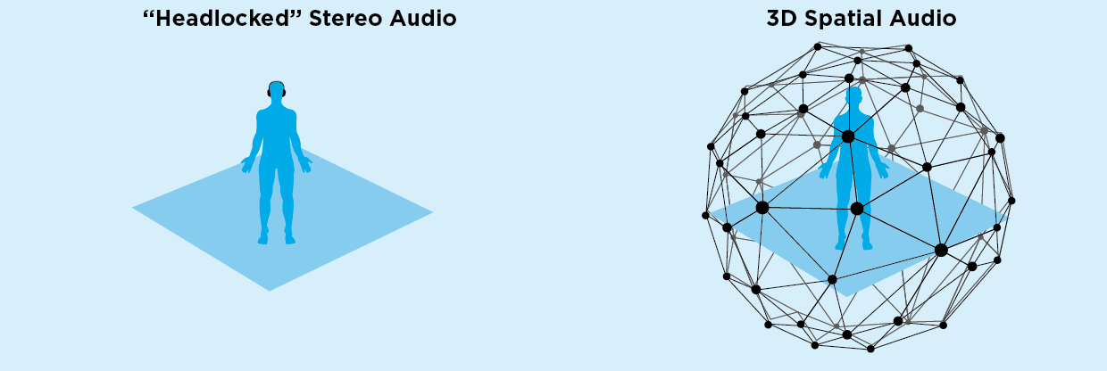
Spatial Audio
Mono/Stereo/Surround audio
Sound sources are located relative to head
Spatial audio
Sound sources are locked in space → Immersive experience

Slide 22
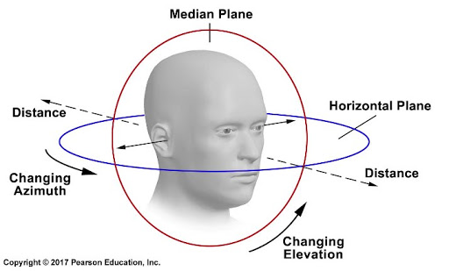
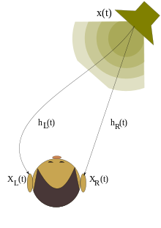
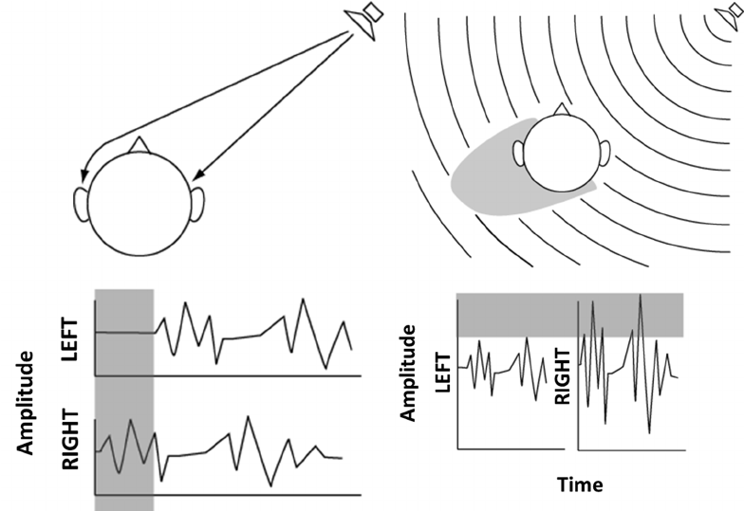
Sound Localization
Human can localize sound using 3 coordinates
Azimuth, elevation, distance
Similar to polar coordinates
Azimuth cues
Duplex theory: cues from two ears
Time difference (Interaural time difference, ITD)
Relative amplitude (IID/ILD)
Most notable in high frequencies
Distance cues
Loss of amplitude, loss of high frequencies, …

Slide 23
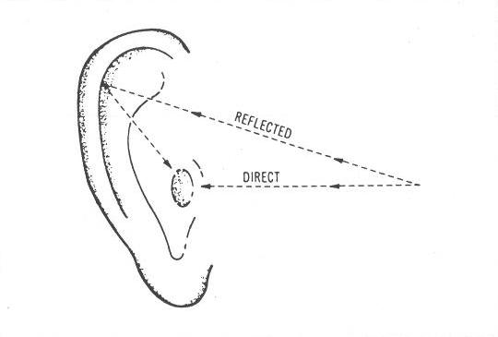
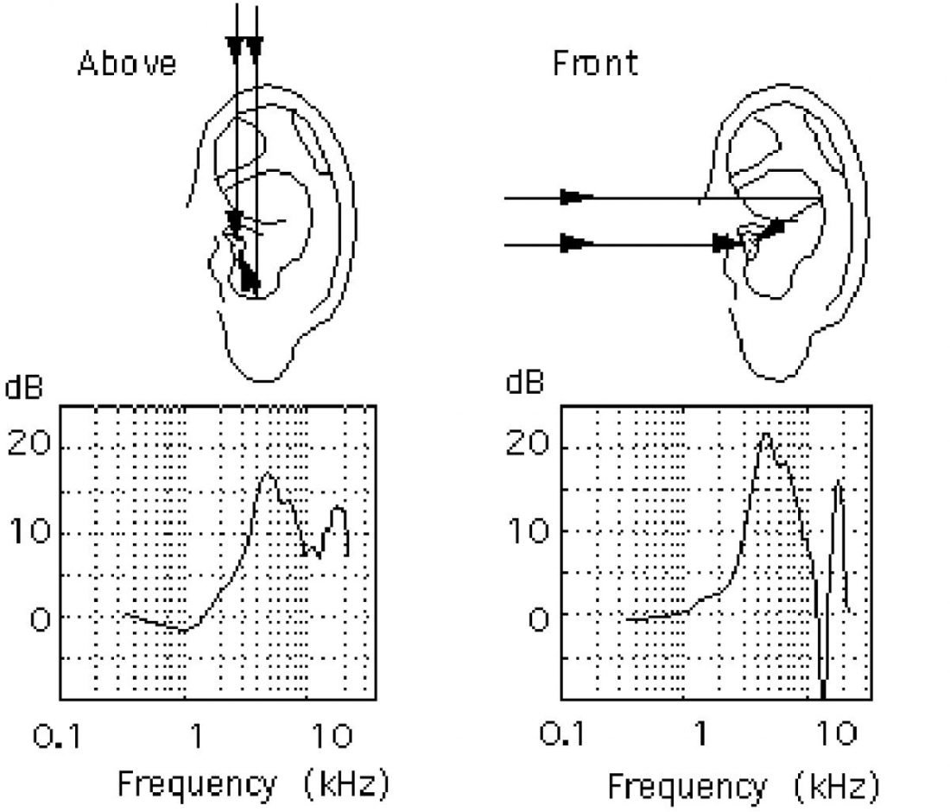
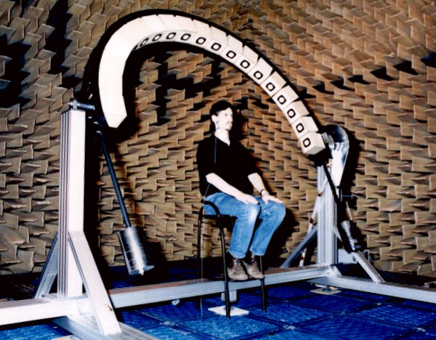
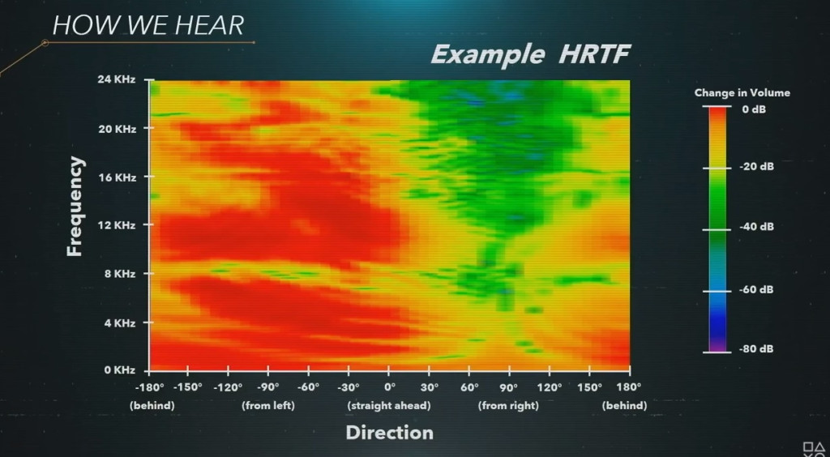
Sound Localization
Elevation cues
Pinna filtering effect
Shape of ears reflects sounds from each direction differently
Exact effect varies by person
Head-Related Transfer Function (HRTF)
Mathematical model for the effect
Requires specialized setup for precise measuring

Slide 24
Sound Localization in VR
Spatial audio engines generates these cues from relative location of sound source
Azimuth cues = strong
Elevation cues = weak, varies from person to person → inaccurate perception
Never solely rely on elevation cues

Slide 25
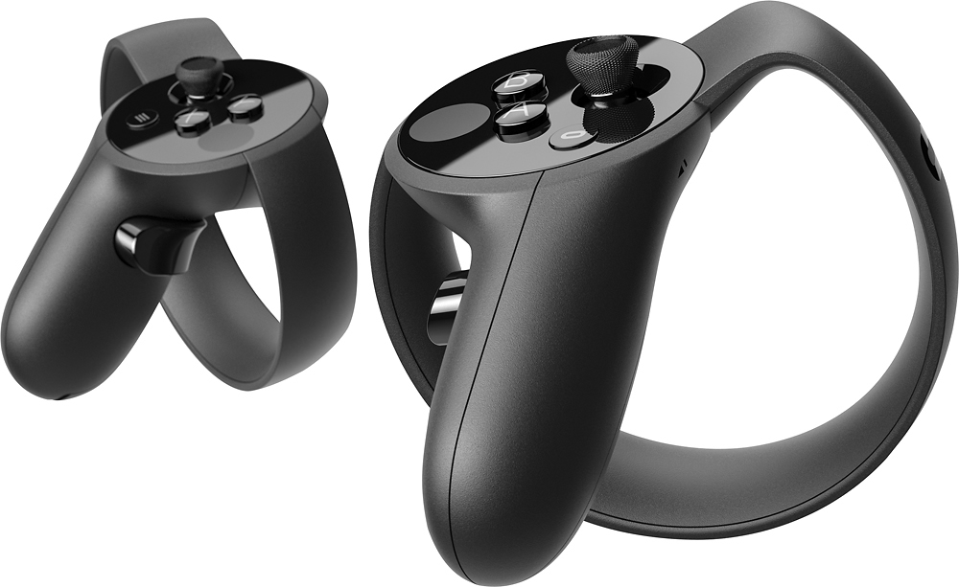
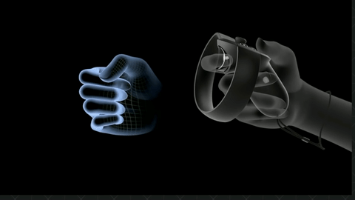
VR Controllers
Oculus Touch (Oculus Rift CV1)
6-DoF Tracking
Patterns located on the rim
4+1 usable buttons
Thumbstick + 2 Face buttons
Trigger (analog)
Grip (analog)
Finger detection → Immersion
Multi-frequency vibration
320*(1/N) Hz
255 steps amplitude

Slide 26
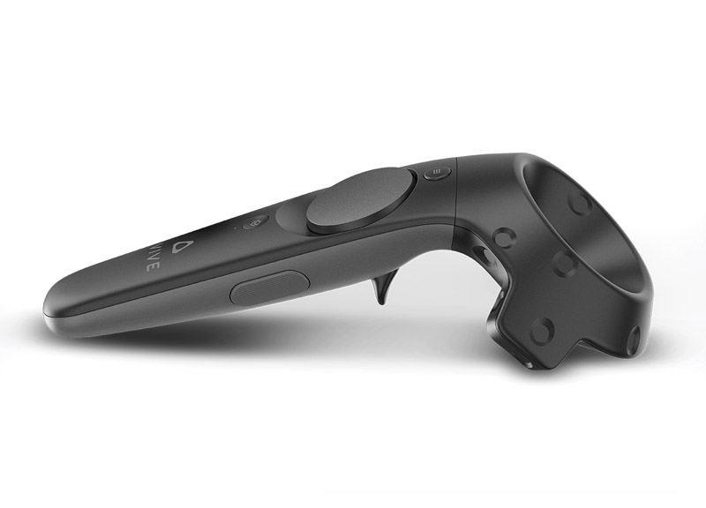
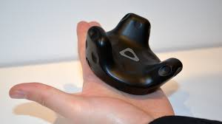
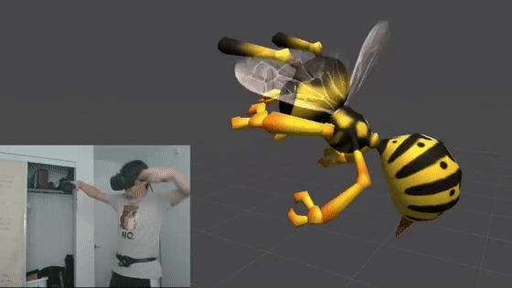
VR Controllers
Vive controller (HTC Vive)
6-DoF tracking
Symmetric design
3+1 usable buttons
Touchpad, Menu button
Trigger (analog, dual-stage)
Grip
HD haptic feedback
Microsecond haptic pulse
Vive tracker
6-DoF tracking to any object

Slide 27
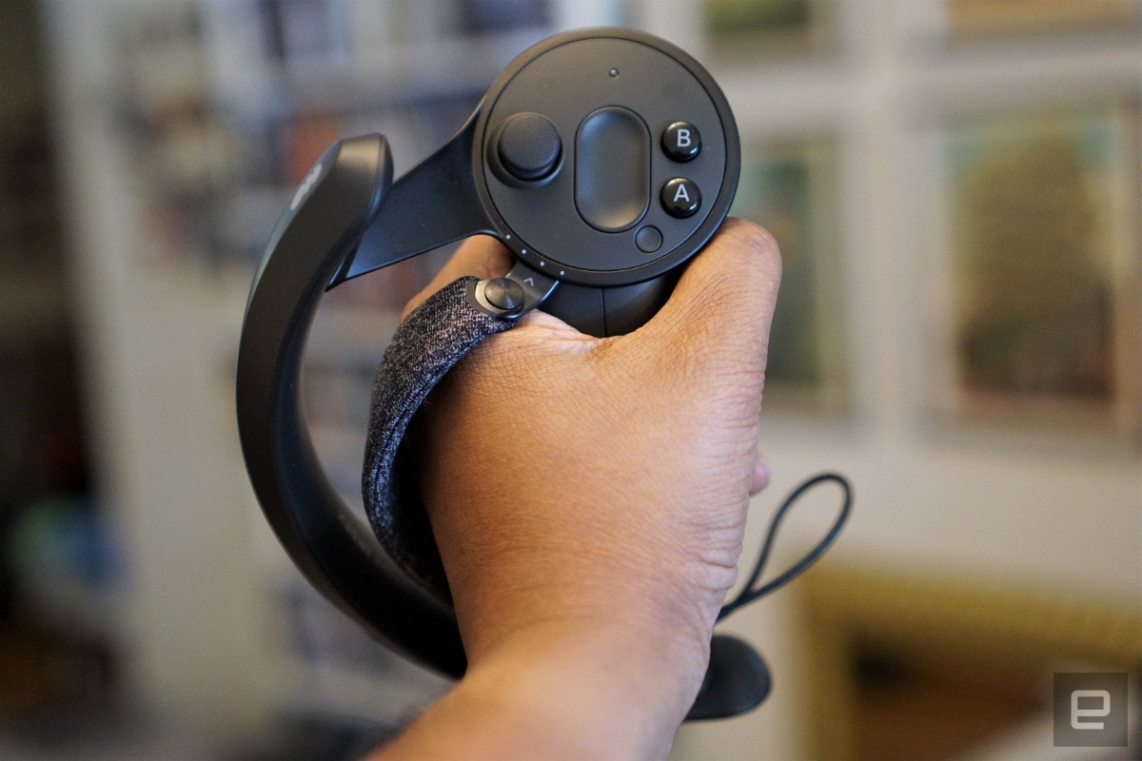
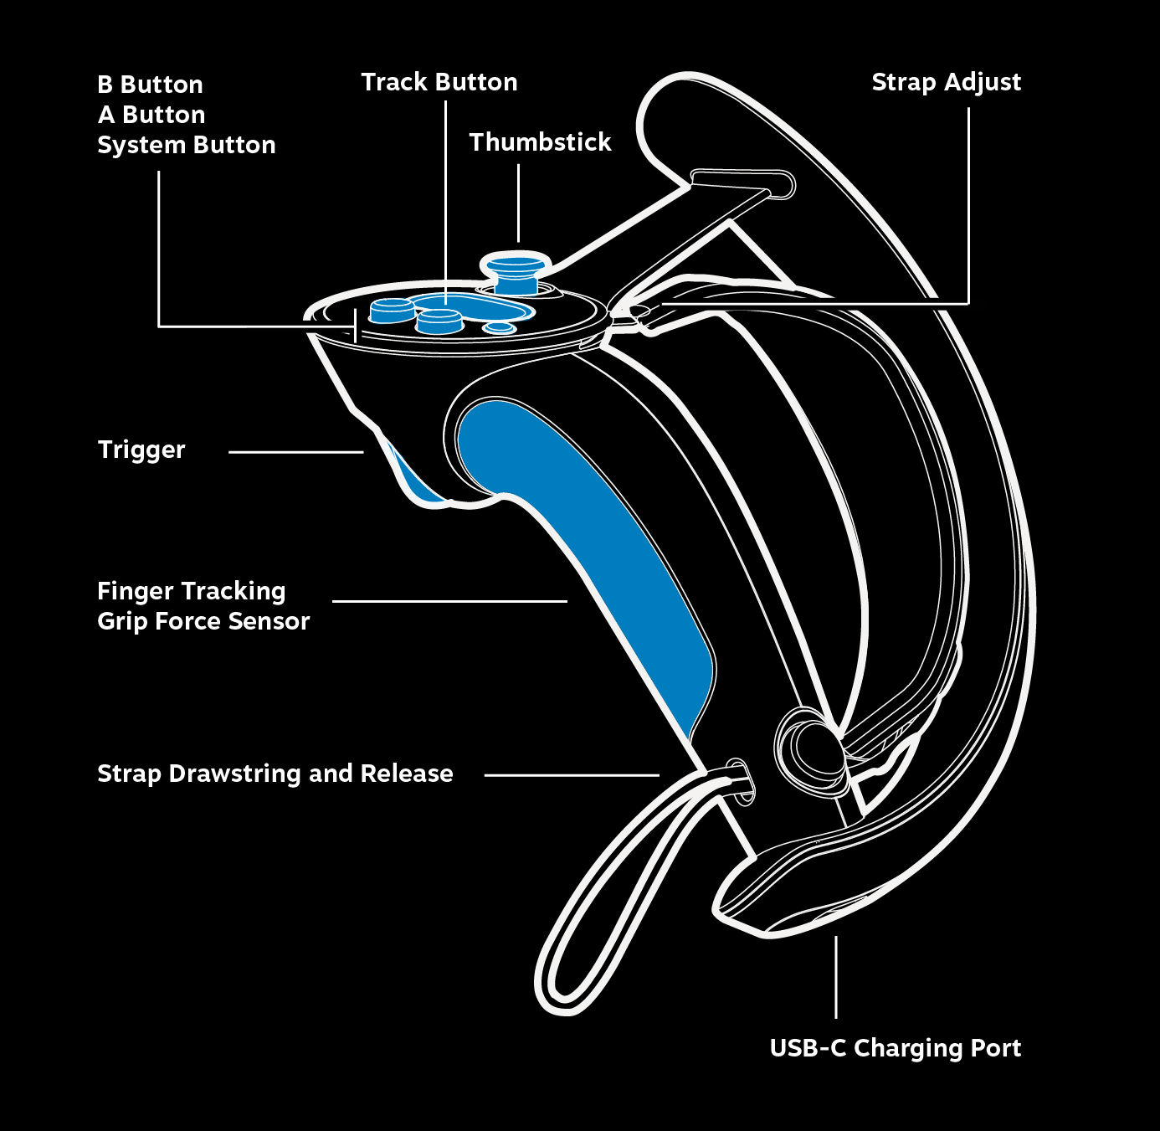
VR Controllers
Valve Index Controllers
6-DoF tracking
4+2 usable buttons
Thumbstick, track button, 2 face buttons
Trigger
Grip force sensor
Finger tracking

Slide 28
VR Controllers – Limitations
Lack of force feedback
Recall:
Constrained motion → Mismatch between virtual and physical hand
Beads on wire
Two-hand weapon (baseball bat)
Weight, touching, pushing, …
Haptic cues are limited (vibration)
Maximize other cues (visual + auditory)

Slide 29
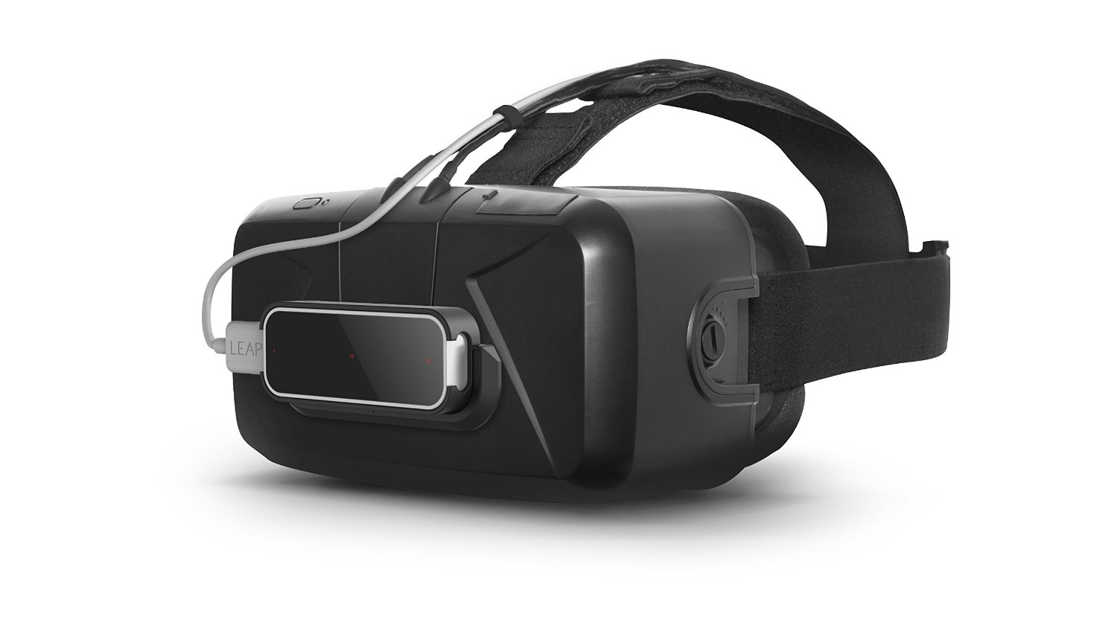
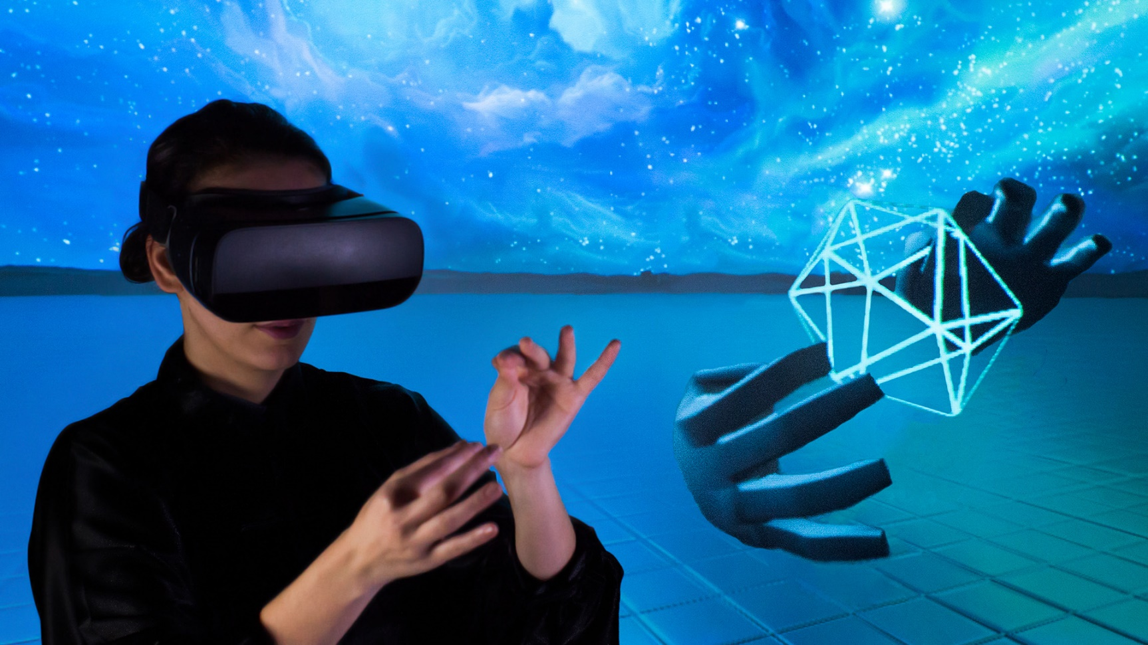
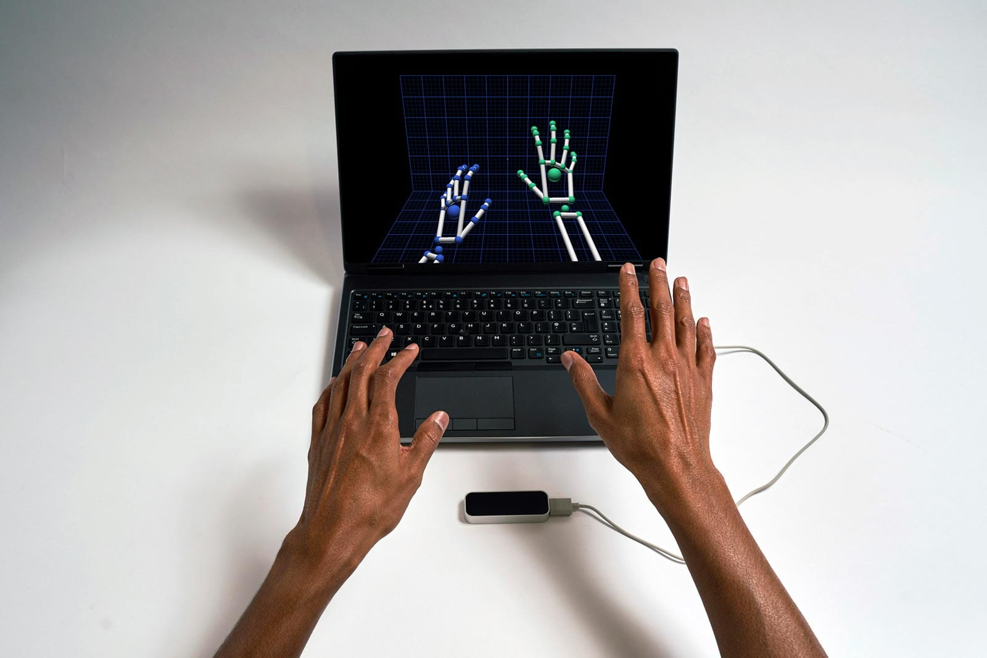
Experimental VR Controllers
Leap Motion
Full hand-tracking
High-precision control

Slide 30
Experimental VR Controllers
Nintendo LABO: VR Kit
Task-specialized add-ons
Rich tactile feedback

Slide 31
Summary
VR games require extensive UI/UX design phase
(What kind of experience will the game give to users?)
How to minimize discomfort?
VR sickness, eye strain, muscle fatigue, …
How to maximize immersion?
UI element placement, primary interaction, …
Need various research to answer such questions
Hardware survey
Case study
Either good ones, or bad ones

