Slide 1
하제인의 게임
22 ChEcKeN (Enrique)

Slide 7
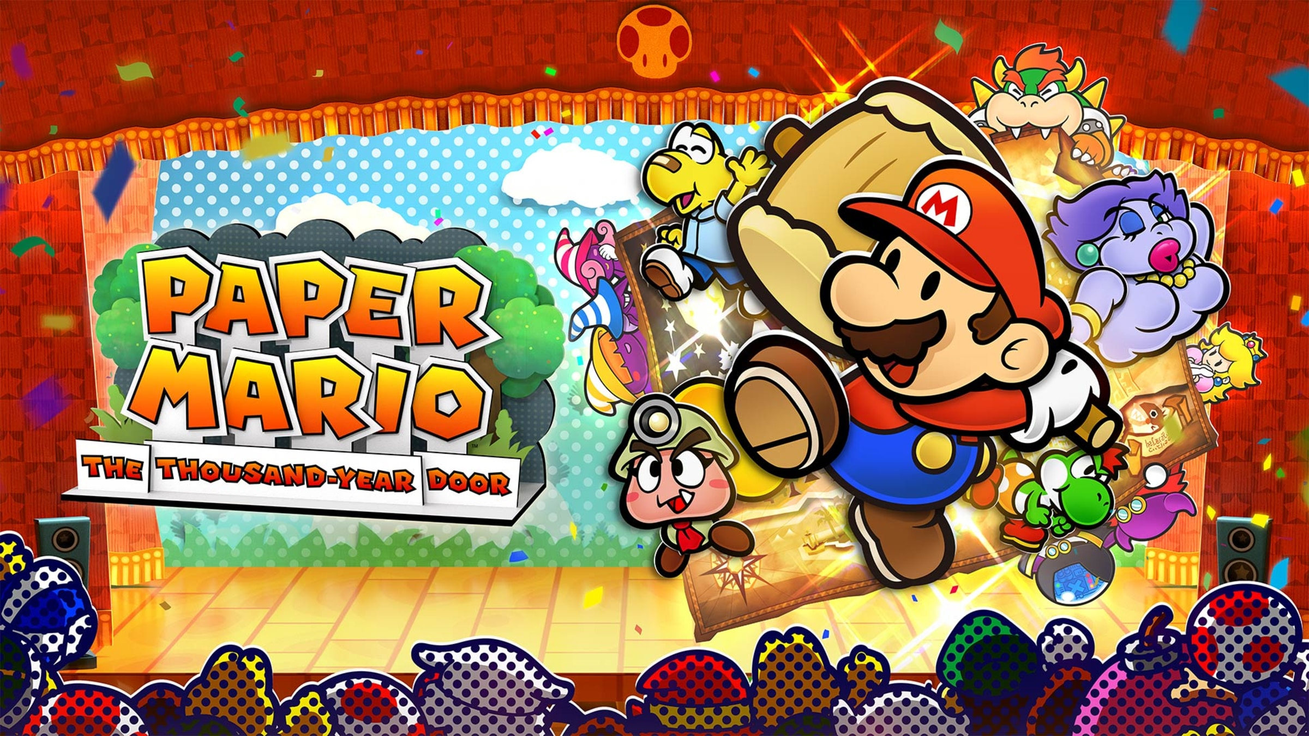

Slide 8
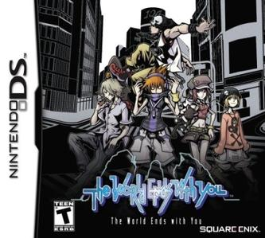
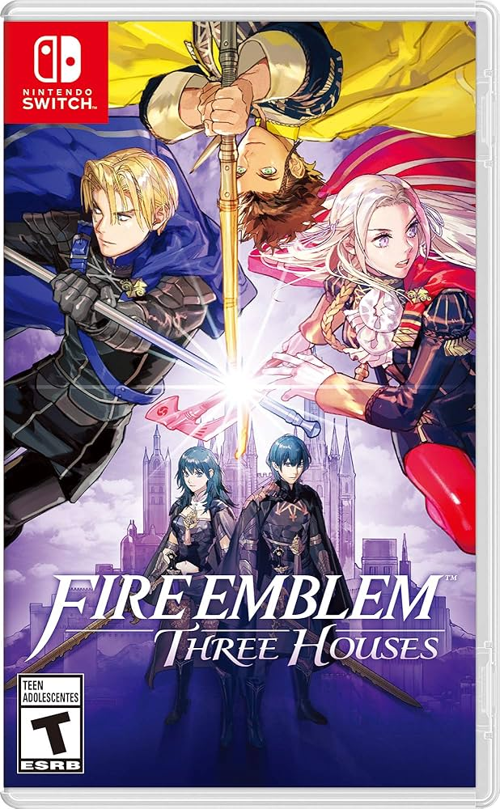
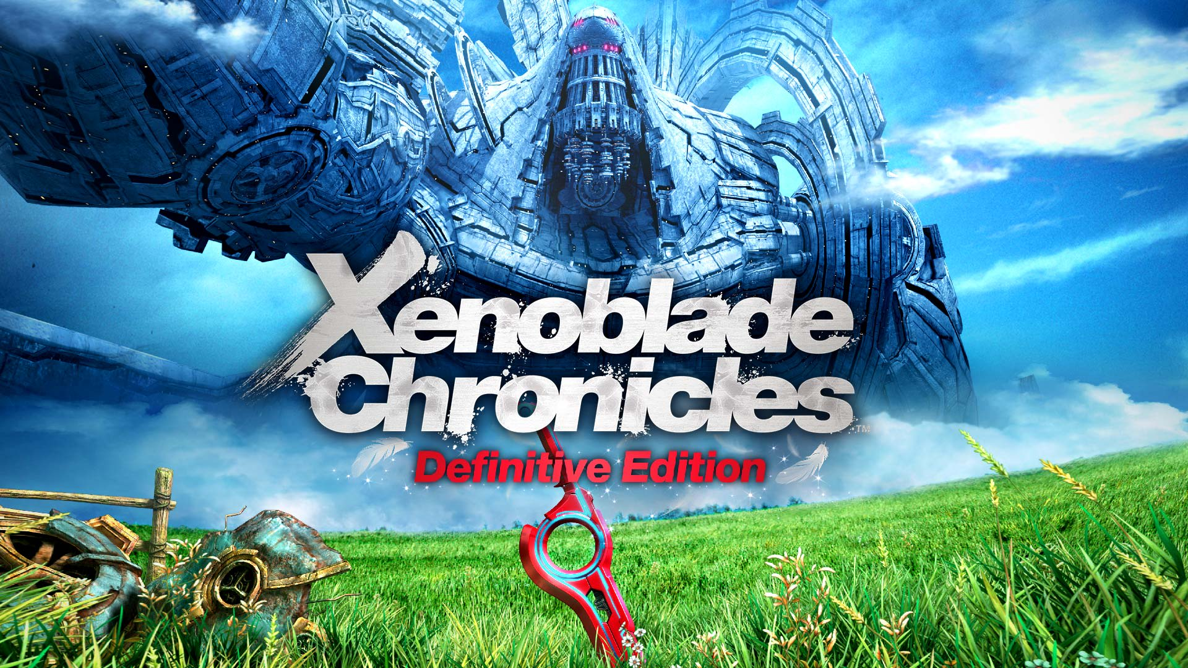
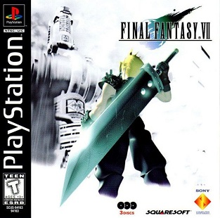
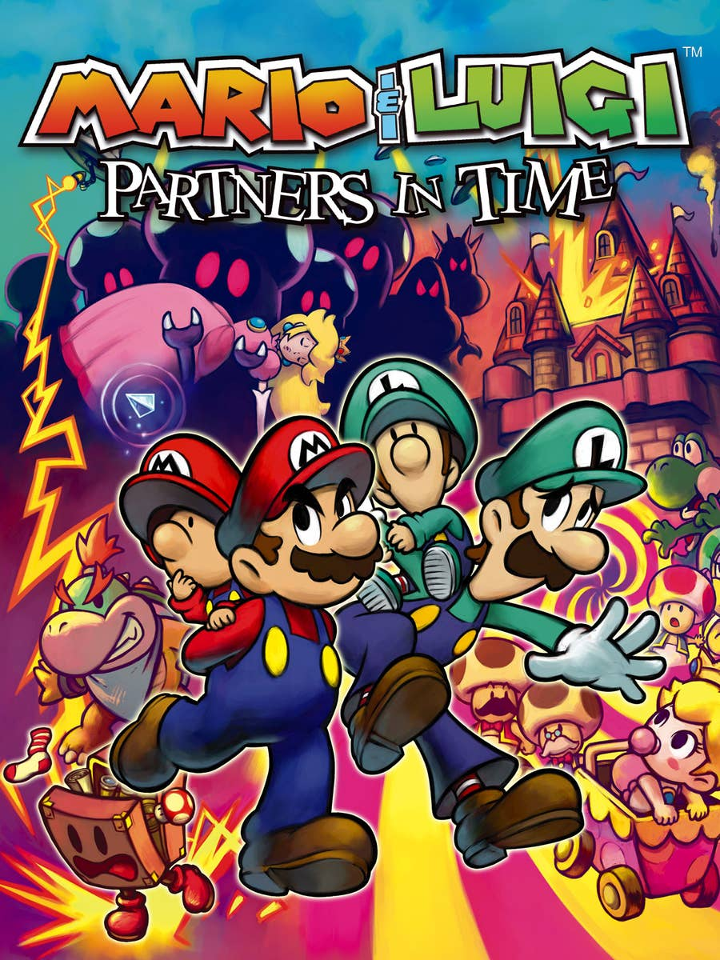
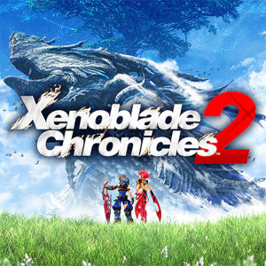
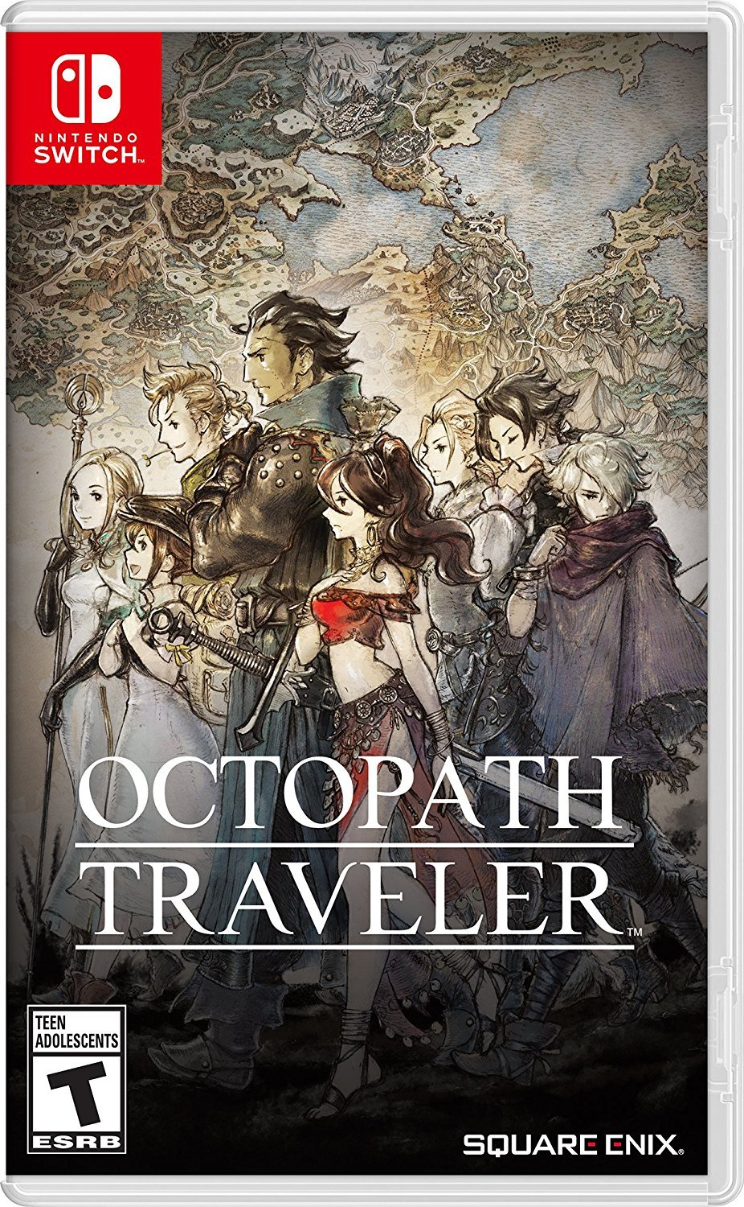
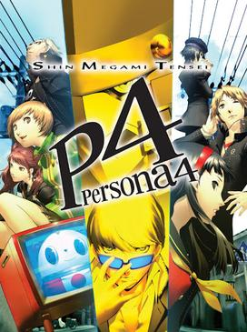
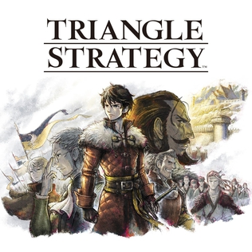
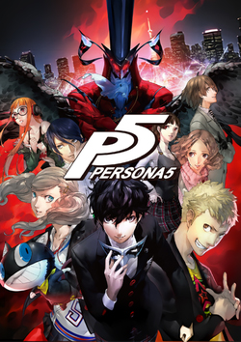
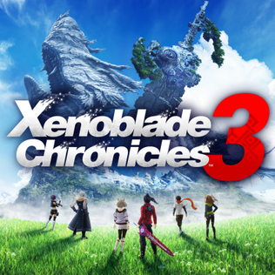
My favorite game of all time
Second favorite game of all time (probably)

Slide 9
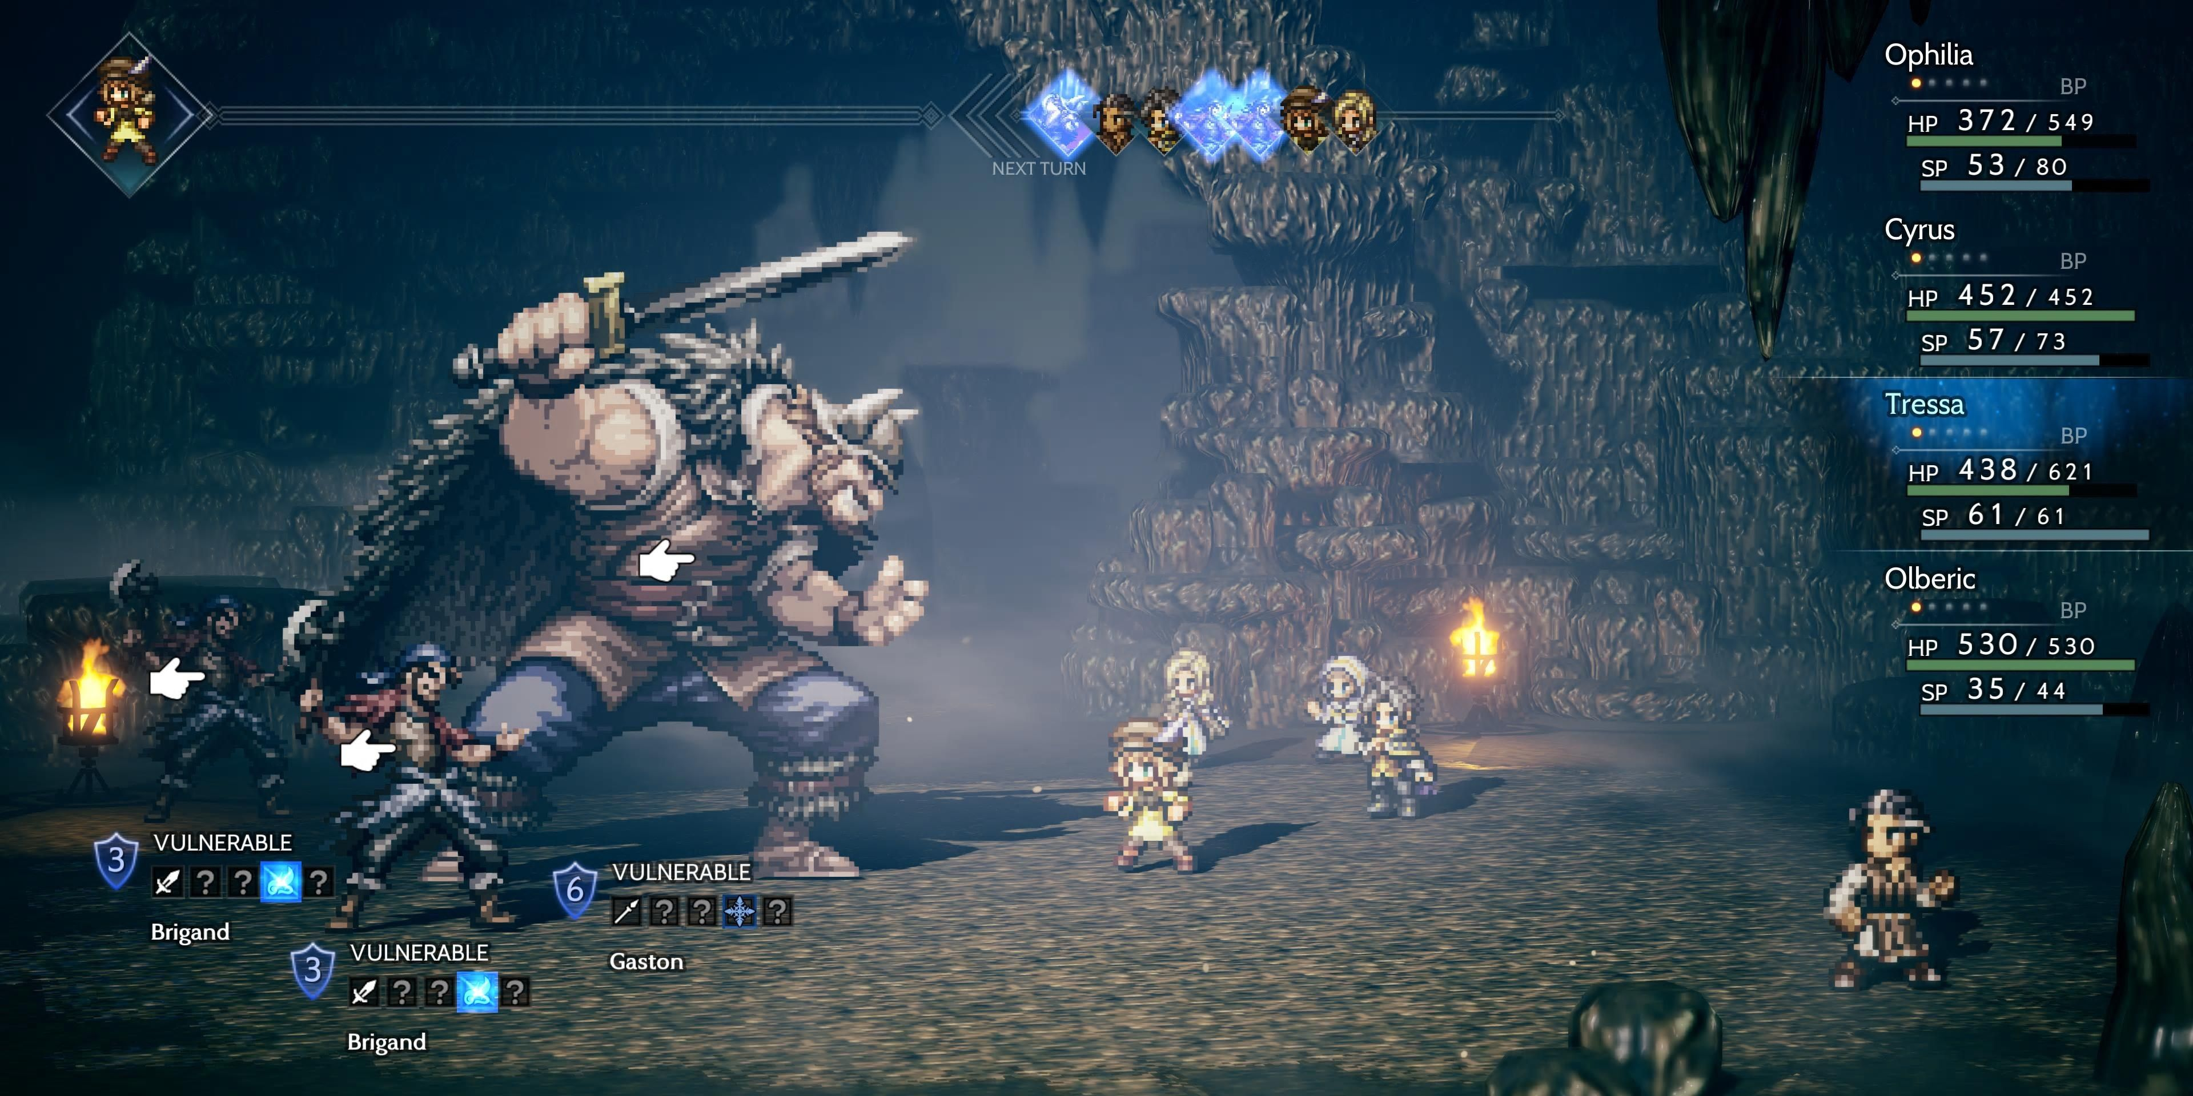
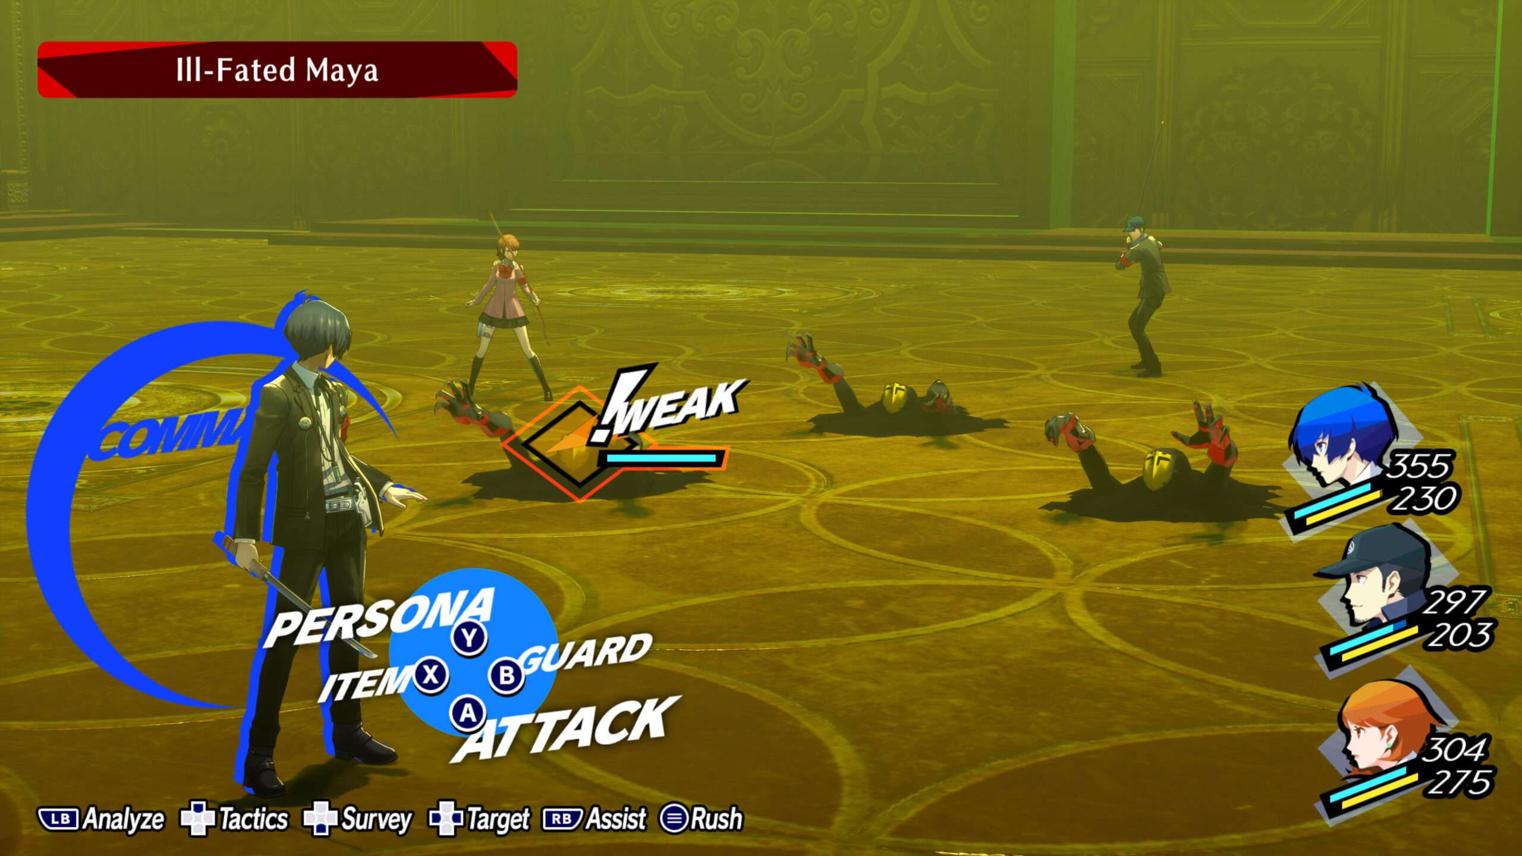
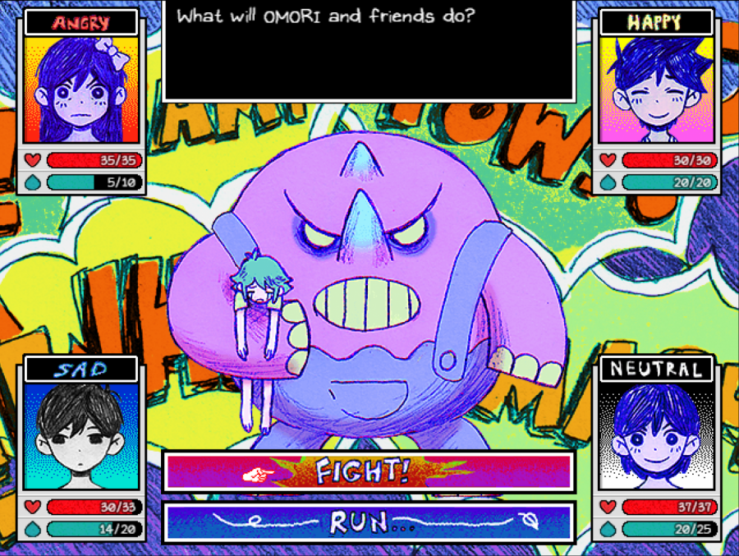
What makes Turn-Based Battles fun?
Strategy!!!!
Feeling epic!!!!

Slide 10
The Problem
This game’s epic.
You never see it comiiiiiiiiiing
A few non-Boss battles later…
Buff > Attack > Win

Slide 11
What makes Mario RPGs better?
ACTION COMMANDS!!!

Slide 12
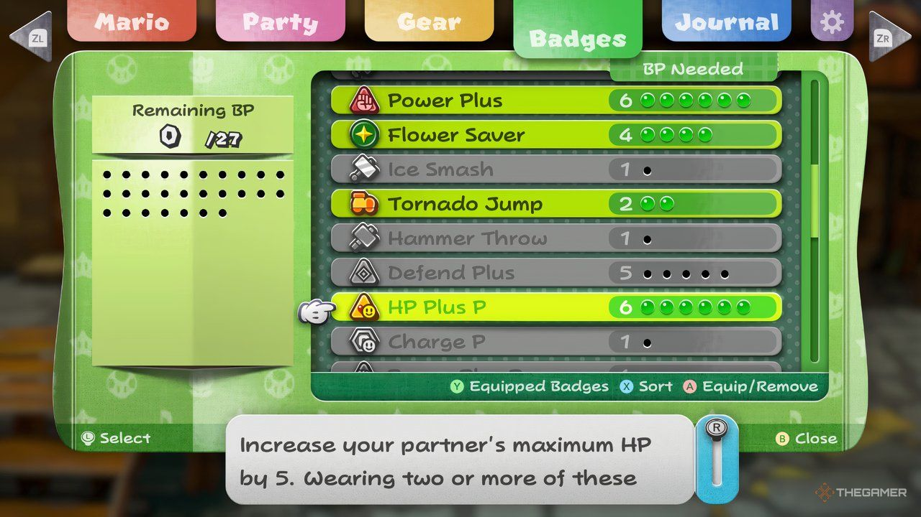
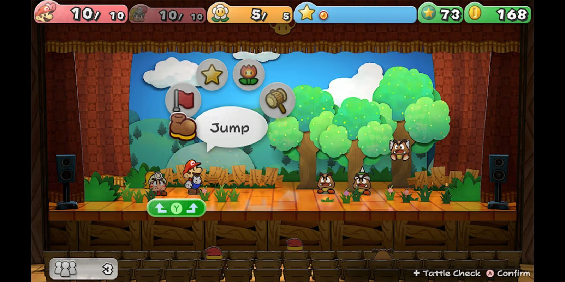
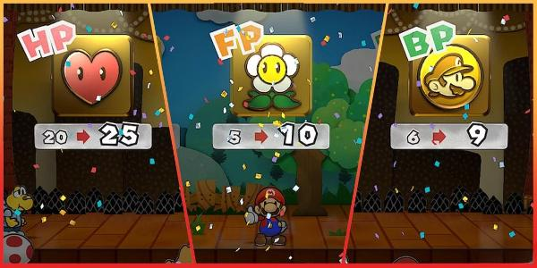
Battle System

Slide 13
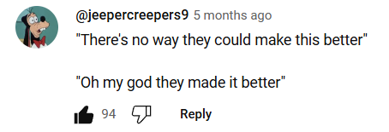
Soundtrack

Slide 14
Soundtrack
Rogueport Theme: https://youtu.be/WtcEaDF7dqQ?si=NxvO3ju5vGxPsXTY
Battle (Chapter 1): https://youtu.be/BNADk_-PJ38?si=E9DVVXjpQFEx_OOD
Battle (Chapter 6): https://youtu.be/uOCAAgEl2p4?si=mvOeq-10_8zfpJ75

Slide 15
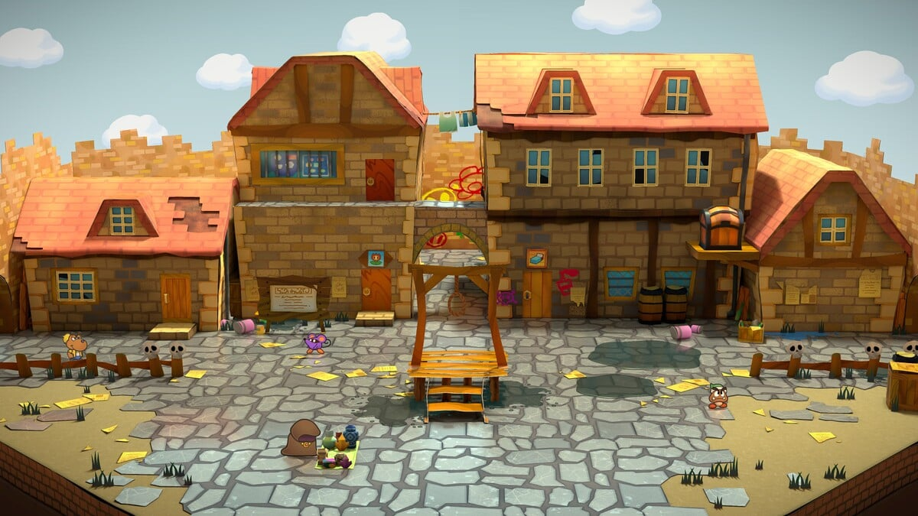

Slide 17
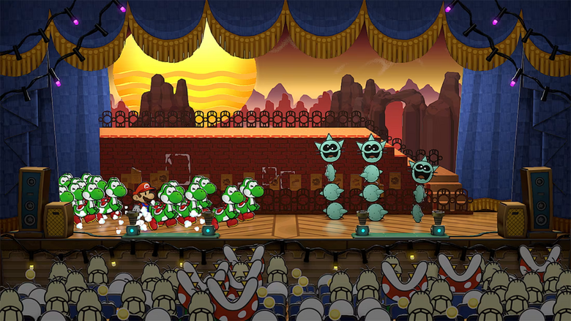

Slide 18
Soundtrack (stick with me)
Hall of the Thousand-Year Door (Prologue): https://youtu.be/xC7yiiuoQ2k?si=eHRYsygj41ZifZ5A
Hall of the Thousand-Year Door (Chapter 3): https://youtu.be/4jYtsZizVwA?si=2pt3NwVNVzvwMOnj

Slide 19
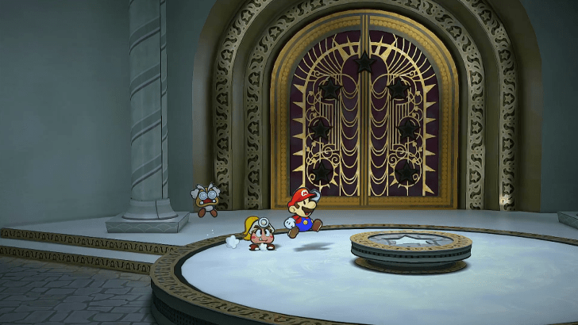

Slide 20
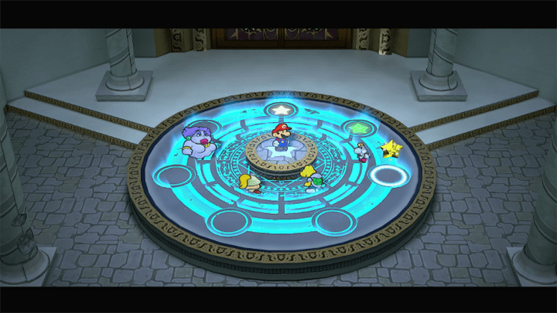

Slide 21
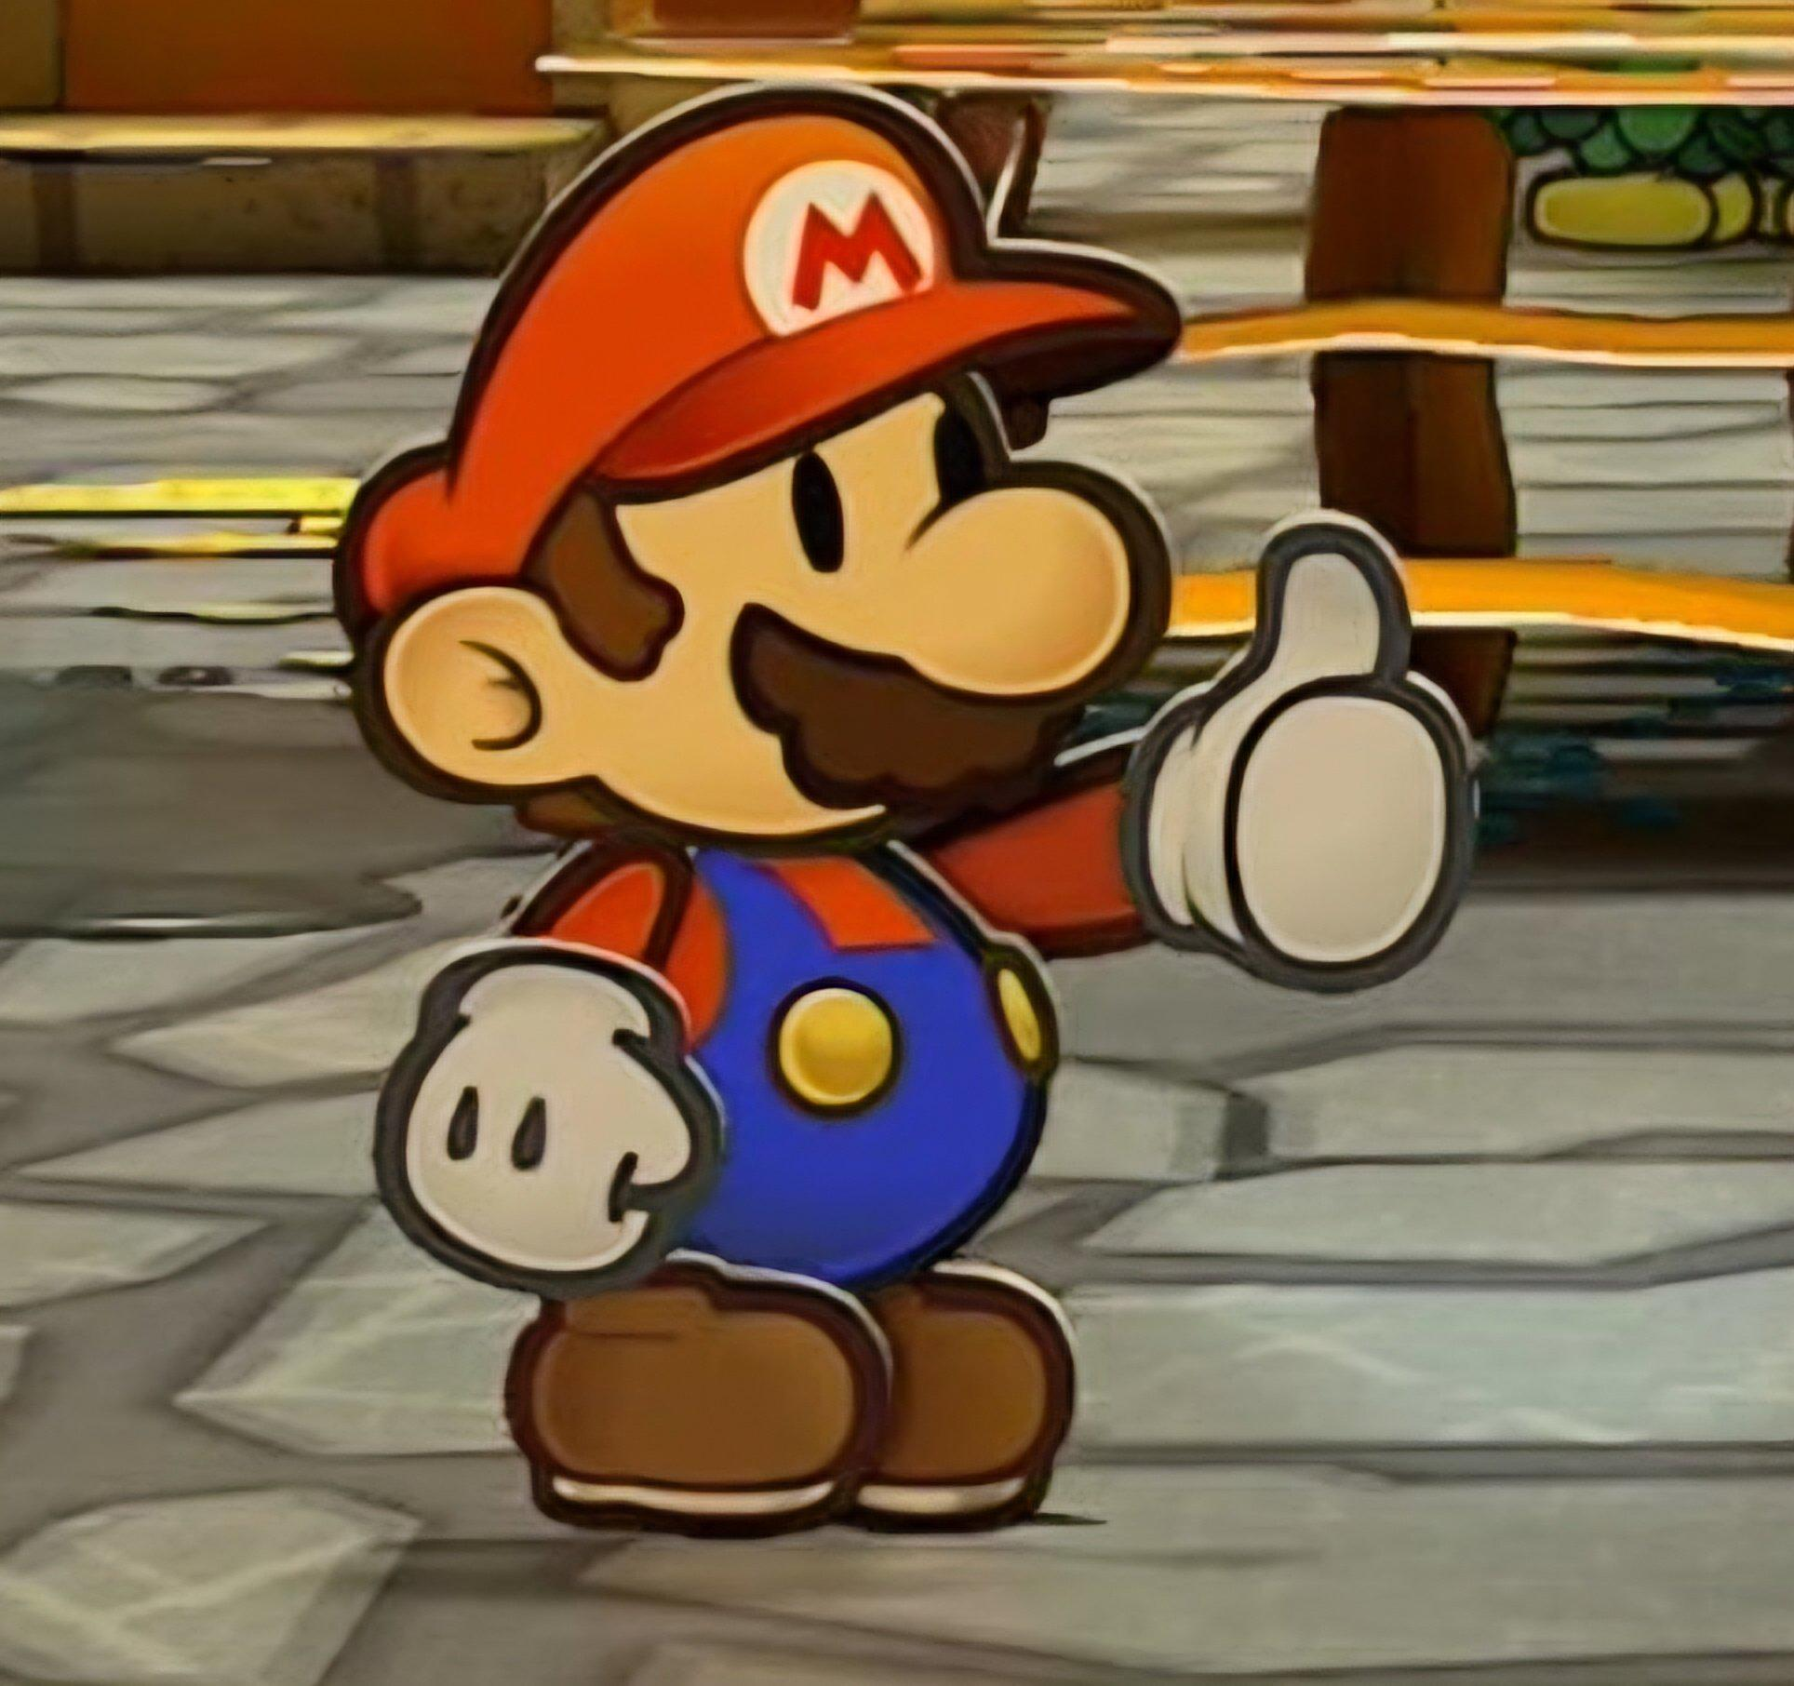
Thanks, please play the game

