Slide 1
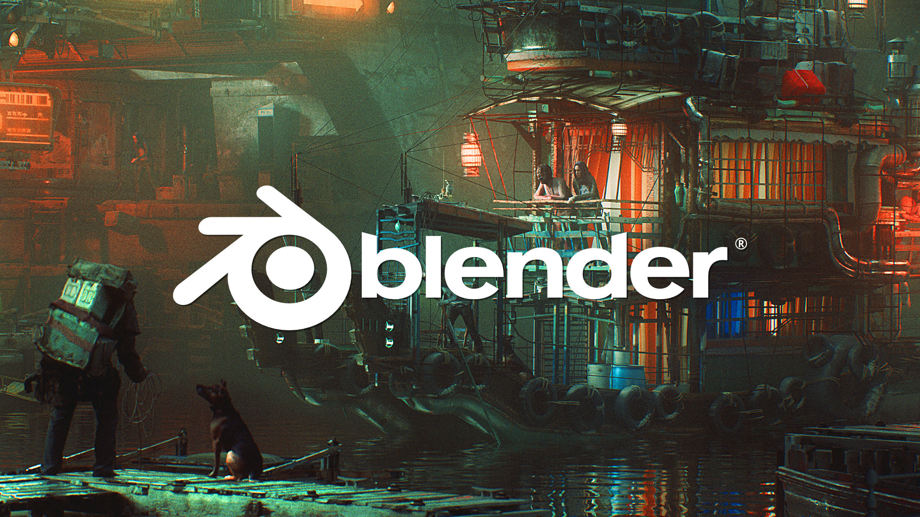
3D Game Art Overview
#project_vr_something

Slide 2
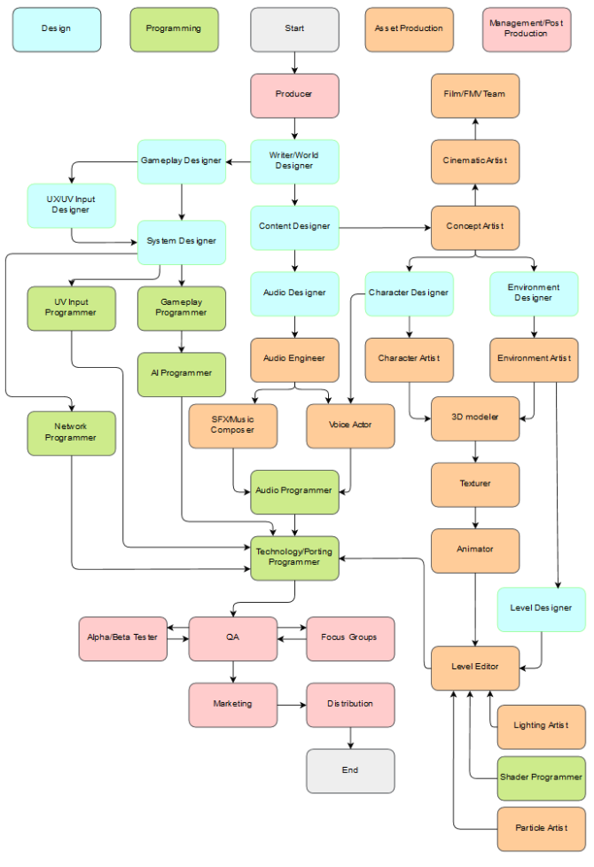
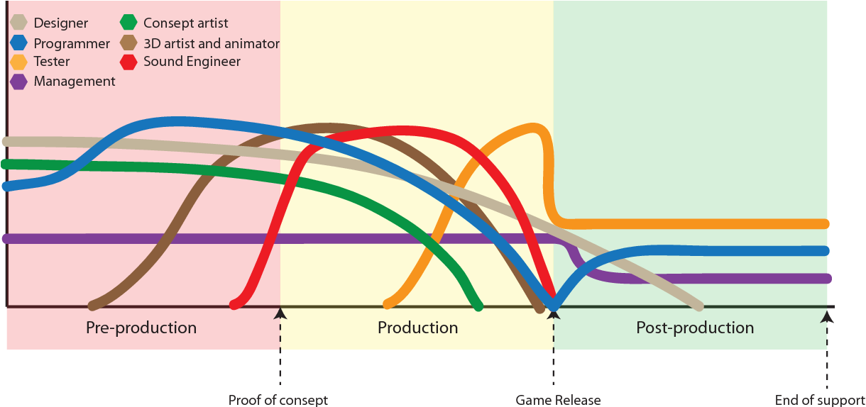
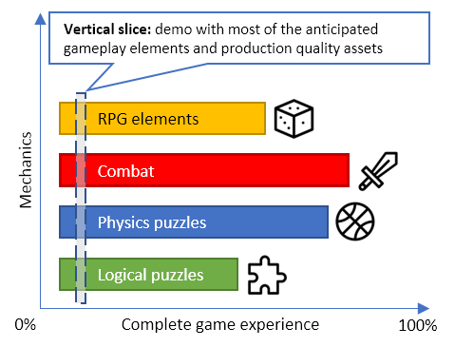
Game Development Process

Slide 3
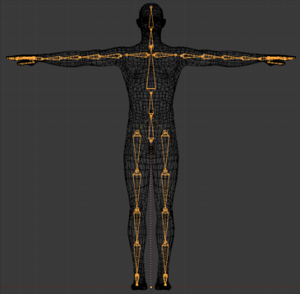
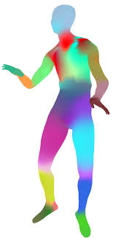
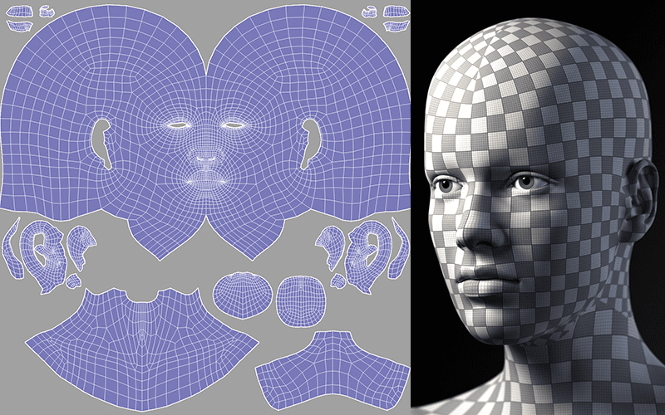
How 3D Graphics Work
Rig
Mesh
Texture
Skinning
UV Mapping
Pose parameterization
of moving things
Shape of things
Visual details of things
Textures
Posed rig
Animation Engine
Renderer
Deformed mesh
Rendered image
Mesh
(Lightings)

Slide 4
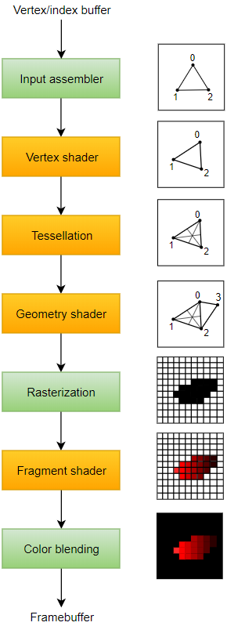
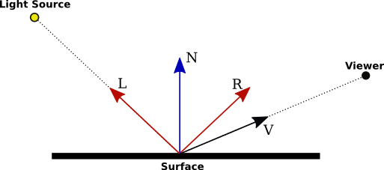
How 3D Renderer Works
Virtual light
Albedo
Specular
Occlusion
Normal
…
Virtual camera

Slide 5
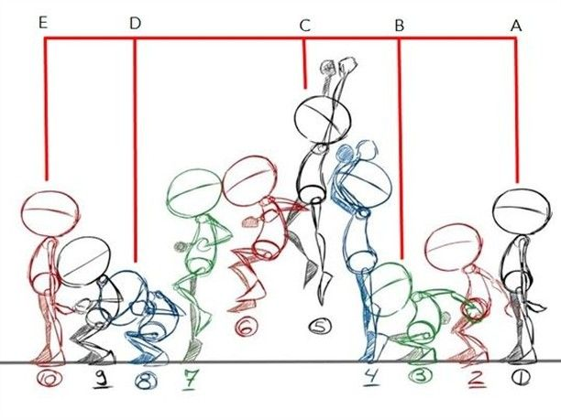
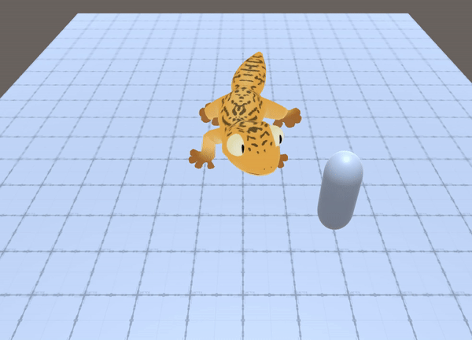
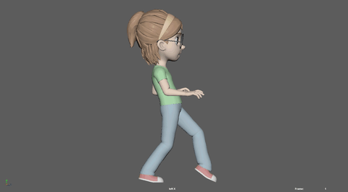
How 3D Animation Works
Keyframe animation
Procedural animation

Slide 6
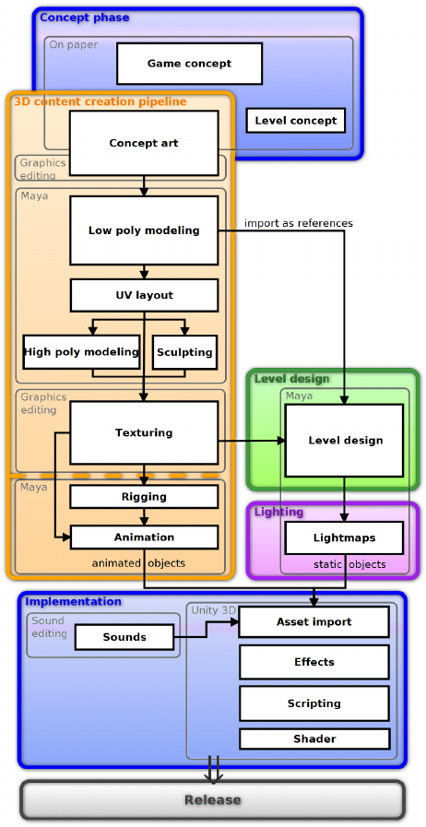
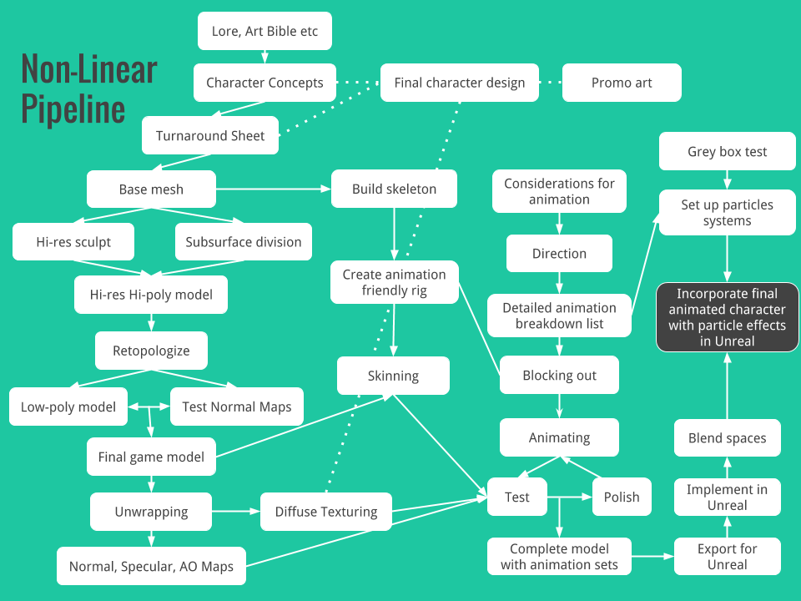
3D Game Art Pipeline
Rigging
Animation
Modeling
Texturing

Slide 7
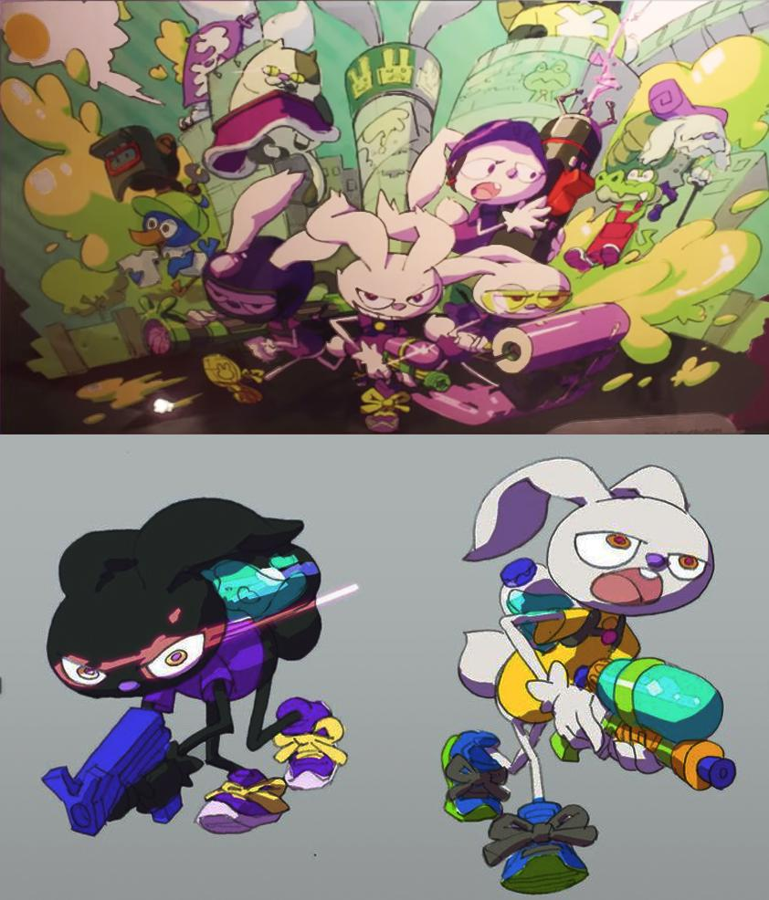
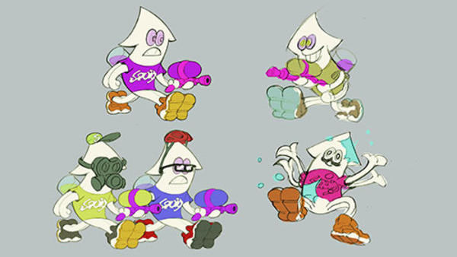
3D Game Art Pipeline – Concept Art

Slide 8
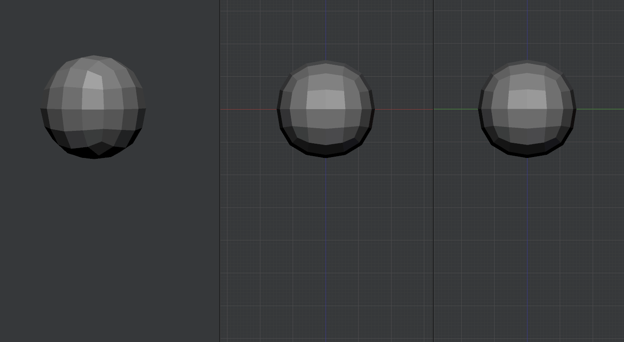
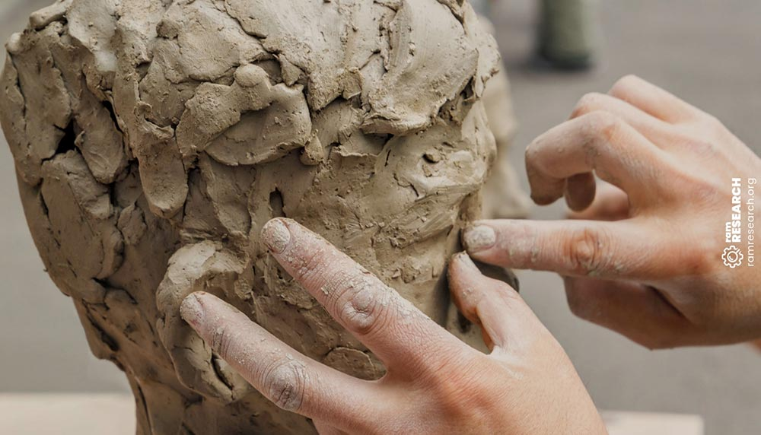
3D Game Art Pipeline – Sculpting

Slide 9
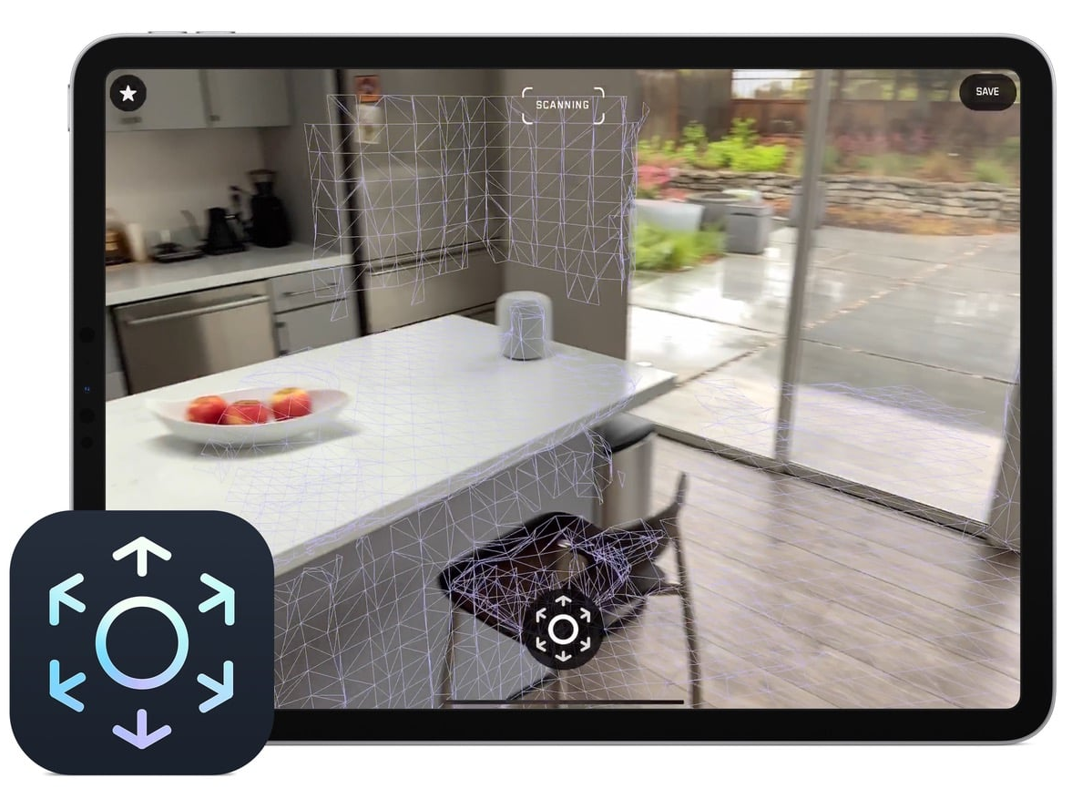
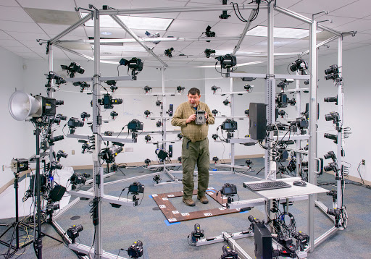
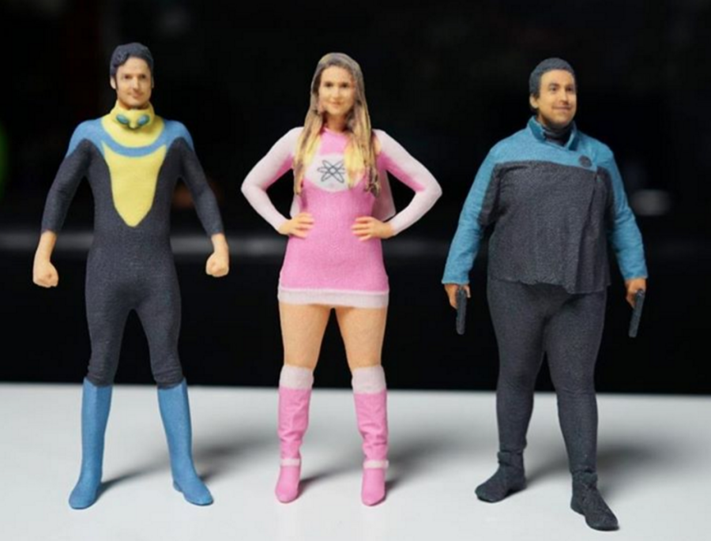
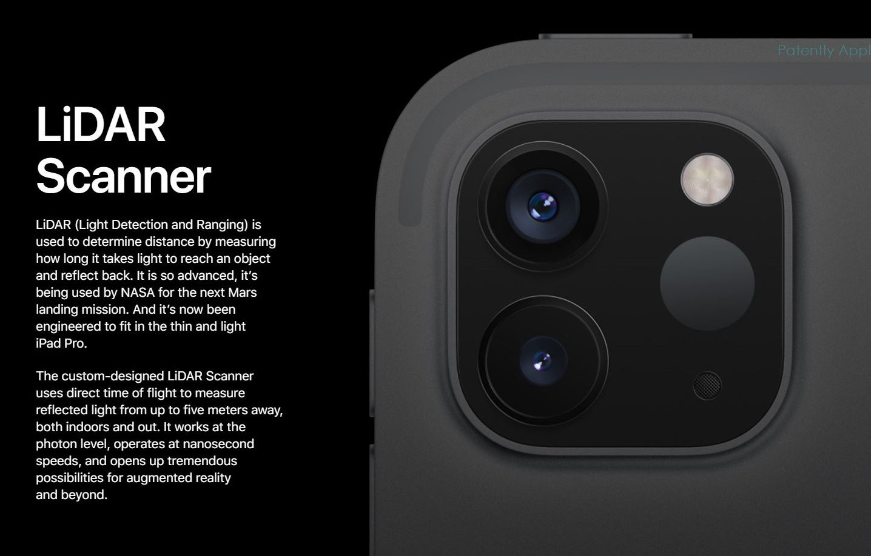
3D Game Art Pipeline – 3D Scanning

Slide 10
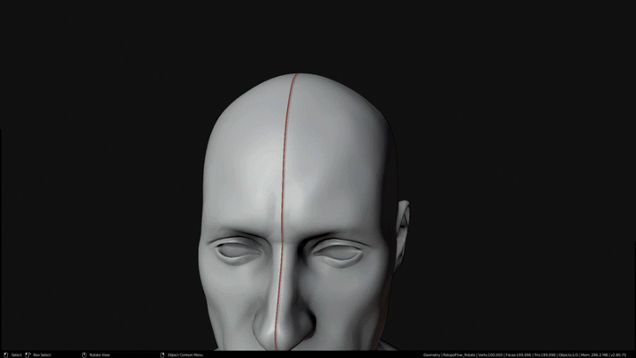
3D Game Art Pipeline – Retopology

Slide 11
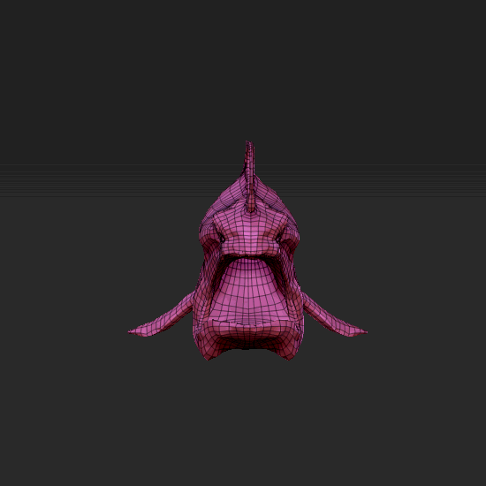
3D Game Art Pipeline – UV Mapping

Slide 12
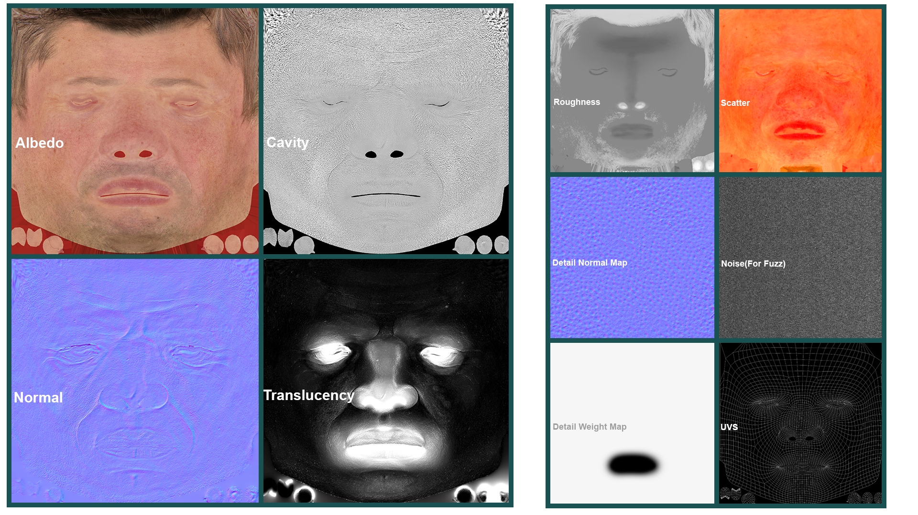
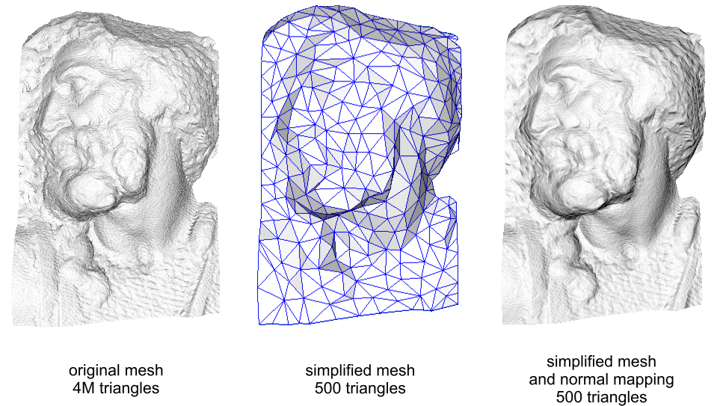
3D Game Art Pipeline – Texturing

Slide 13
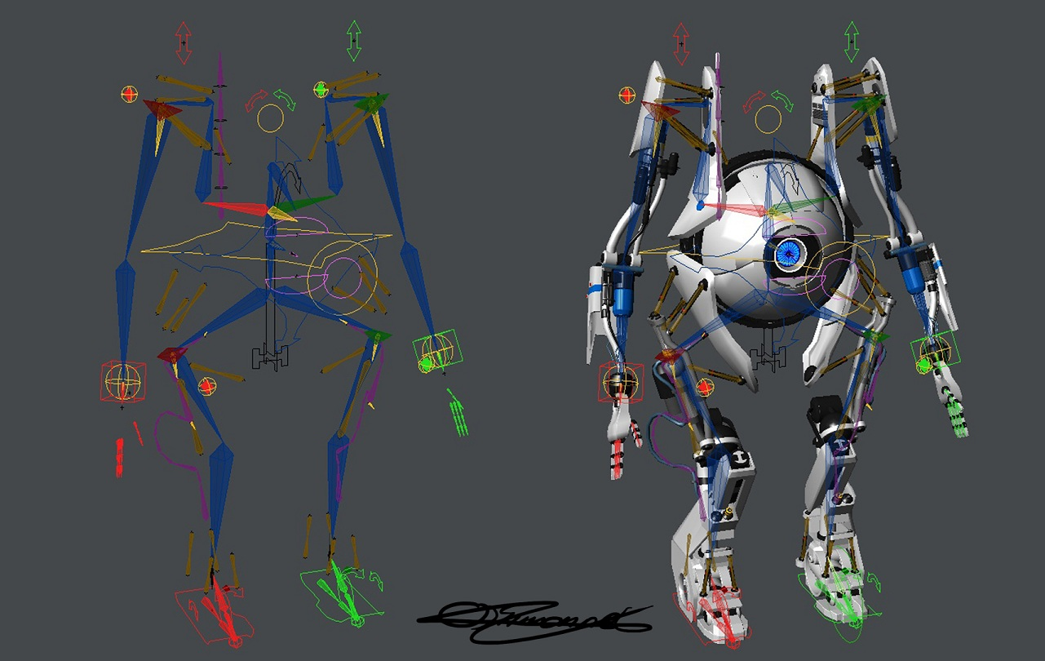
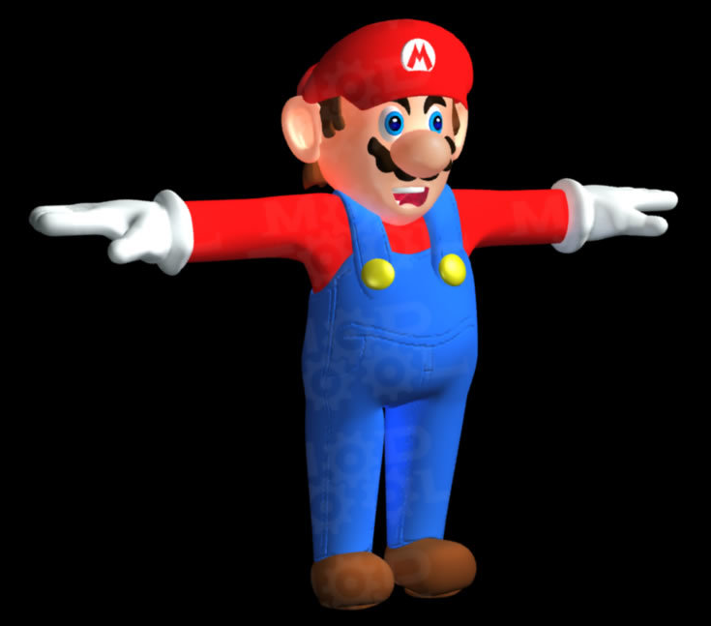
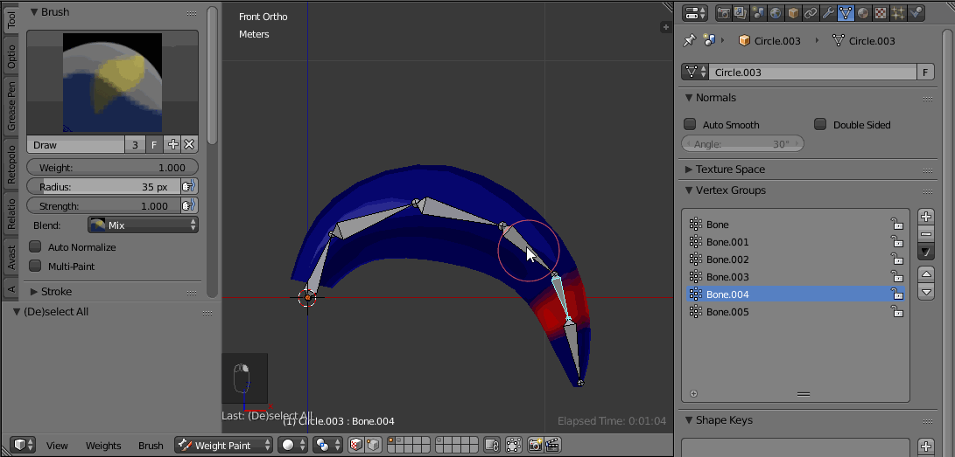
3D Game Art Pipeline – Rigging & Skinning

Slide 14
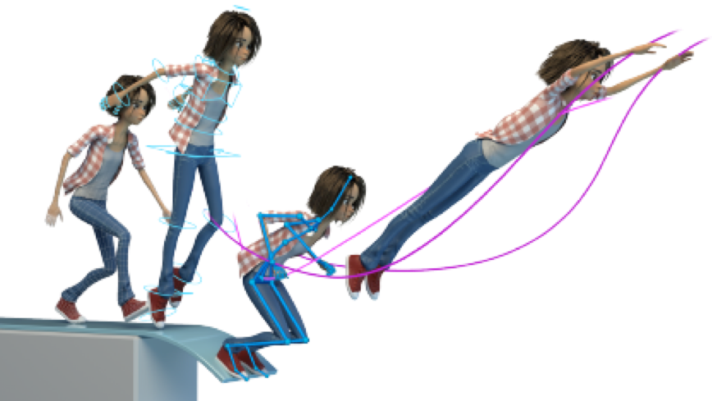
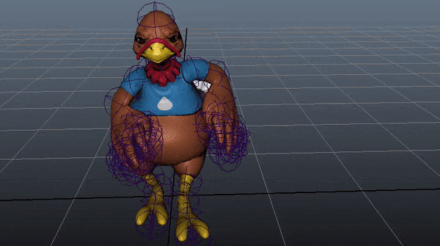
3D Game Art Pipeline – Animation

Slide 15
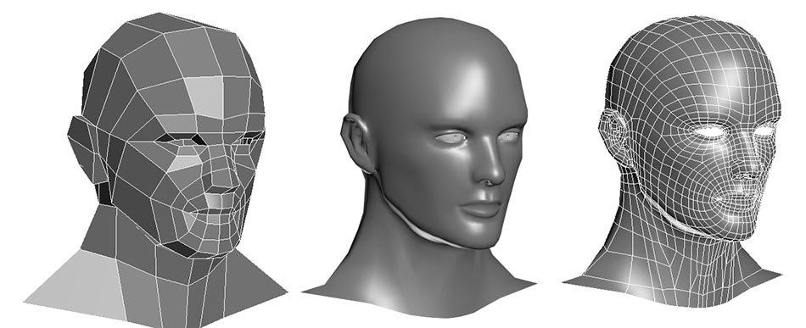
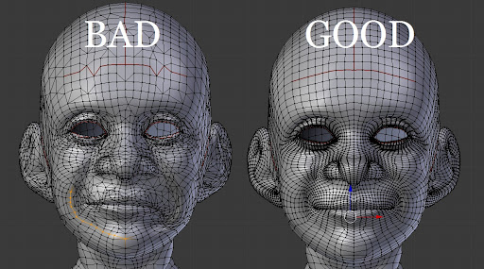
Technical Challenges – Modeling
Good topology vs Bad topology
Watertight
Edge flow
Extra edges near joints
…
Polygon count

Slide 16
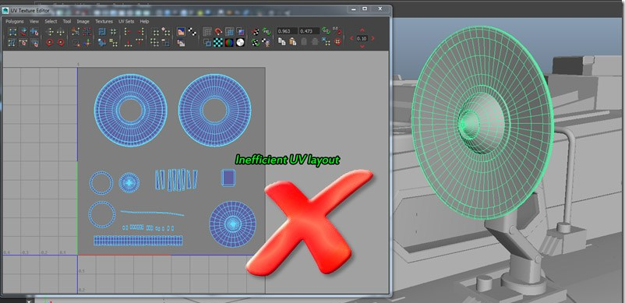
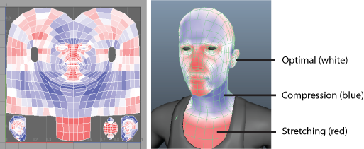
Technical Challenges – UV Mapping
Minimize seams/distortion/overlap
Efficient layout

Slide 17
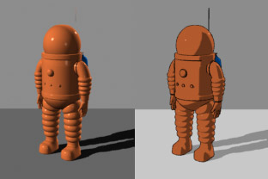
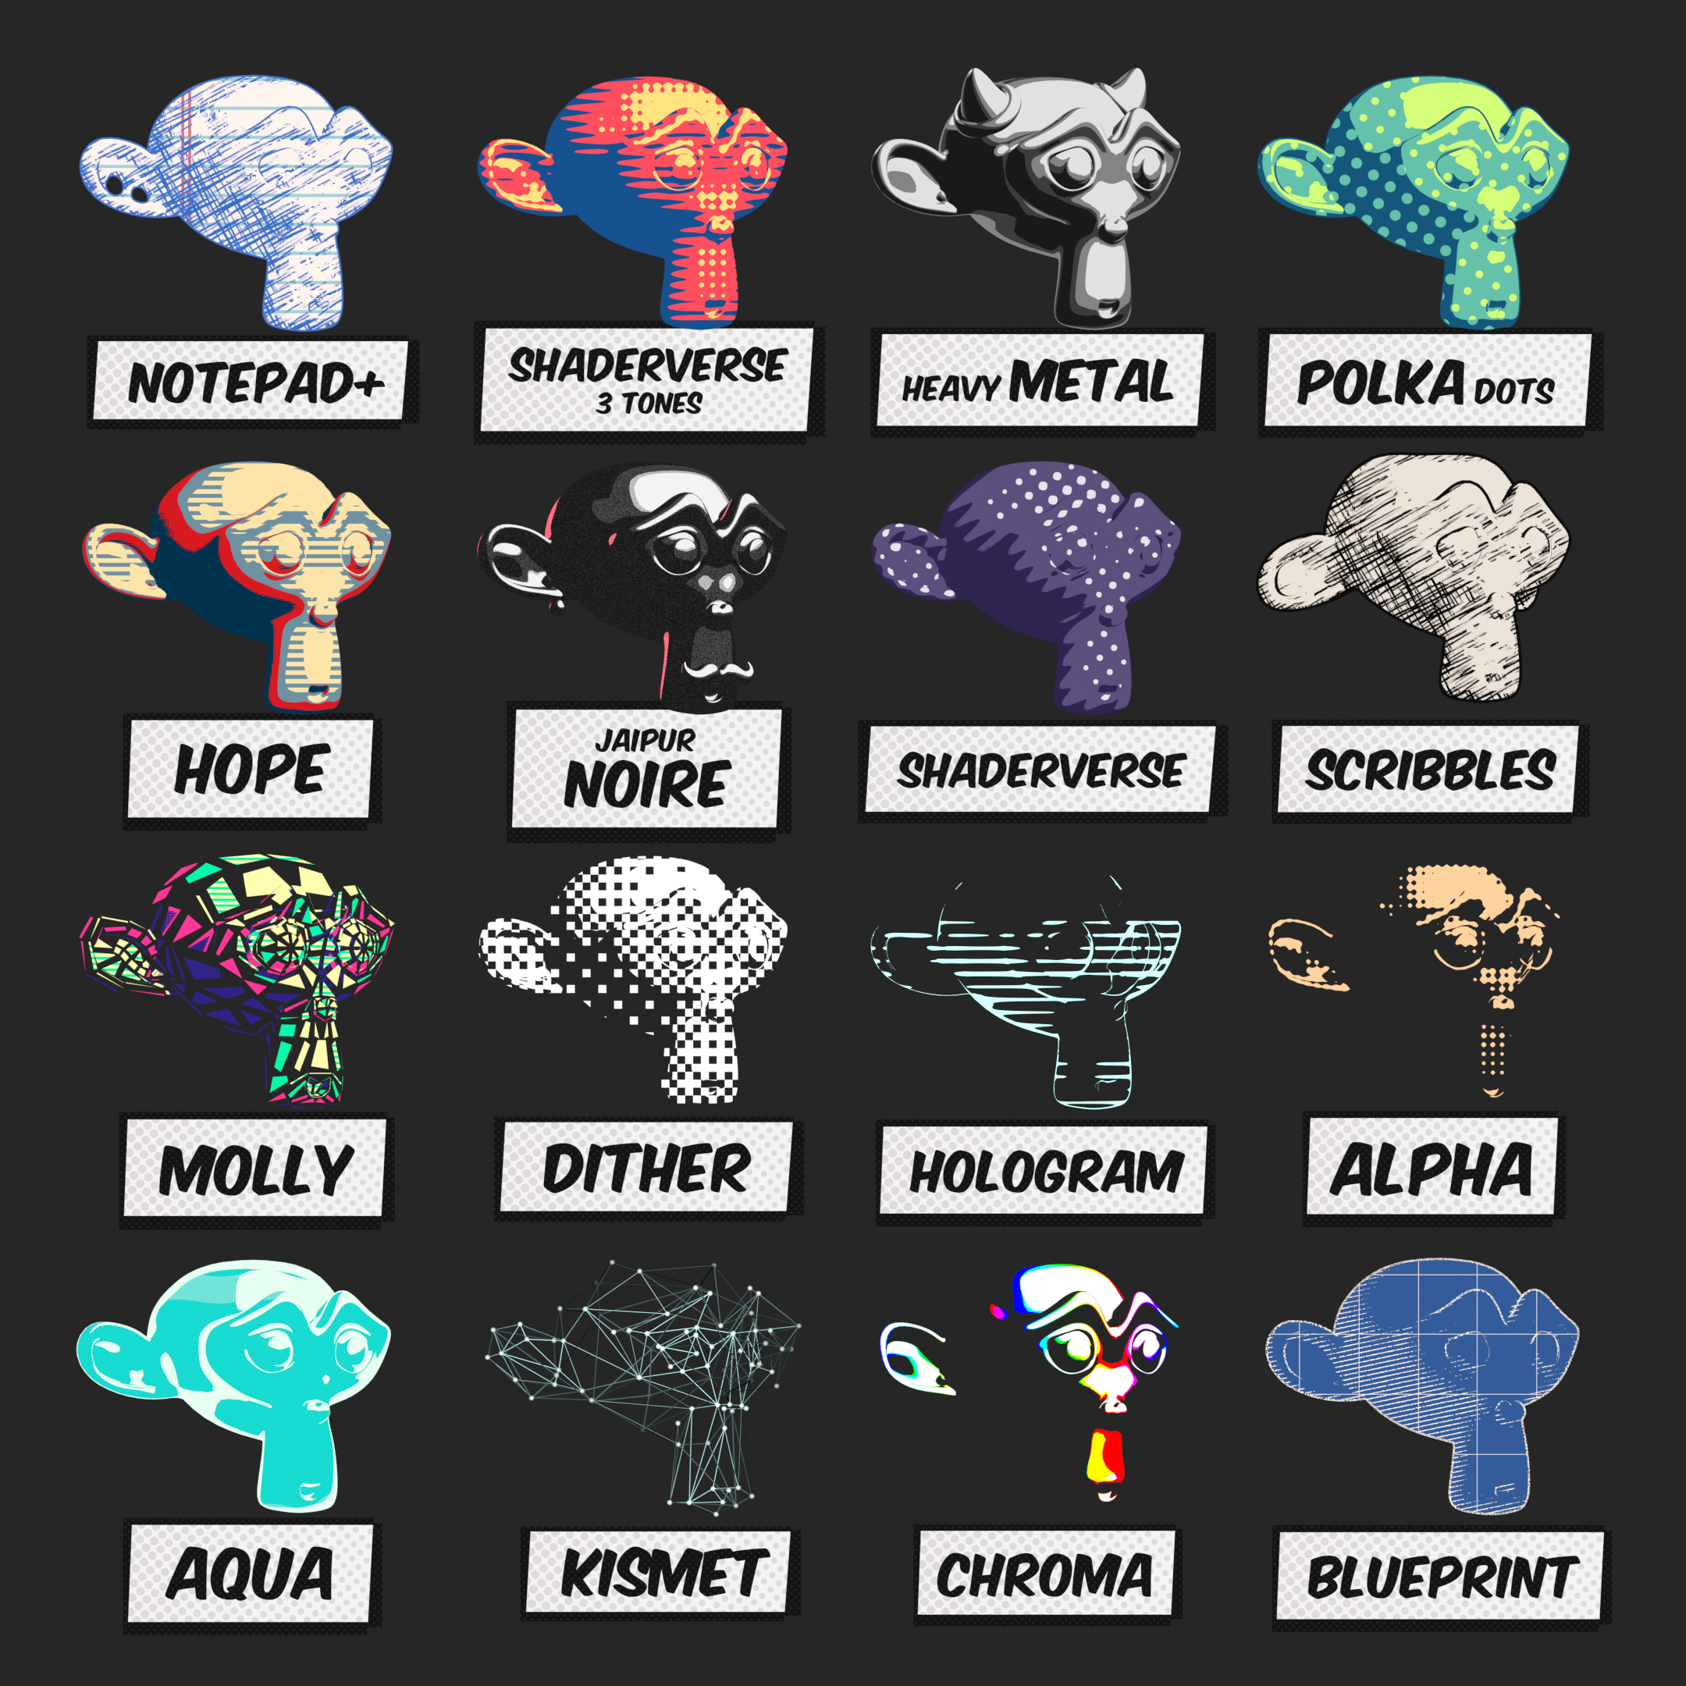
Technical Challenges – Texturing
Material parameterization
Physically-based rendering
Non-photorealistic rendering

Slide 18
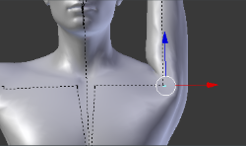
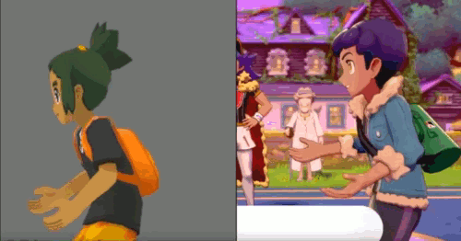
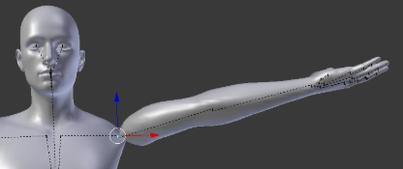
Technical Challenges – Rigging & Skinning
Expressive vs Complicated
General-case rig / special-case rig
Reusable rig
Common artifacts
Extreme bending → Bulging
Extreme twisting → Candy-wrapper

