Slide 2
Overview
Developed by Lucas Pope(creator of papers please)
First person detective game/murder mystery
Set in the 1800s on board an East India Company ship
Has a unique approach to deduction that is different
One-of-a-kind art style

Slide 4
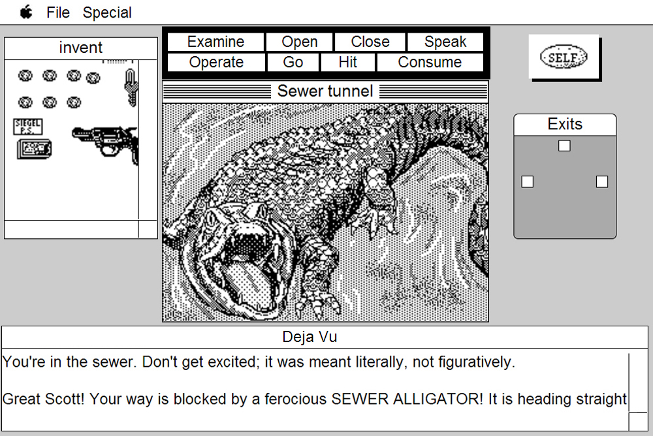
1-bit monochrome graphics
Retro feeling
Inspired by old games such as macintosh era games
Creates a dreary atmosphere that adds to the mystery of the game
Makes the player focus on the details of the scenes
Déjà vu, a classic macintosh game

Slide 5
Many themes

Slide 6
Premise

Slide 7
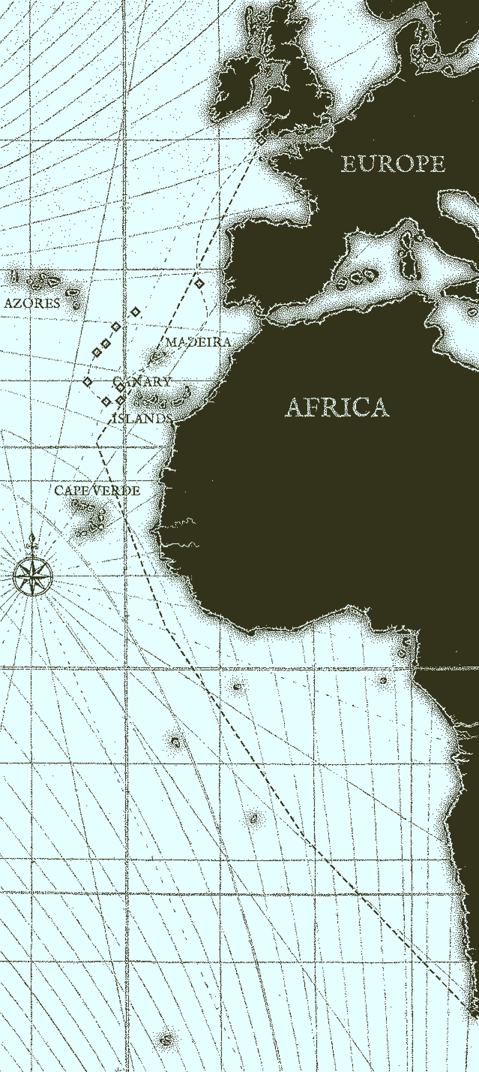
Obra Dinn sets off from London in 1802
5 years later it appears back at shore, completely empty

Slide 8
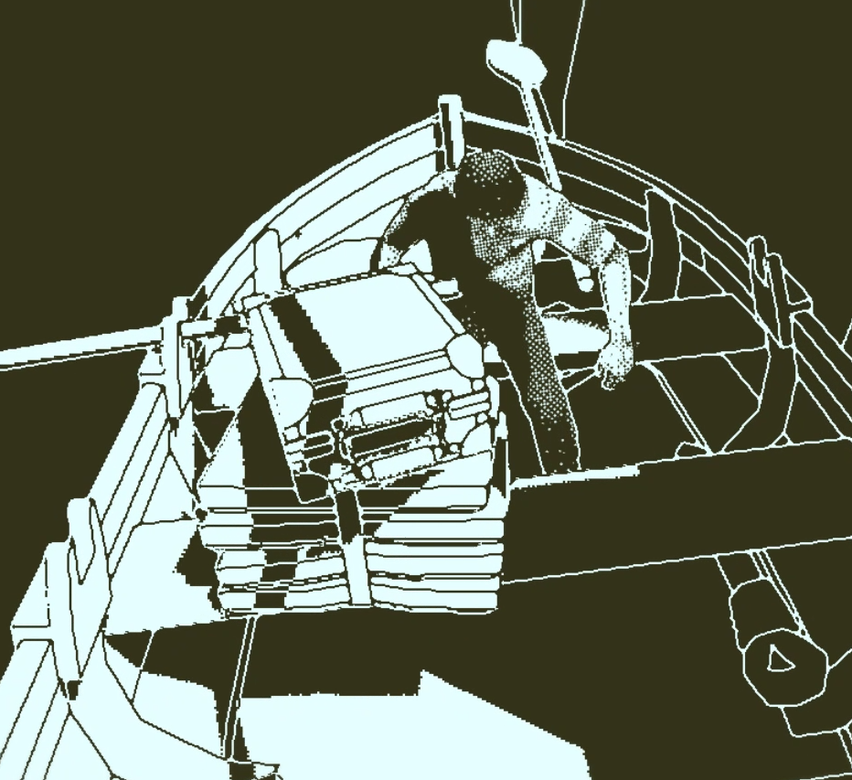
You are an insurance agent tasked with investigating what happened on the ship
You are given a suitcase with two items and are sent on a ferry to the Obra Dinn
Ferry and the suitcase

Slide 9
Your main job is to find how every single crew-member died

Slide 10
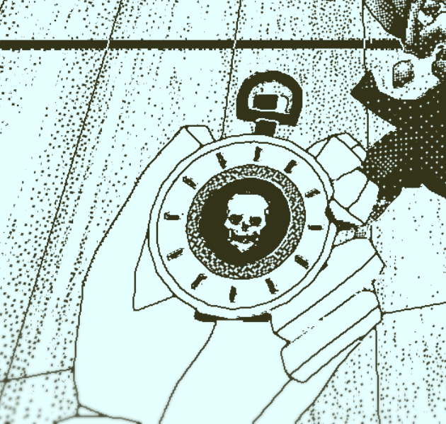
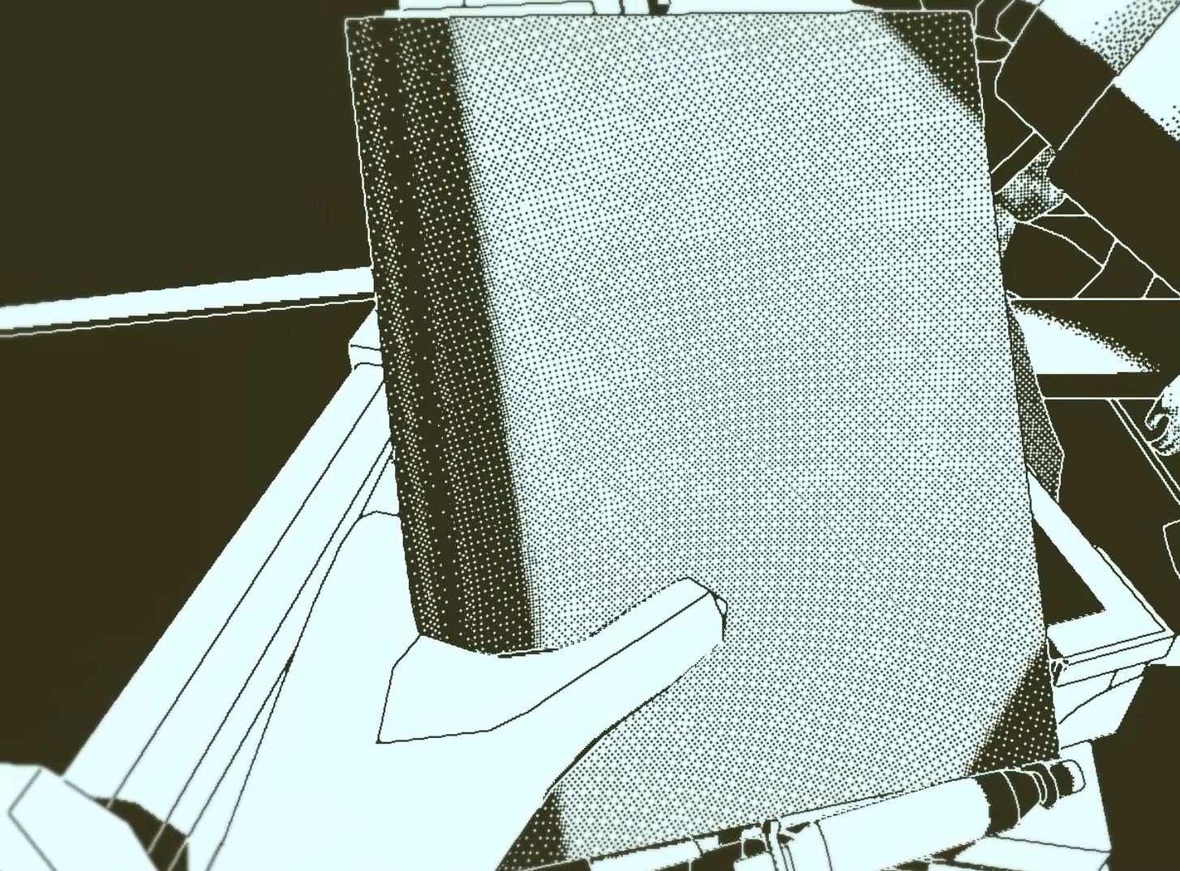
Suitcase
Journal
Stopwatch

Slide 11
Journal

Slide 12
Shows the journey and where each chapter takes place
Shows a map of each of the ship's levels
Can be useful but not so important

Slide 13
Enough yapping for now

Slide 14
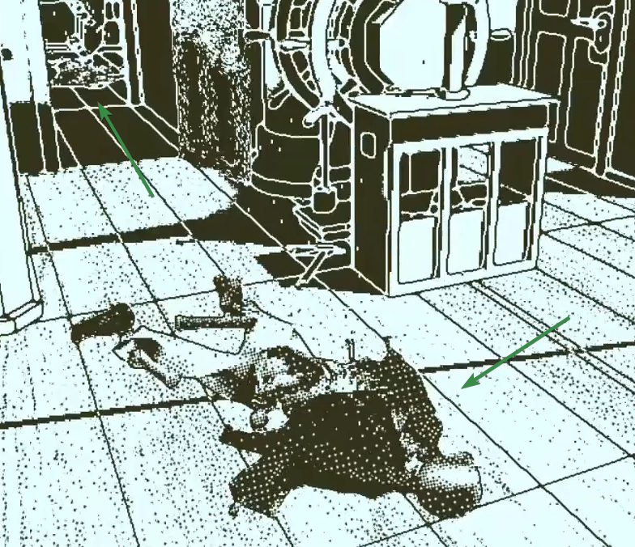
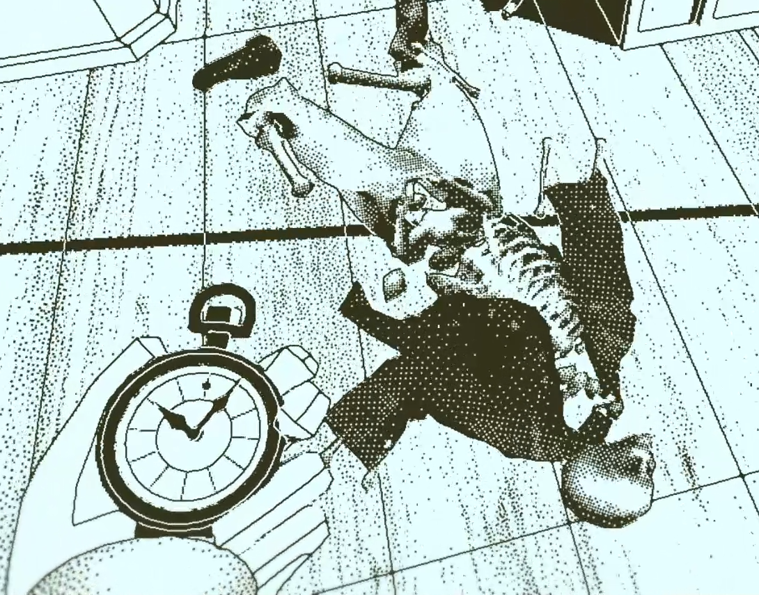
The ship is filled with corpses.
That’s where the stopwatch comes in

Slide 15
Let’s see

Slide 16
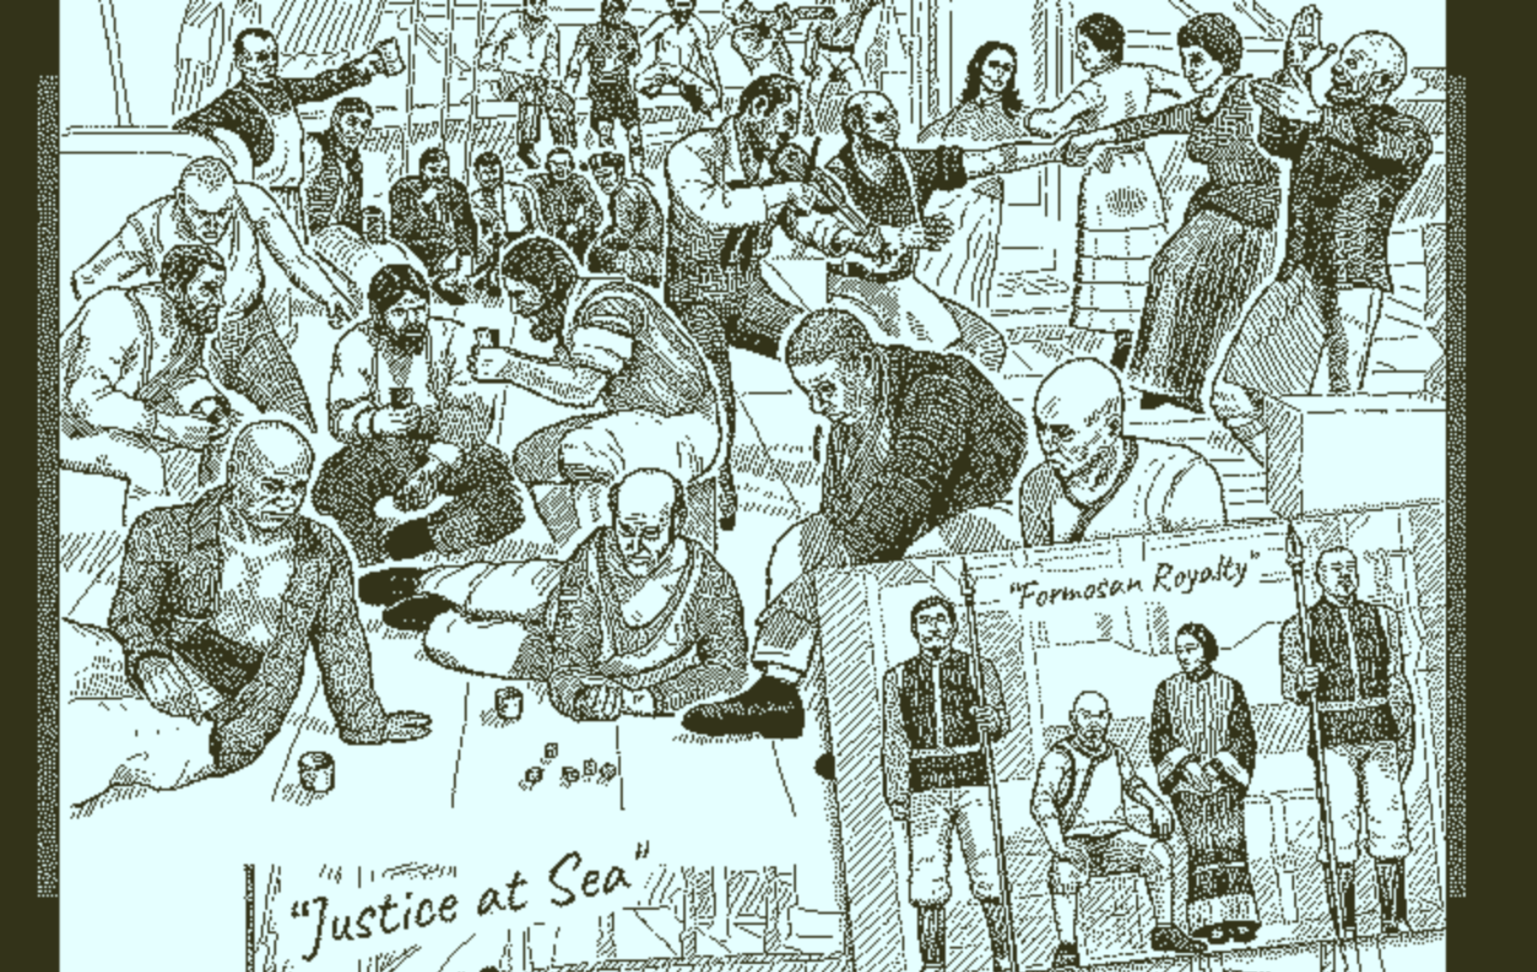
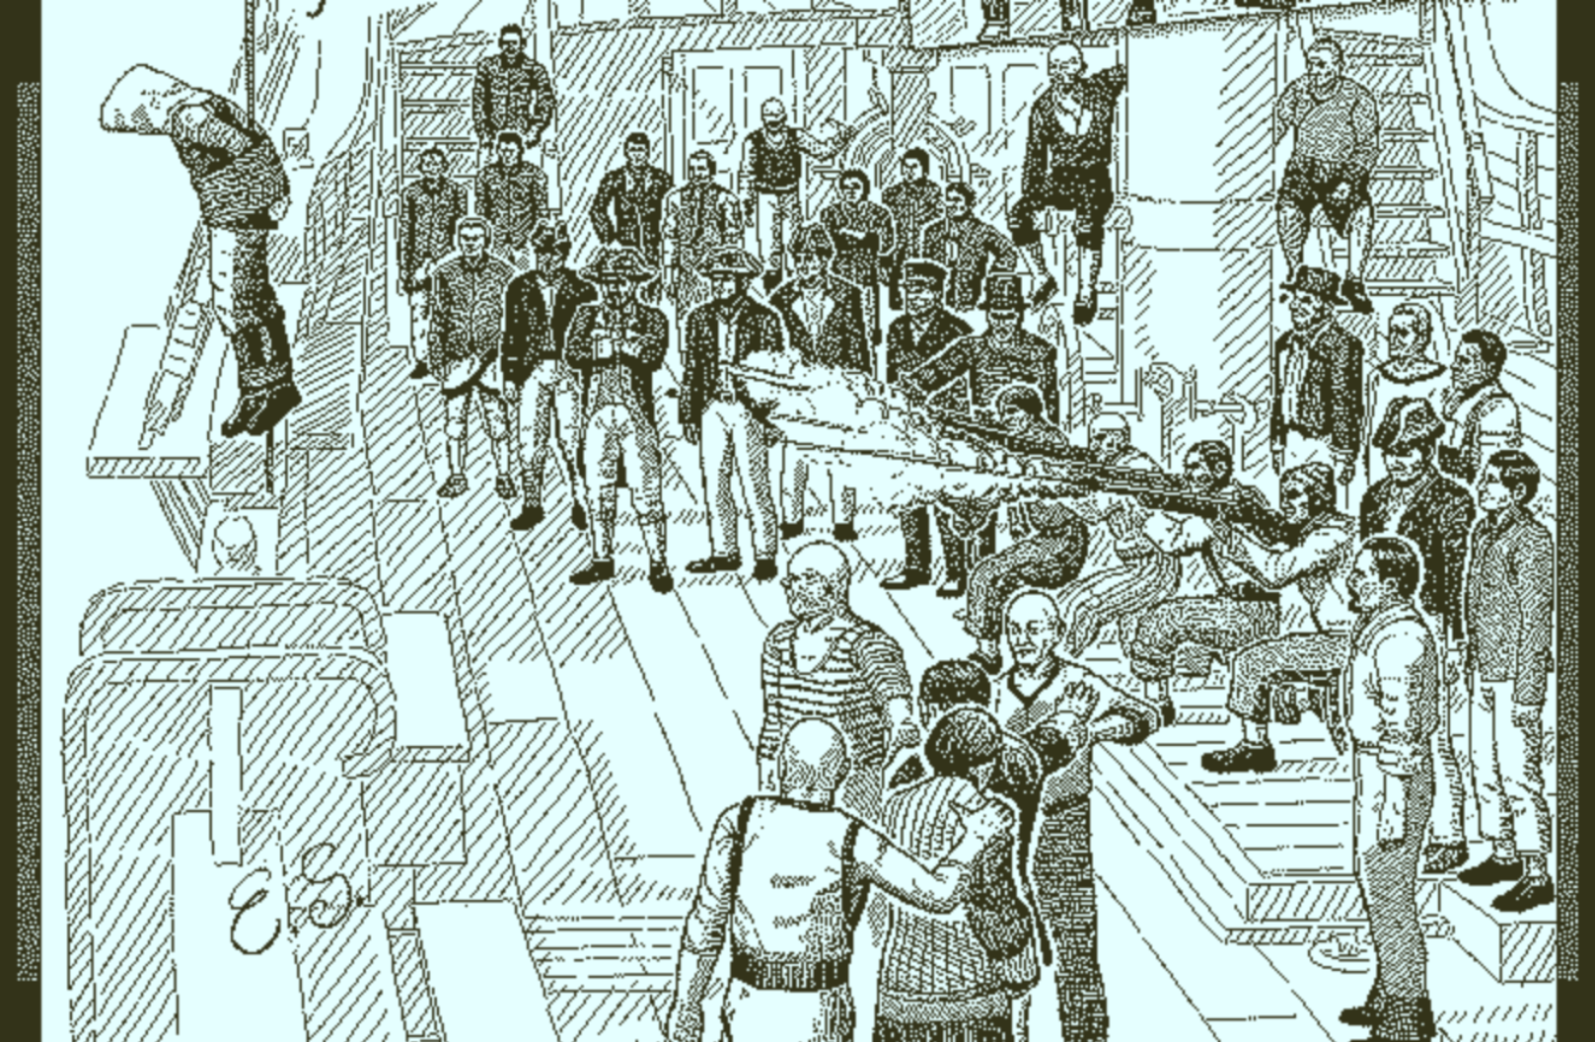
Before finishing that let’s show the journal pages
Two photos of the entire crew

Slide 17
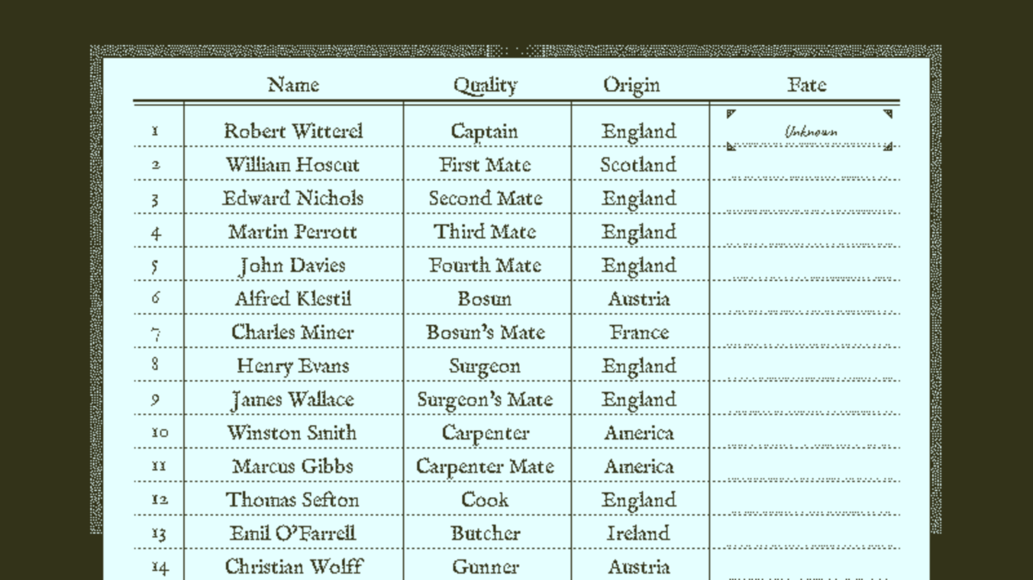
And a written list of all the crew members
Including their jobs and origins
And “Fate”

Slide 18
How do all these tie in together?
Back to the scene we go

Slide 20
After each memory, a page is added to the journal

Slide 21
What about his name??

Slide 22
A few scenes later…

Slide 23
Going back to the names list

Slide 26
How do other games go about deduction

Slide 27
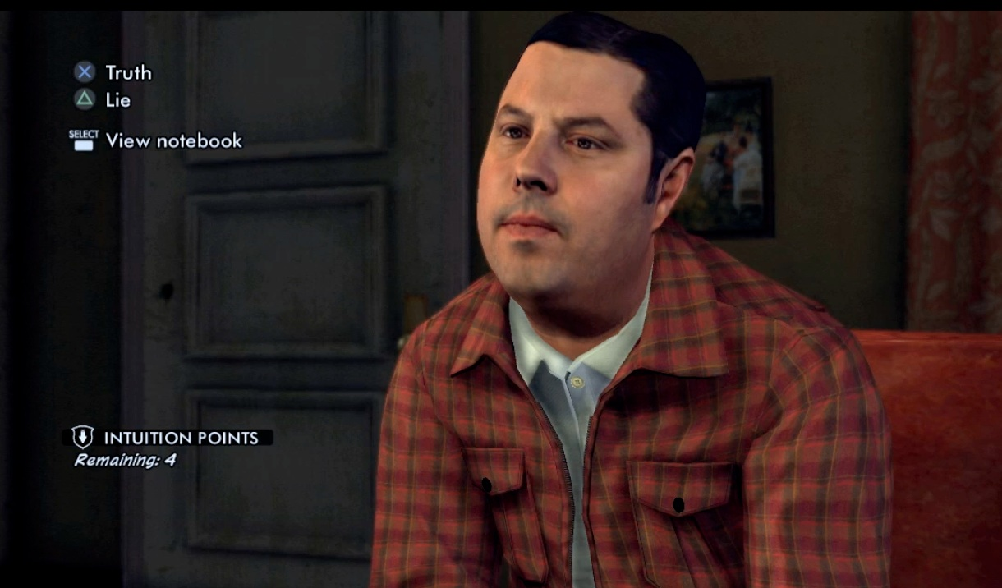
Choices
Small number of choices
Choosing wrong may not affect the game
Can be easily guessed
Although they may still come from reasoning
LA Noire, a popular detective game

Slide 28
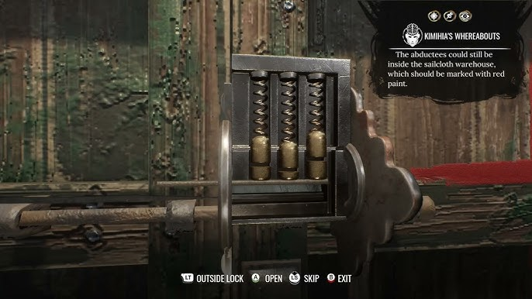
Minigames
Rarely has any deduction
Doesn’t feel like you’re doing anything special
Cannot get them wrong
The Sherlock Holmes game series

Slide 29
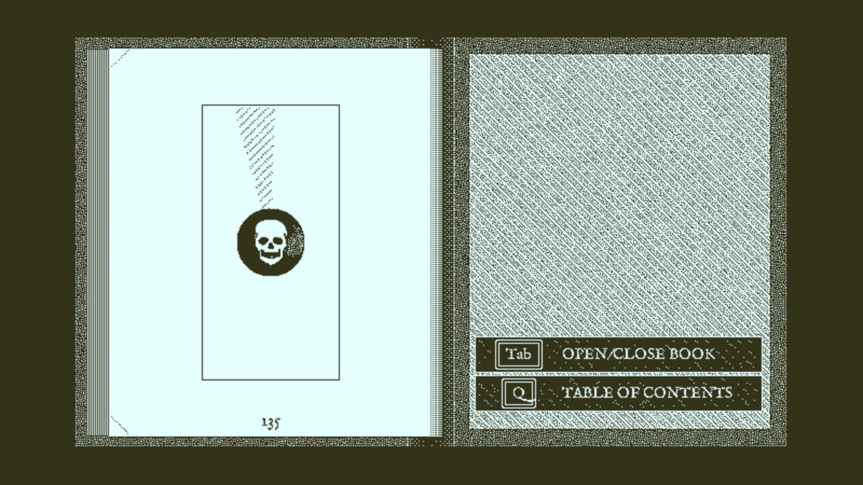
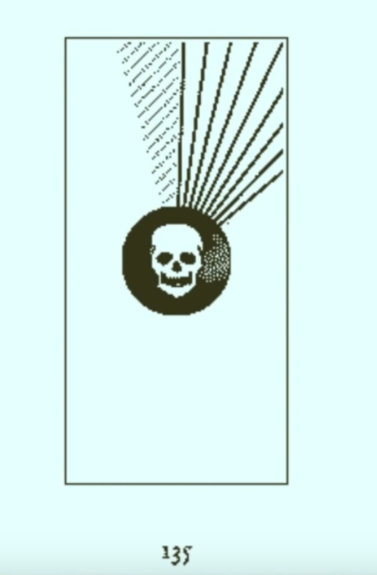
On the other hand…
Obra Dinn is not limited by realism
Fates in Obra Dinn are not verified immediately
Verification happens when you guess 3 fates correctly, meaning you can’t guess
Too many options to make brute force difficult
Many ways to reach the same result, e.g., close observation, previous memories, dialogue intricacies, etc.
Back cover of the journal
Each line represents
a correct fate

Slide 30
Other aspects of the game
Story is non-linear, first memory is in the last chapter, and you can enter memories in many different orders
Game can be finished in 1 or 2 days of playing
There is Korean
Localization

Slide 31
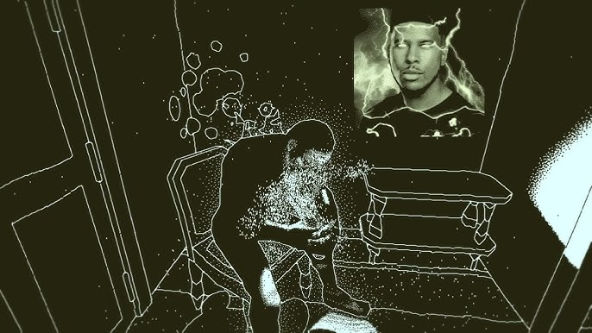
Thank you for listening

